Slide 1
Workplace Bullying
Ciara Kirwan, MSc.Psych, MSc.OEHS

Slide 2
Who am I
HSA Inspector
Workplace Bullying – Nationwide remit
Psychologist
Organisational & Health and Safety

Slide 3
Todays Presentation
Workplace Bullying
Code of Practice
Inspections in Action
Findings
Useful Information

Slide 4
Bullying – Definition
“Workplace bullying is repeated inappropriate behaviour, direct or indirect, whether verbal, physical or otherwise, conducted by one or more persons against another or others, at the place of work and/or in the course of employment, which could be reasonably regarded as undermining the individual’s right to dignity at work”

Slide 5
Bullying is not
An isolated incident /once-off incident
Harassment
Ordinary performance management
Workplace conflict where people disagree on others’ points of view
Expressing differences of opinion strongly

Slide 6
Workplace Bullying- Ireland
Estimated Per Year
Cost to the economy of €239 million*
More prevalent in the public sector
Larger effect on absences in the private sector
Those who experience workplace bullying are 1.6 times more likely to experience cardiac health issues
Notes:
https://academic.oup.com/occmed/article/70/4/251/5839678?login=false NUIG 2020 study The value of lost productivity from workplace bullying in Ireland
J Cullinan, M Hodgins, V Hogan, L Pursell

Slide 7
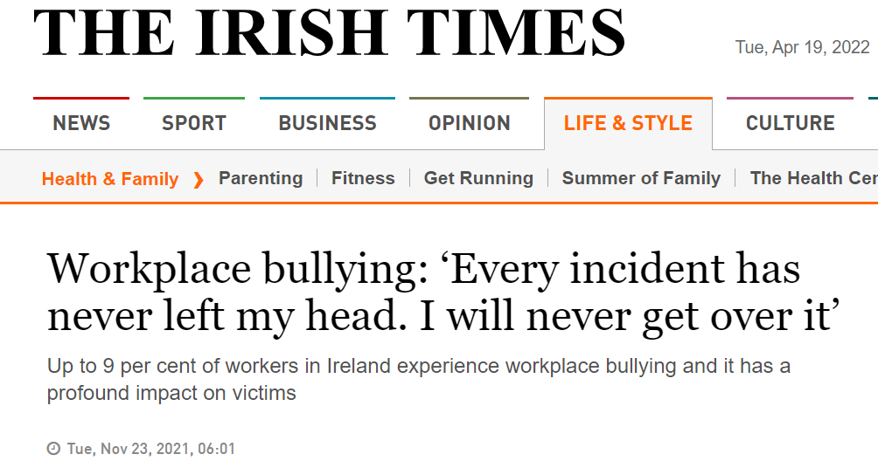
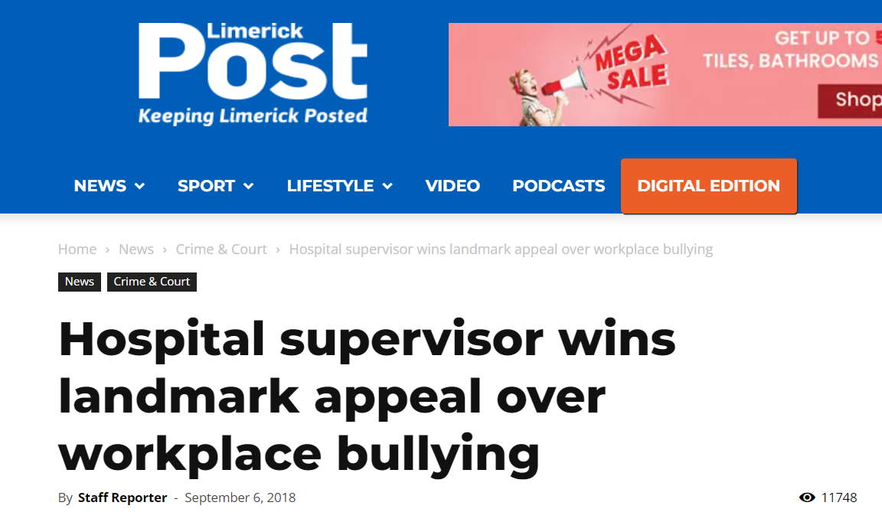
Media Coverage Examples
Notes:
Address issues in a structured approach
section 8 (2)(b) of the 2005 Act as regards ‘managing and conducting work activities in such a way as to prevent, so far as is reasonably practicable, any improper conduct or behaviour likely to put the safety, health and welfare at work of his or her employees at risk’. It also applies to employees in relation to their duties under section 13 (1)(e) of the 2005 Act to ‘not engage in improper conduct or behaviour that is likely to endanger his or her own safety, health and welfare at work or that of any other person’.

Slide 8
In the Code
Guidance for
Employers
Employees
Representatives
Practice and Procedures
Solution focus
Informal and formal
Appeal
Not statute – used as standard

Slide 9
Why is this Code Important?
We are hurt by injustices
We seek fair play
Undermined sense of justice affects performance and productivity at work
Mental Wellbeing
Dysfunctional work environments
Low morale
Lost time
Litigation

Slide 10
HSA Inspections

Slide 11
Operational Findings
Confused on whether to make a complaint
Don’t know if it’s worth it
Don’t know if it’s bullying
Don’t trust the process (don’t believe it’s robust)

Slide 12
The Code in Action Pilot Study
General Findings
Policy not updated
Missing/skipping stages
Merging of concepts
Contact Person Role
Generic

Slide 13
Importance of Policies
Guidance
Clear process outlined
Avoids confusion
Consistency
Fairness
Identifies who to contact

Slide 14
Employer Advice
Policy
Stick to the steps in the policy
Ensure the policy is site-specific and relevant to that place of work
Code update
Employee communication and information access

Slide 15
Management Advice
Know and take on board the role limits - what are they?
Understand psychology of both parties (emotions)
Aggrieved/angry/upset – festering?
Affronted, angry, afraid – revenge?
Communication should be clear and repeated

Slide 16
Employee's Responsibilities
Not engage in improper behaviour which would endanger the health, safety and welfare of yourself or the other employees
Comply with relevant anti-bullying policies, as appropriate
Co-operate with employer when an allegation of bullying at work is being investigated
Notes:
Section 13 2005 Act

Slide 17
Remember
Check your role?
Are you responding as a
Friend
Colleague
Contact Person
Manager
This is only one side of the story
Be mindful of your response

Slide 18
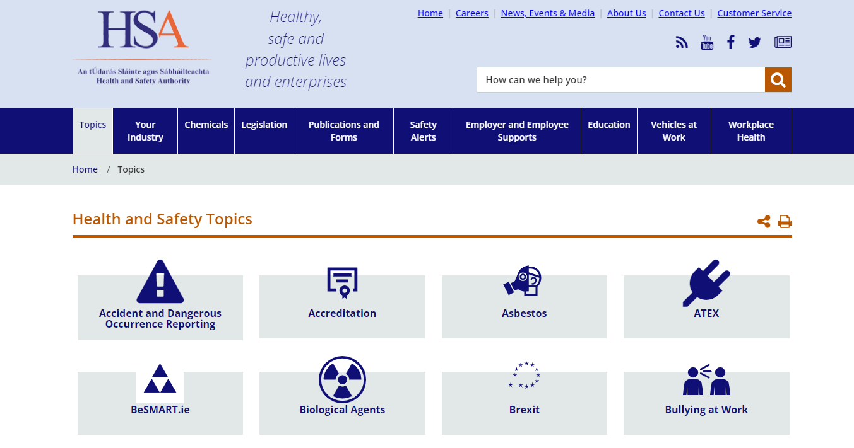
Supports

Slide 19
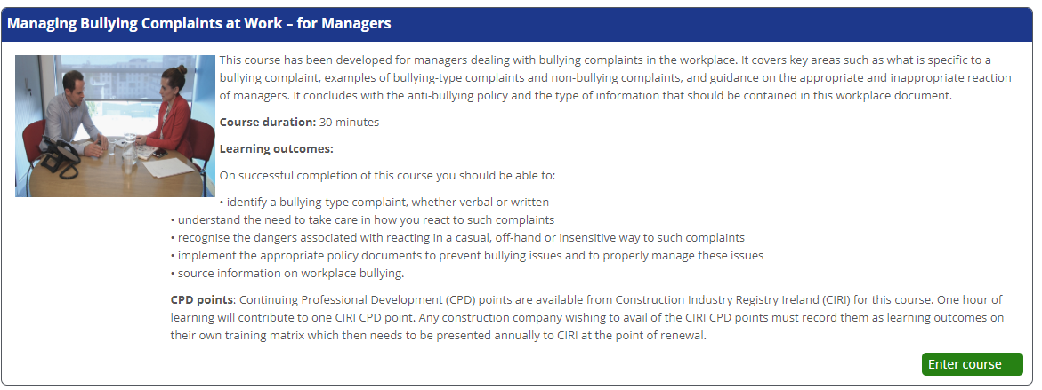
Supports

Slide 20
Go raibh maith agaibh
Thank you
T: 0818 289 389
E: contactus@hsa.ie
W: www.hsa.ie

