Slide 1


Management and Control of Dust Exposure in Quarries

Slide 2
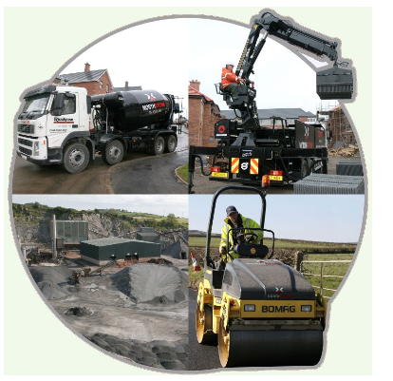
Welcome and Introduction
John Evans
Health and Safety Advisor
Northstone Materials
Notes:
John Evans H &S Advisor with Northstone Materials for 8 years.
Northstone Materials have over 50 production locations. (Vary between Hard Rock Quarries, Sand and Gravel , Pre-cast Block/Tiles and RMC)
So as you’ll understand some of the materials we process are likely to contain silica dust.

Slide 3
Agenda
Management and Control of Dust Exposure in Quarries
Notes:
Agenda for today is to give you guys an outline of how Northstone Materials Manage and Control Dust Exposure at our Locations.
Also with me today is Pierce Kirwan who is the Quarry Manager at our Hard Rock Quarry In Craigantlet, Co.Down. He will be explaining at first hand how he and his team manages and controls dust at there specific location.

Slide 4
What Are the Risk Factors?
In the EU 7,000 cases of Lung Cancer a year are attributed to Silica Dust.
Nearly 800 people die a year from Cancer caused by Silica Dust at Work in Britain.
As well as Lung cancer, silica dust causes silicosis - this serious lung disease kills 46,300 people worldwide each year.
Information provided by IOSH Campaign- “Working together to beat occupational cancer”

Slide 5
Dust- What The Law Says?
Safe places of work without risk to health.
Risk Assessment where there is potential exposure to dust.
Implement effective control measures/ monitoring
Monitor Exposure to Employees & Health Checks
Notes:
Employers to provide and maintain working conditions that are safe and without risk to the health of employees.
Required to carry out a Risk Assessment in situations where there is exposure to Dust.
Implement effective control measures
Monitor effectiveness of these control measures.

Slide 6
HSE Prosecution
A director of a London Masonry company was handed a suspended prison sentence for exposing workers to harmful stone dust and ignoring two Improvement Notices served on the company by HSE.
HSE identified serious concerns which were communicated to the company but ignored.
The Director (Mr Islam) was sentenced to 10 months in prison, suspended for two years and was ordered to pay £9,000 in costs for breaches to the H&S at Work Act.
Notes:
A director of a London Masonry company was handed a suspended prison sentence for exposing workers to harmful stone dust and ignoring two Improvement Notices served on the company by HSE.
HSE identified serious concerns which were communicated to the company but ignored.
The Director (Mr Islam) was sentenced to 10 months in prison, suspended for two years and was ordered to pay £9,000 in costs for breaches to the H&S at Work Act.

Slide 7
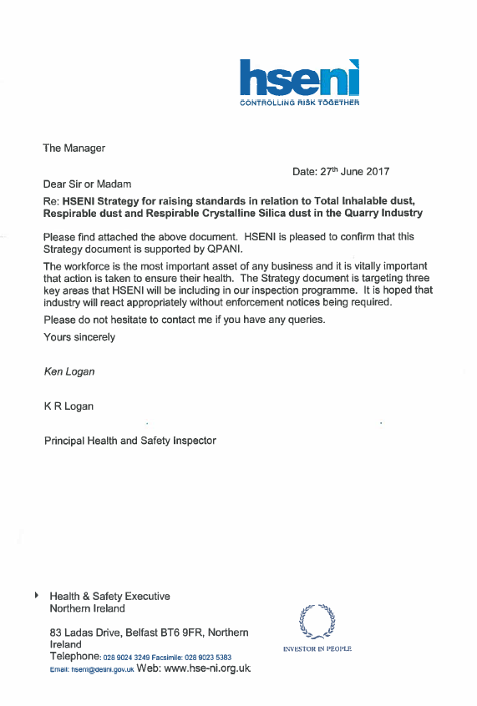
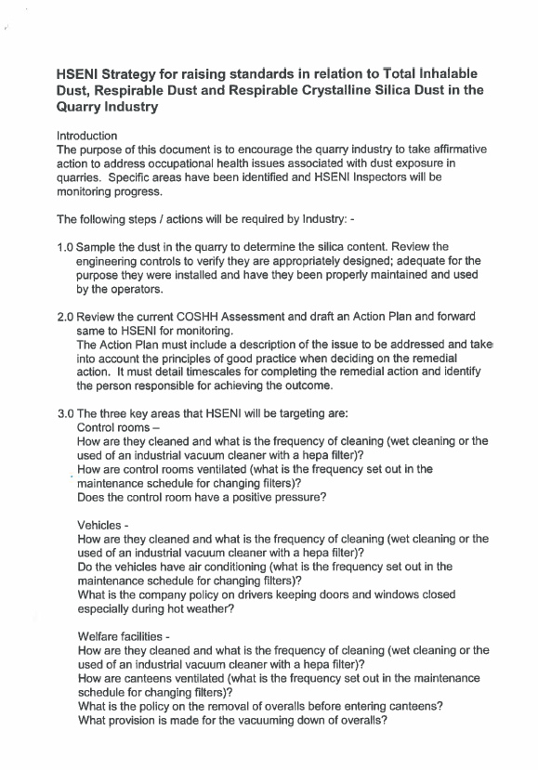
HSENI Guidance
Notes:
In June 2017 HSENI wrote to all Employers in the Quarrying Industry outlining the Strategy they advised all companies to follow regarding the control of dust exposure.
The keys areas HSENI requested industry to focus on were-
Control Rooms
Vehicles
Welfare Facilities
Suitable Risk Assessments and Methods of Work to reduce exposure
Suitable RPE
Health Surveillance

Slide 8
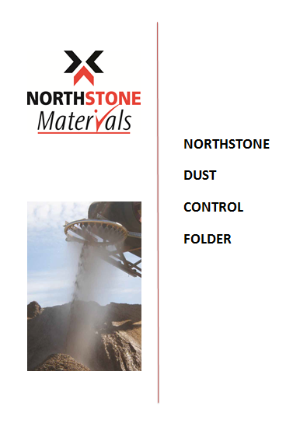
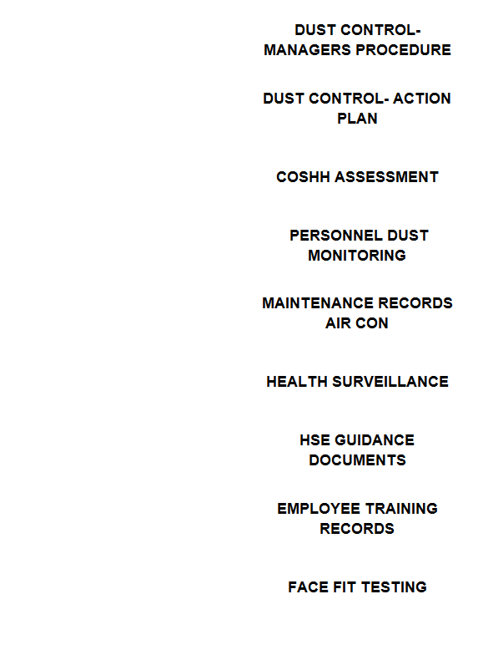
Compliance Strategy
Notes:
As part of our measures to comply with the HSENI strategy we developed our own Dust Control folders for each of our operational quarries.
The content of the folders was based around a simplified four step approach.

Slide 9
4 Step To Compliance
Risk Assessment
Action Plan
Implementation of Control Measures
Monitor and Review
Notes:
Complete a Risk Assessment looking at all processes where dust may be generated at the location
Develop an Action Plan to manage and control the dust
Implementation of the control measures identified in the Action Plan
Monitor Effectiveness of the Control Measures

Slide 10
Risk Assessment
Drilling & blasting
Maintenance and cleaning
Loading and hauling
Dust exposure
Handling filler
Asphalt/RMC production
Bagging and packing
Stone working & stock handling
Crushing and screening
Notes:
Our Risk Assessment covered an overview of the actives we complete within our Business

Slide 11
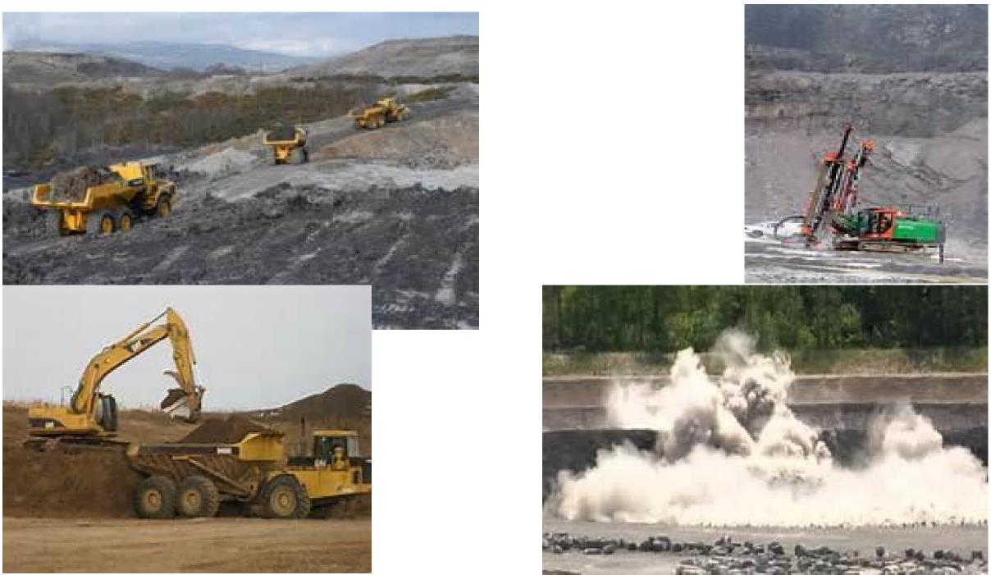
Risk Assessment
Notes:
Dust generated from haul road activates and Drilling & Blasting activates.

Slide 12
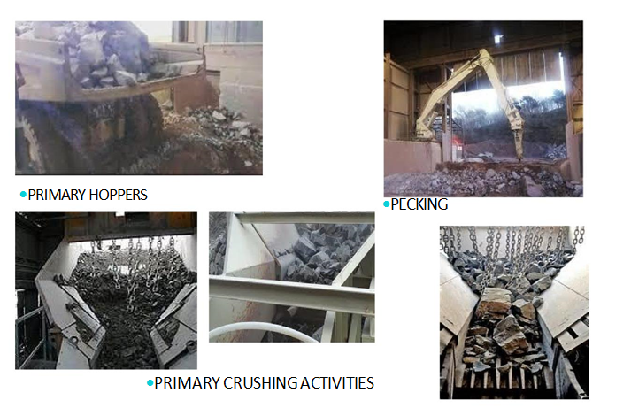
Risk Assessment
Notes:
Dust generated from crushing activities.

Slide 13
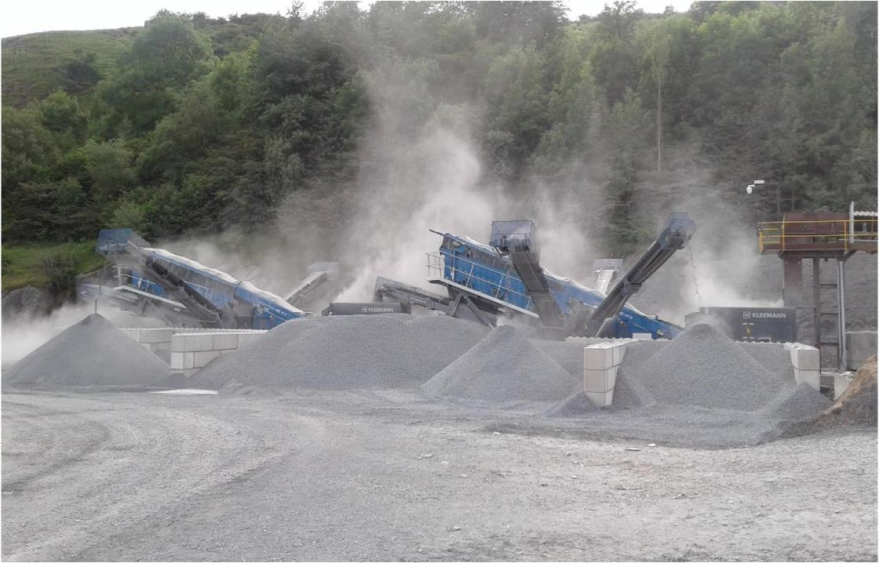
Risk Assessment
Notes:
Dust Generated from Mobile Crushing and Screening Plant. (In our assessment we included Sub-Contractor activites operating within the quarry)

Slide 14
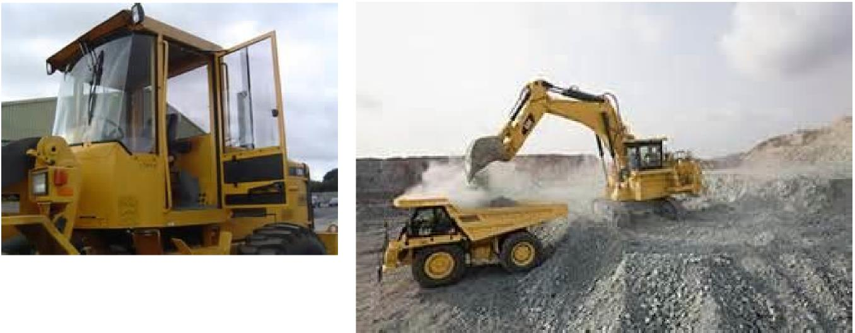
Risk Assessment
ARE A/C SYSTEMS MAINTAINED AND OPERATIVE - MACHINE DOORS &
WINDOWS MUST BE KEPT CLOSED
Notes:
We looked at the type of site vehicles we were using and the use of air-con systems.
Review compliance with our closed door policy to prevent dust entering vehicle

Slide 15
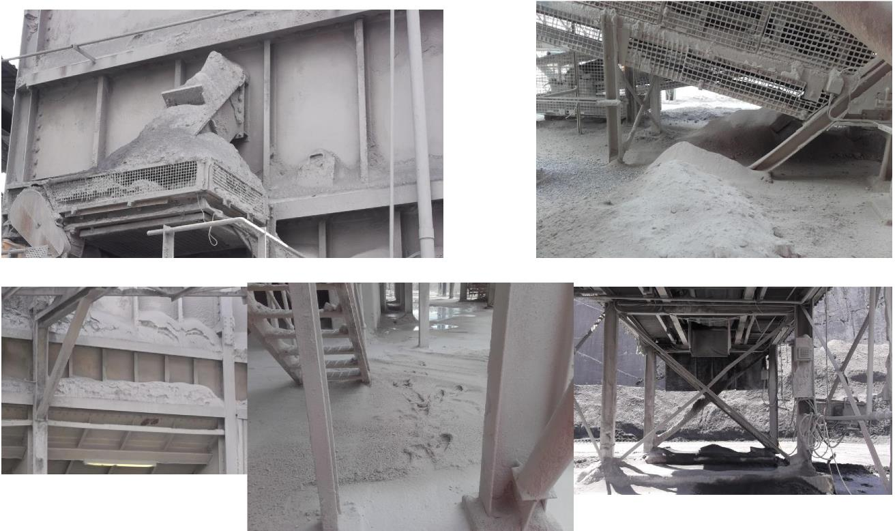
Risk Assessment
Notes:
Reviewed the spillage of material around fixed plant

Slide 16
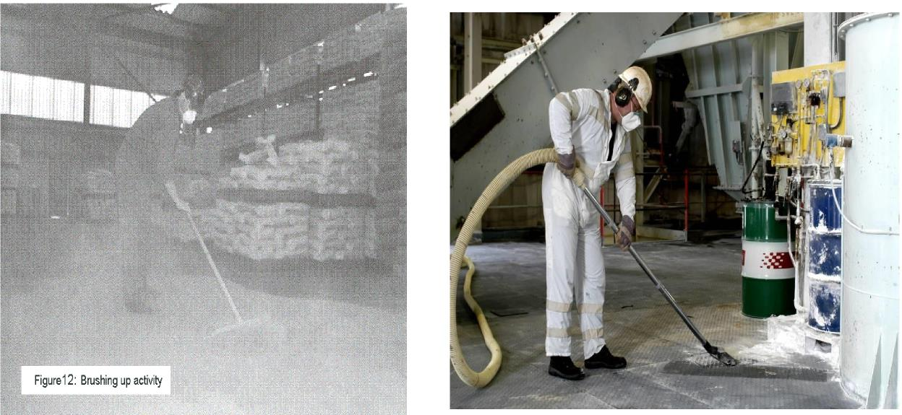
Risk Assessment
VACUUM V SWEEPING
Notes:
Reviewed our Housekeeping methods at our plant locations
Preference for use of vacuum systems to sweeping to prevent blooms of dust.

Slide 17
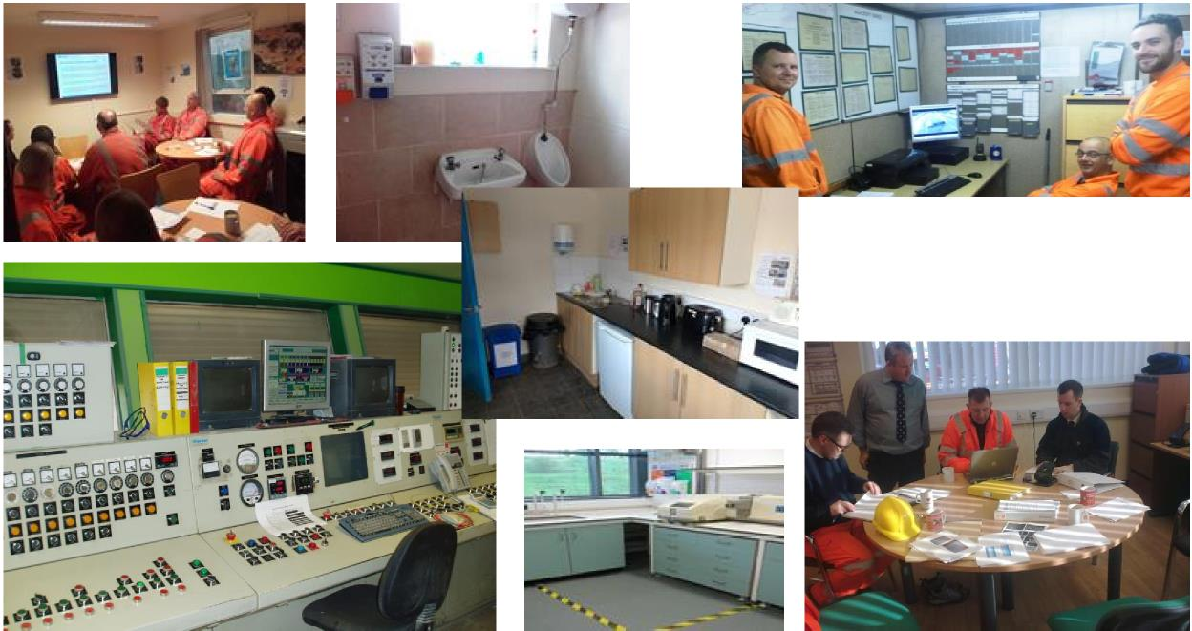
Risk Assessment
OFFICES–MEETING ROOMS–CANTEEENS–CONTROL ROOMS-WEIGHBRIDGES -
TOILETS ETC
Notes:
Dust generated in the quarry and entering office/canteen facilities through poor housekeeping practices. (Windows and doors left opened, No Air-con, Poor housekeeping schedule)
Following the development of a Risk Assessment at each of our locations the Quarry Managers then developed there own Action Plan to manage and control the dust.

Slide 18
From Procedure
to
Implementation.
Notes:
I'm now going to pass you over to Pierce Kirwan. Pierce is the Quarry Manager at our Hard Rock Quarry In Craigantlet, Co. Down.
Pierce will explain at first hand how he and his team reviewed the completed Risk Assessments and Procedures and developed them into a effective Action Plan.

Slide 19
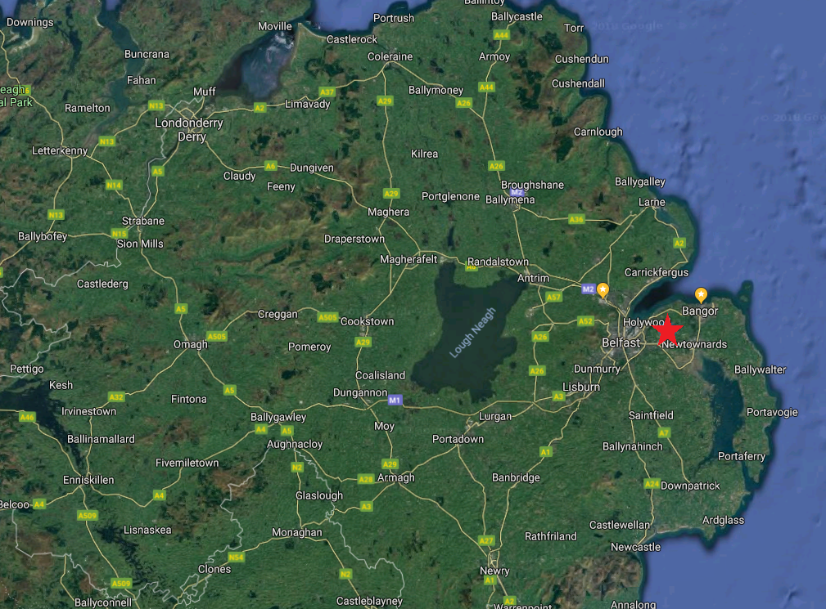

Slide 20
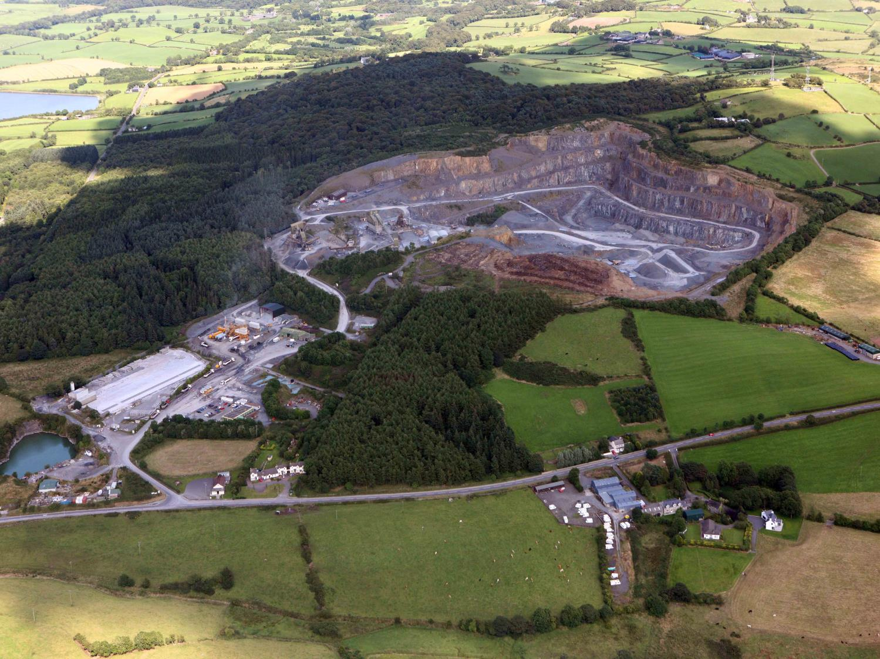

Slide 21
Dust Control at Site level
Eliminate
Control
Protect
Suppression
Design
Encapsulation
Fixed
Mobile
Fixed
Mobile
Education

Slide 23
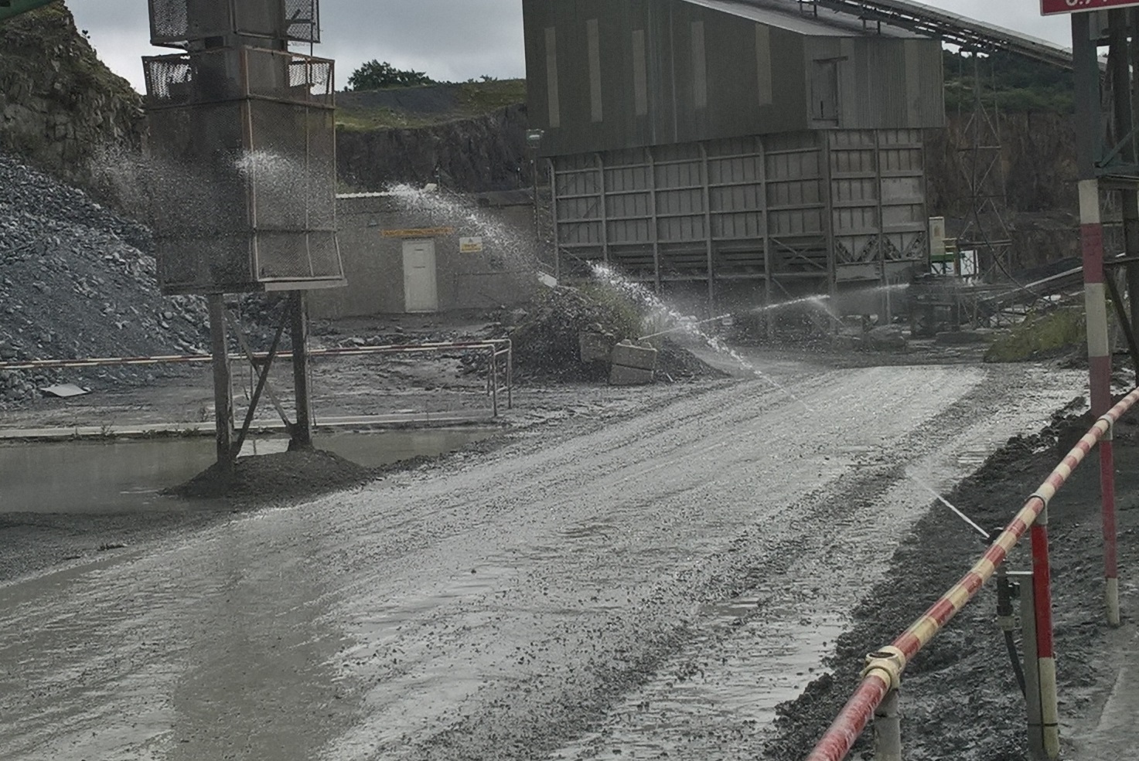
Fixed road sprays deployed to minimise airborne dust created by vehicle movements

Slide 24
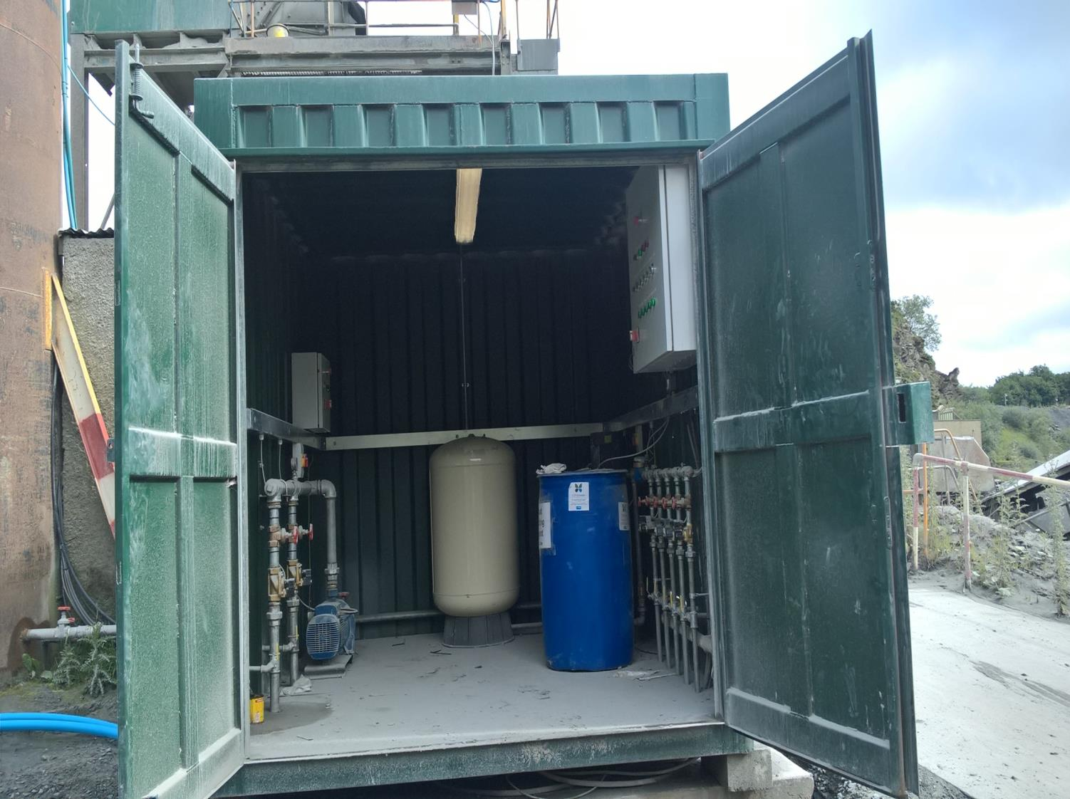
suppression control cabin B
Automated suppression system:
Primary plant
Secondary Plant
Road sprays phase 1
Road sprays phase 2
Wetting agent
Secondary fixed plant surpression controls
Road sprays phase 2 controls

Slide 25
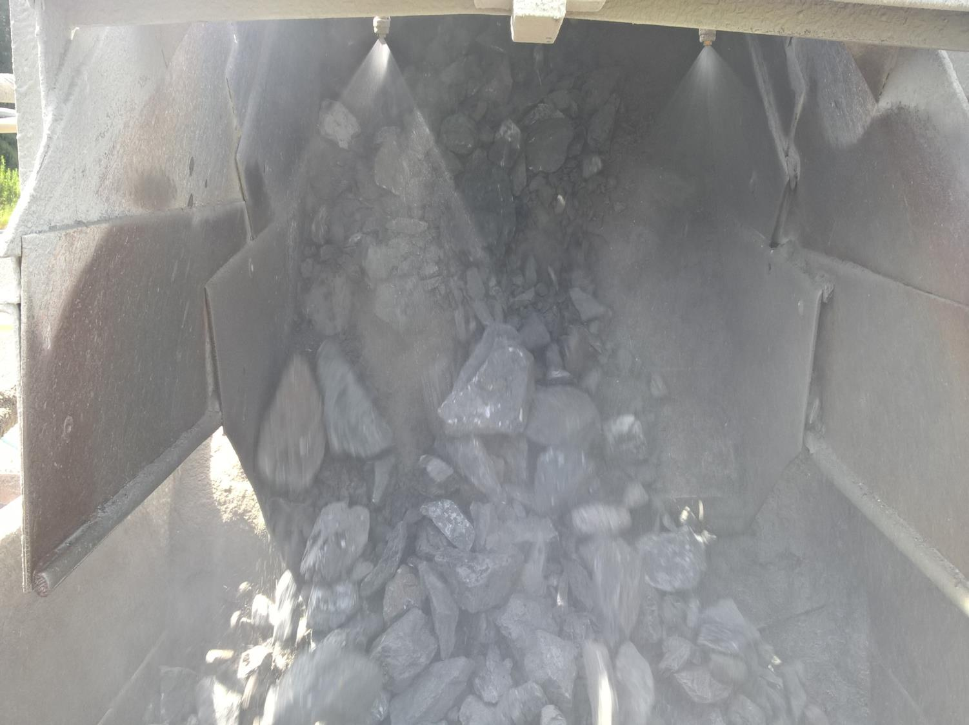
CT controlled spray bars at material transfer points

Slide 26
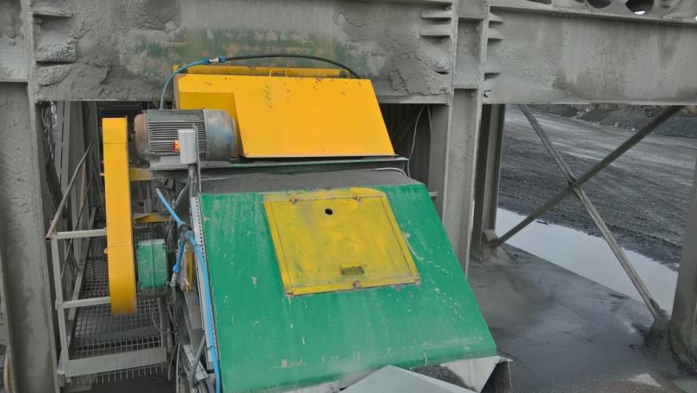
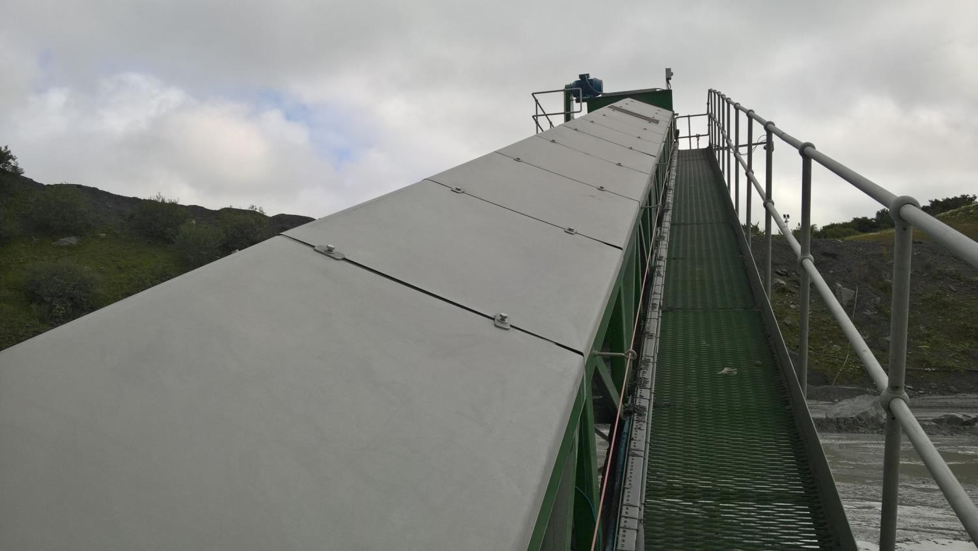
Encapsulation at transfer points and on conveyors

Slide 27
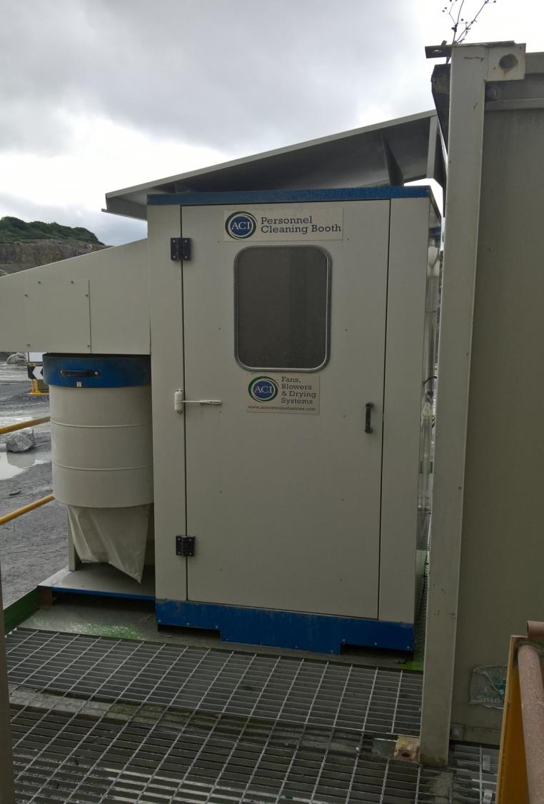
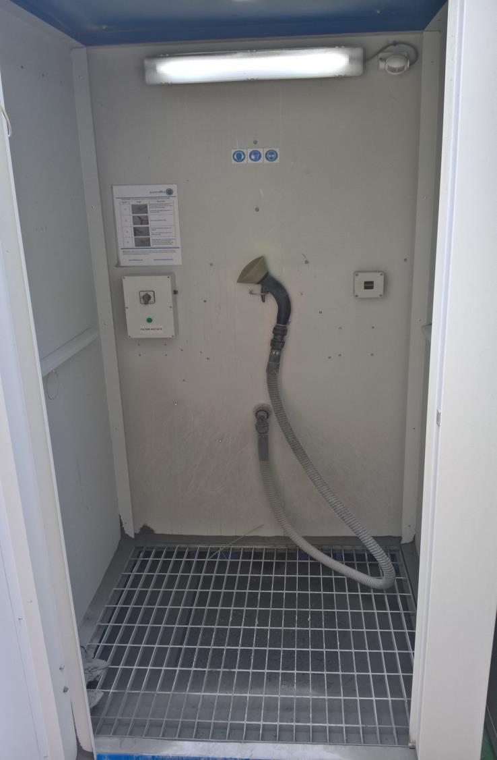
2no Blow off booths at
Primary and Secondary plant to clean workwear before entering controlled atmosphere buildings

Slide 28
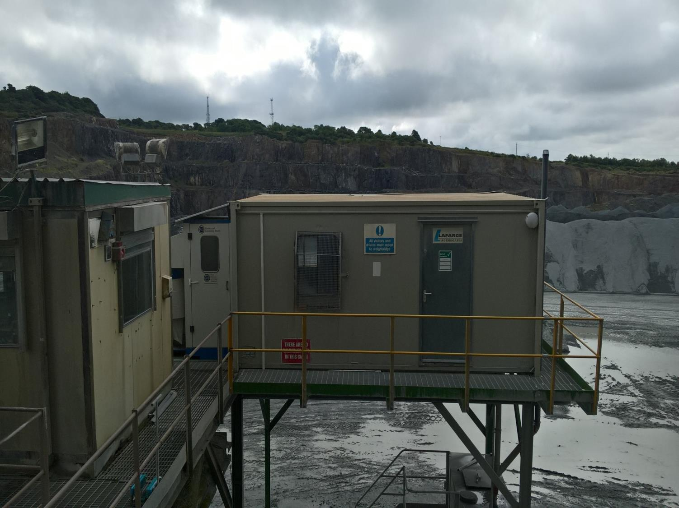
Separate clean welfare areas away from work zones.
Buildings fitted with air conditioning units

Slide 29

High level of cleanliness maintained in all vehicles.
All cloth seats fitted with wipe clean seat covers.
Machines fitted with air conditioning and HEPA filters.

Slide 30
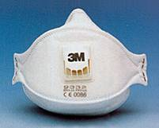
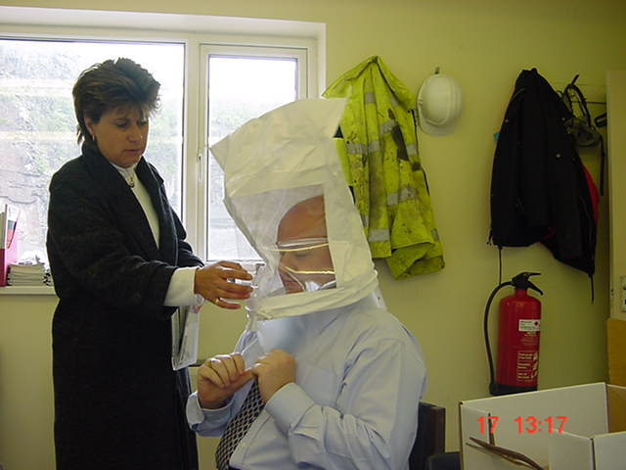
Respiratory protective equipment (RPE)
Use the correct type (Usually FFP3)
It must be maintained, replaced and cleaned as needed;
Face fit testing is required;
Report any loss or defect;
Only use disposable masks and gloves once then throw them away
Remember RPE is the last resort!

Slide 31
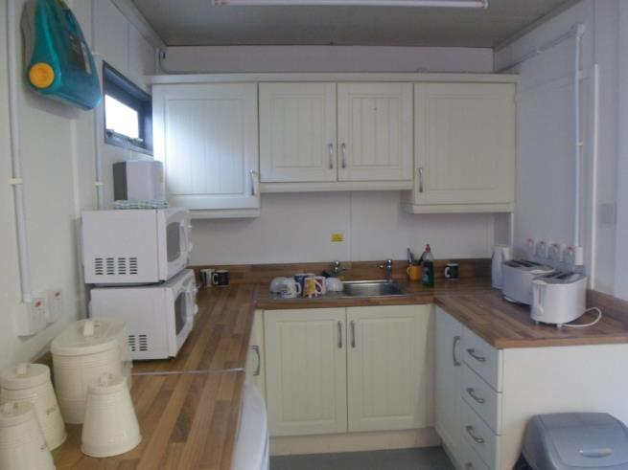
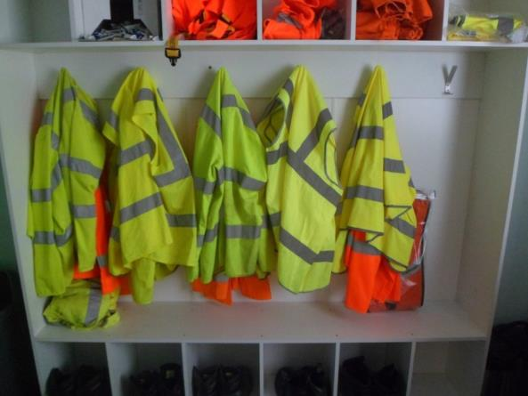
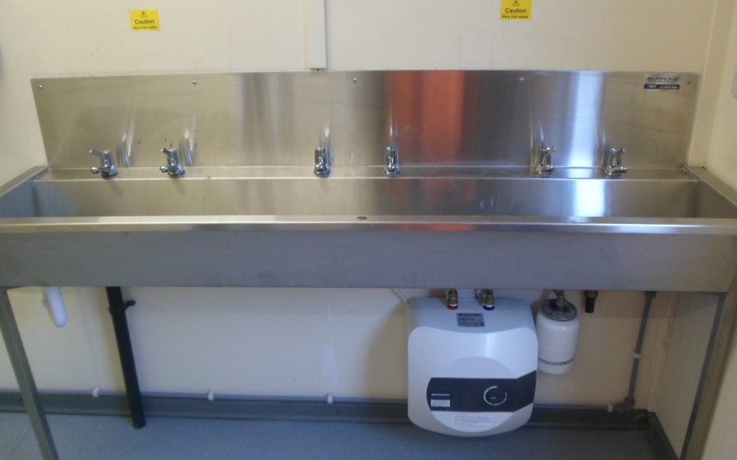
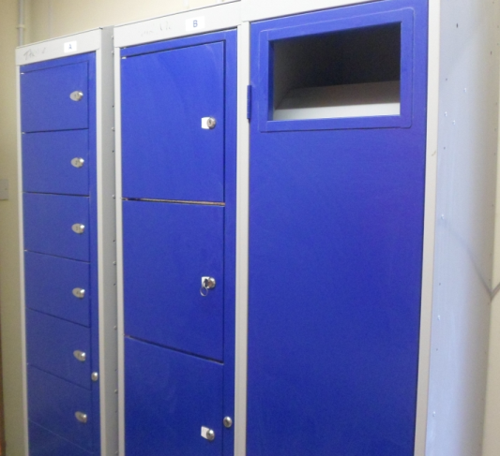

Slide 32
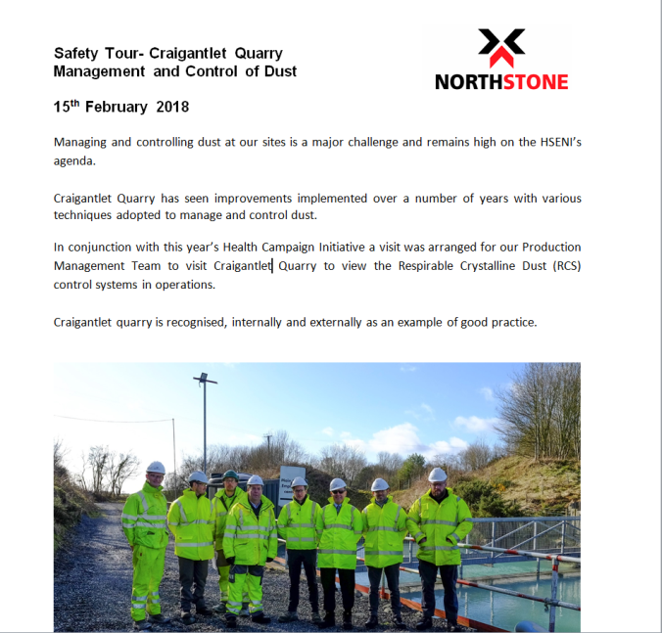
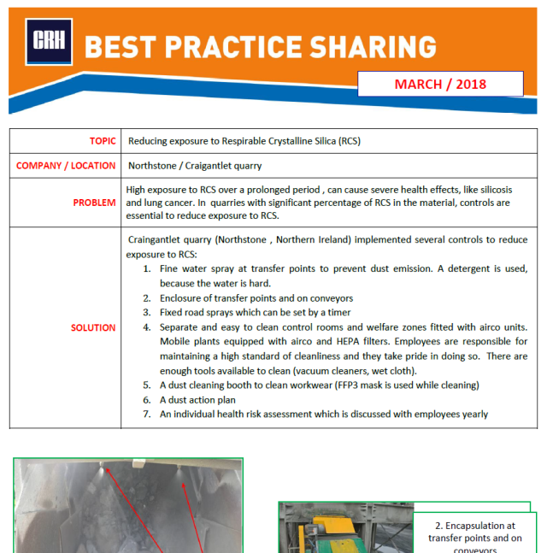

Slide 33
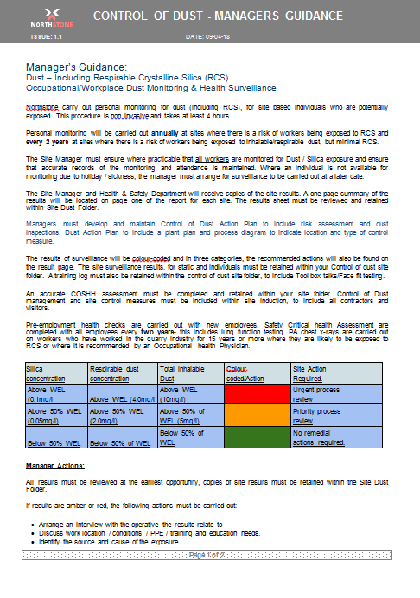
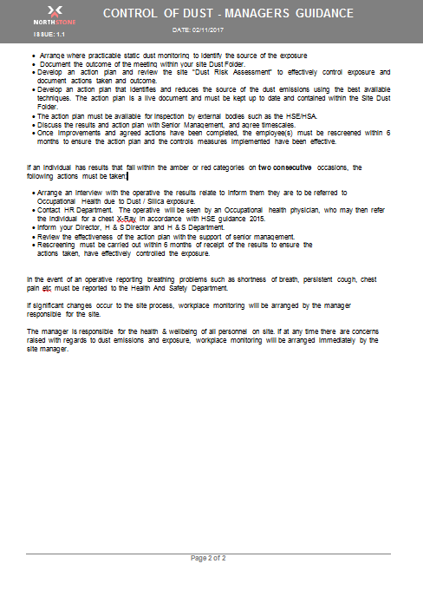
Health Surveillance and Dust Monitoring
Notes:
We developed Internal Procedure which outlines our Health Surveillance and Dust Monitoring Strategy.
Depending on the level of risk identified at each location we complete Health Surveillance and Dust Monitoring of our employee’s.
(For example- dust monitoring is completed annually at quarries where we have a known high % of silica content in the material)
If deficiencies are recorded then we carry out an internal review of our Dust Action Plans to generate improvement.

Slide 34
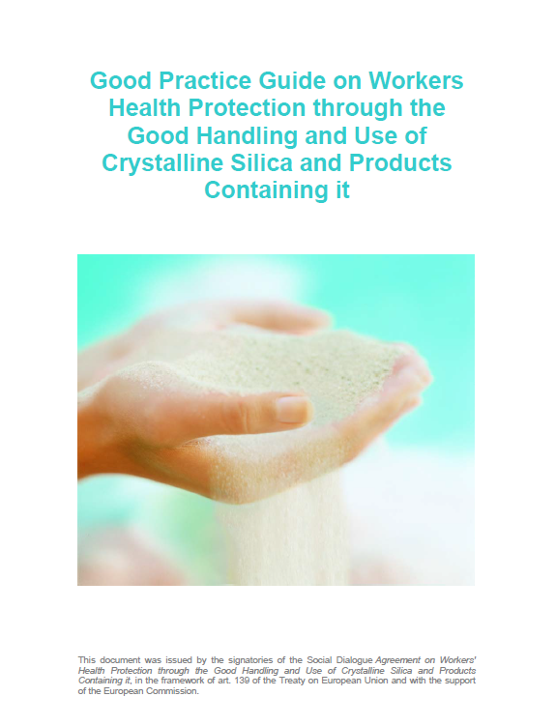
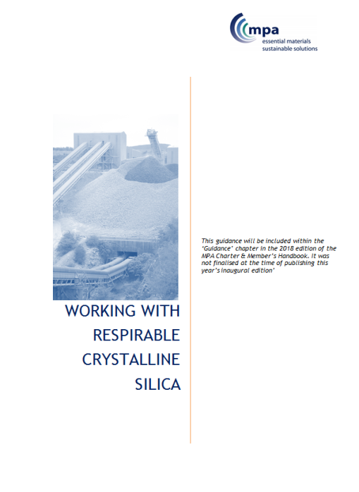
Guidance Documents
For more information visit
http://www.safequarry.com
http://www.nepsi.eu/agreement-good-practice-guide/good-practice-guide.aspx
Notes:
There are excellent Guidance Documents available to download on How to Control and Management of Dust in Quarries.
Here are two examples- This Document produced by NEPSI on Good Handling and Use of RCS and Products containing it.
And MPA Guidance on Working with RCS.

Slide 35
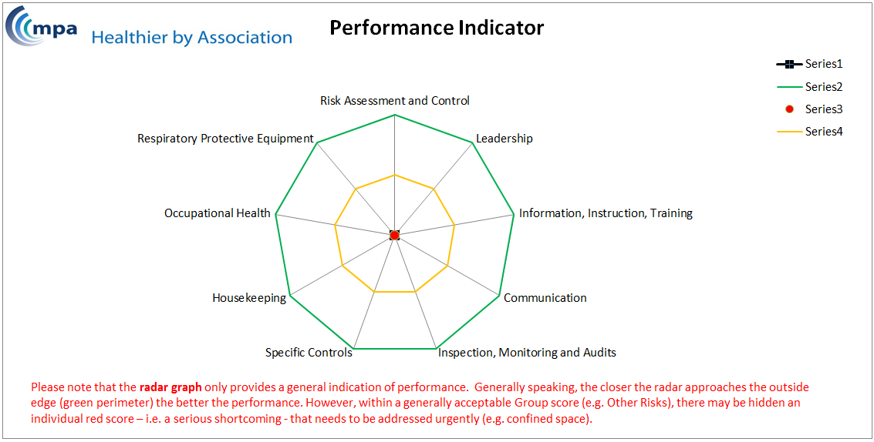
Healthier By Association
Notes:
MPA have produced an very useful Dust Control Auditing Template which you can download online. It can be used to evaluate your companies Dust Control systems. With MPA’s Best Practice Guidance protocols.
The excel document will then product a Performance Spider Diagram once complete highlight any gaps which may exist.

Slide 36
Stop the Dust before it Stops You.
Notes:
Employers to provide and maintain working conditions that are safe and without risk to the health of employees, so far as is reasonably practicable.
This means they need to ensure exposures to dust is kept as far below the Workplace Exposure Limits (WELs) as reasonably practicable.
Required to carry out a Risk Assessment in Situations where there is exposure to Dust.
Implement effective control measures
Monitor effectiveness of these control measures.

