Slide 1
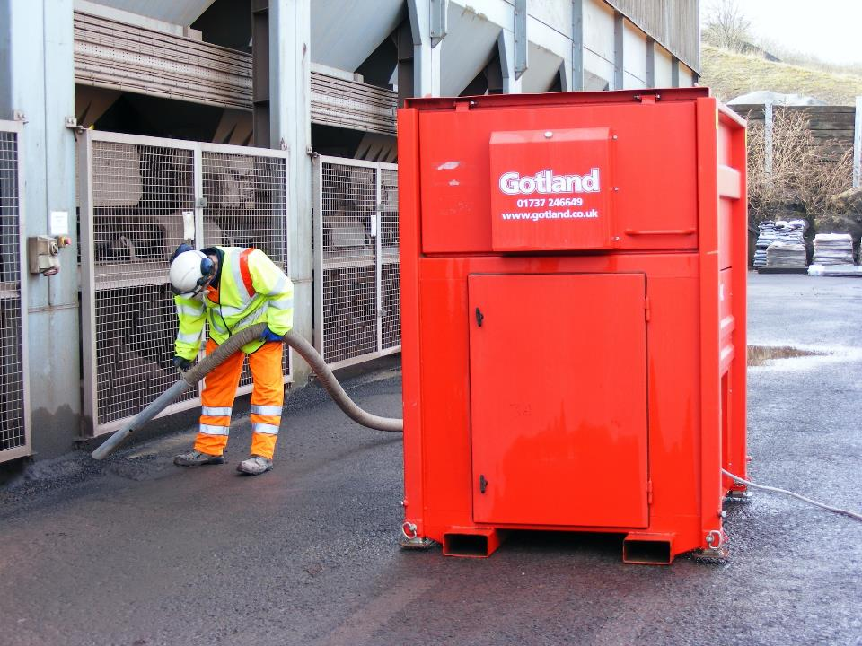


Workers Health Protection through the Good Handling and Use of Crystalline Silica and Products Containing it
UNION EUROPÉENNE DES PRODUCTEURS DE GRANULATS
EUROPÄISCHER GESTEINSVERBAND
EUROPEAN AGGREGATES ASSOCIATION
Miette Dechelle
UEPG Public Affairs Manager

Slide 2
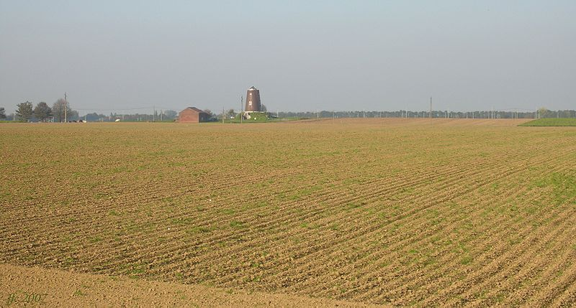
Crystalline Silica is ubiquitous in nature :
it forms 12% of the Earth crust

Slide 3

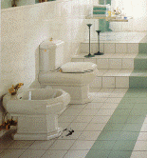
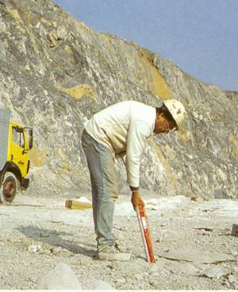
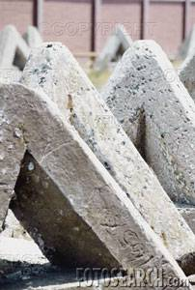
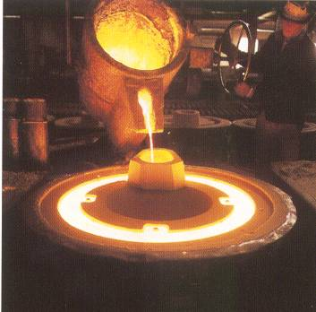
Crystalline silica is present in almost all materials extracted from the soil. These materials are essential components in many products such as glass, ceramics, foundry, paints, plastics and construction products.

Slide 4
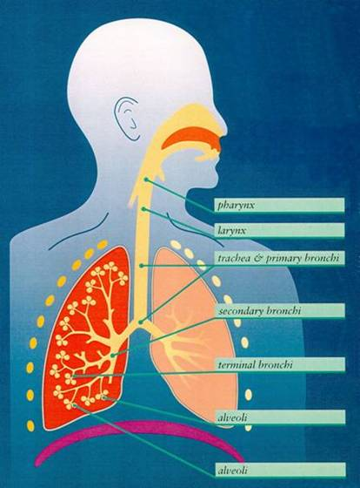
RCS
Respirable Crystalline Silica (RCS)
RCS
RCS health effects
Prolonged inhalation of fine dust containing a proportion of crystalline silica can cause a specific type of lung damage called silicosis. Silicosis is one of the world’s oldest known occupational lung diseases.
Studies show an excess risk of lung cancer in populations exposed to respirable crystalline silica, in particular amongst silicotics.
IARC – International Agency for Research on Cancer, classified inhaled crystalline silica (quartz or cristobalite) from occupational sources as a Group 1 carcinogen (1997).

Slide 5
Revision of the Carcinogens and Mutagens Directive
The protection of workers from the risks related to exposure to carcinogens or mutagens at work: Directive 2004/37/EC.
Since 2016 Under on-going revision of Annexes (1st, 2nd, 3rd batches)
Jan. 2018 Entered into force – (1st batch)
Directive (EU)2017/2398
By Jan. 2020 Members States’ transposition’s deadline - Directive (EU)2017/2398
Notes:
May 2016 EC Proposal
Dec 17 Publication into the Official Journal
Currently: 2nd & 3rd batches:
2nd batch Interinstitutional level - no further mention of RCS but a stronger Recognition of Social Dialogue Agreement as NEPSI
3rd batch European Parliament Amendments

Slide 6
Revision of the Carcinogens and Mutagens Directive
Directive (EU) 2017/2398 (1st batch)
CMD 1st batch with the Inclusion of RCS
A proportionate and technically feasible:
  BOELV of 0.1 mg/m³ (Respirable fraction) (Annex III)
  “Work involving exposure to respirable crystalline silica dust generated by a work process” (Annex I - 6.)
NEPSI Recognition
  as a valuable and necessary instrument to complement regulatory measures and to support the effective implementation of the limit value (Recital 19)
The evaluation of RCS when appropriate according to review process on the basis of available information, including scientific and technical data, economic feasibility, a thorough assessment of the socioeconomic impact and availability of exposure measurement protocols and techniques at the workplace (Article 1-18ª – Recital 1)

Slide 7
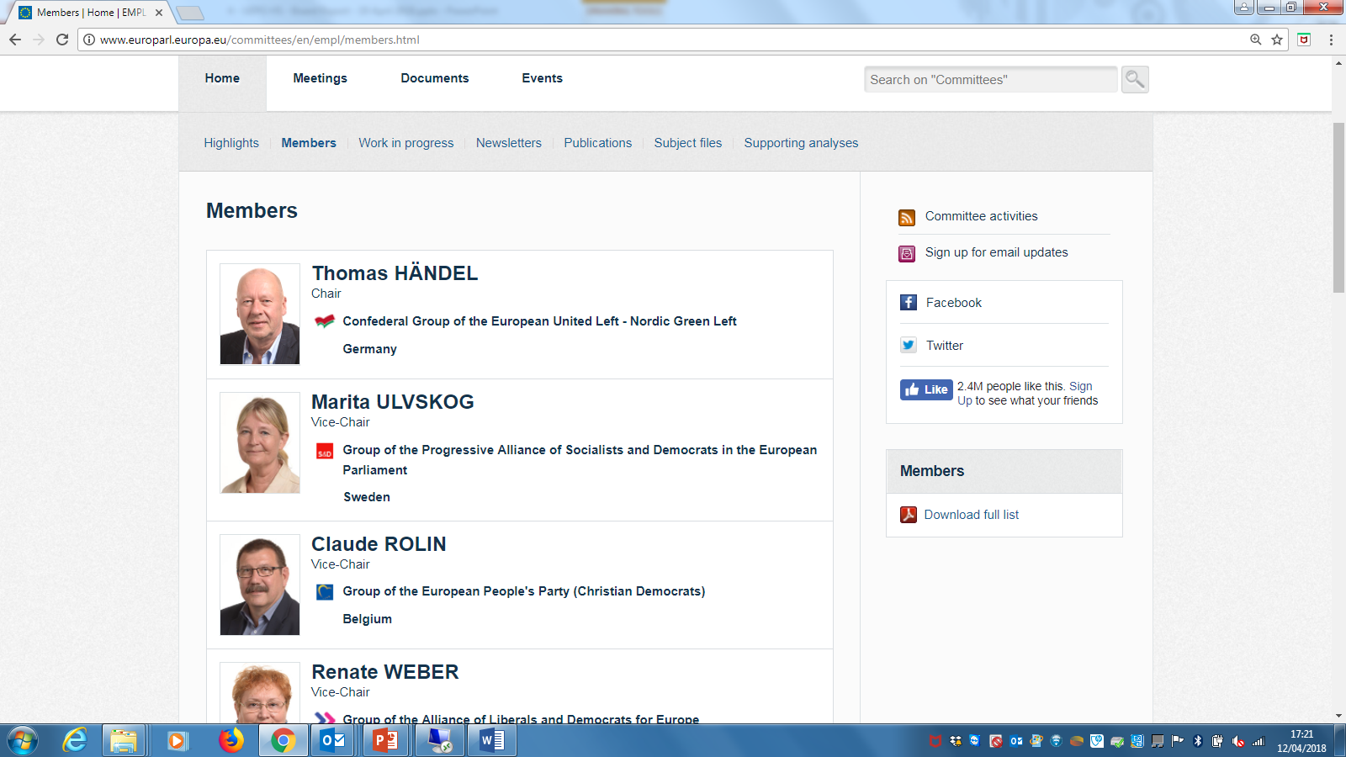
Revision of the Carcinogens and Mutagens Directive
(2nd batch) under interinstitutional work
Rapporteur Claude Rolin (EPP, Belgium):
New European Parliament amendments on the “Recognition of Social Agreement as NEPSI” into the text.
March 2018:
  MEP Rolin’s Report was approved at the Employment and Social Affairs Committee of the European Parliament .
Now:
  the interinstitutional work has started between the European Commission, the Council/ Austrian EU Presidency and the European Parliament.

Slide 8

A voluntary action programme since 2006
What is the NEPSI Social Dialogue Agreement?
  Strong commitment to control
  the exposure of workers
  to respirable crystalline silica dust
  First multisectoral agreement published in the Official Journal
signed by the European trade union industriAll and 17 employers organisations: extractive industry (Euromines, EuroRoc, IMA-Europe, UEPG), Ceramics (Cerame-Unie, EXCA), Foundry (CAEF/CEEMET), Glass (APFE, FEVE, Glass for Europe), Mineral Wool (EURIMA), Construction Products (Cembureau, ECSPA, EMO, BIBM and ERMCO, ASTA worldwide)
The Agreement is improving the protection of health of employees occupationally exposed at the workplace to RCS (EC implementation study, 2016)

Slide 9
A voluntary action programme since 2006
AIM of the NEPSI Social Dialogue Agreement
Protection of health of Employees and other individuals occupationally exposed at the workplace to Respirable crystalline silica from materials / products / raw materials containing crystalline silica.
Minimisation of exposure to Respirable crystalline silica at the workplace by applying the Good Practices stipulated herein in order to prevent, eliminate or reduce occupational health risks related to Respirable crystalline silica.
Increasing the knowledge about potential health effects of Respirable crystalline silica and about Good Practices.
The Agreement is improving the protection of health of employees occupationally exposed at the workplace to RCS (EC implementation study, 2016)

Slide 10
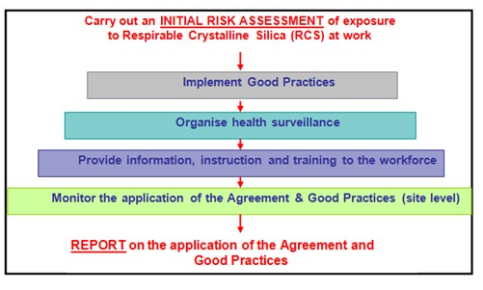
NEPSI implementation: Reporting Process
Reporting every 2 years – 2018 Reporting

Slide 11


NEPSI implementation: key performance indicators
A continuous improvement
 | 2008 | 2010 | 2012 | 2014 | 2016 | 2018
Number of Sites | 5.102 | 6.395 | 6.922 | 7.184 | 7.550 | 8.749
Number of reported Sites | 4.607 | 5.526 | 6.047 | 5.951 | 6.234 | 7.426
% of Reported Sites: | 90,3% | 86,4% | 82,8% | 82,8% | 82,6% | 84,9%
Number of Reported Employees: | 410.909 | 438.113 | 440.159 | 440.159 | 433.411 | 439.689
% of Employees potentially exposed to RCS: | 39,8% | 40,3% | 40% | 40,1% | 39,5% | 41,3%
% covered by risk assessment: | 88% | 90,4% | 91,5 | 93,5% | 95% | 95,5%
% covered by exposure monitoring: | 64,5% | 69% | 71,7% | 73,4% | 76,3% | 78,9%
% covered by generic health surveillance: | 87,5% | 88% | 90% | 89,1% | 90,7% | 91,4%
% covered by Health Surveillance Protocol for Silicosis: | 34,7% | 34,3% | 35,7% | 37,9% | 41,4% | 43%
% covered by general training : | 75% | 83% | 84% | 88% | 90% | 88,7%
% covered training on Task Sheets: | 42,8% | 54,6% | 60% | 65,1% | 67,5% | 65,9%

Slide 12
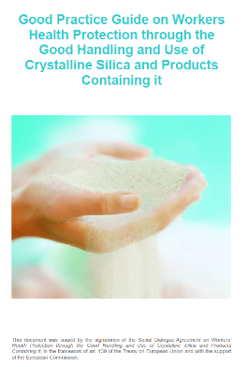
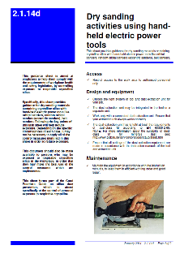

NEPSI Tools
Task sheets & PIMEX videos
with the support of the European Commission
Risk awareness & training
Tailor made solutions
Task oriented measures
Compliance with the legislation
www.nepsi.eu

Slide 13
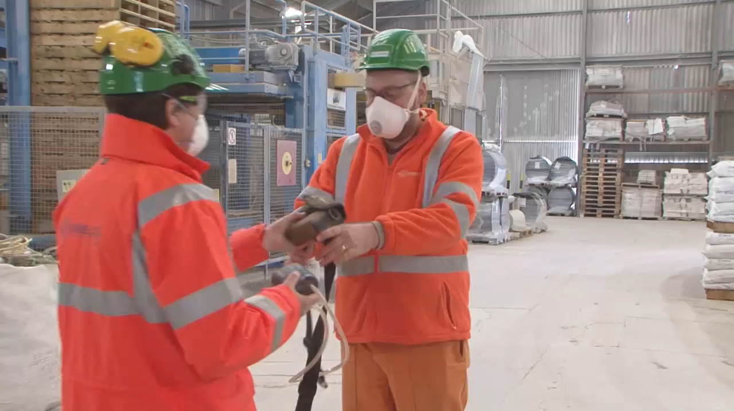
Dust Monitoring training for NEPSI
Dust monitoring is used to assess compliance and guide prevention

Slide 14

NEPSI 2018-2020 Road Map
NEPSI 2018-2019 ROAD MAP
Develop a specific action/training programme and guidances for SMEs and the new generations of workers, and develop up-to-date information/communication on RCS exposure control for different audiences.
Review the Good Practice Guide and Task Sheets and update when necessary.
Development of a detailed standardized Respirable Crystalline Silica Measurement Methodology.
Continue the KPIs Reporting, enhance the participation through continuous awareness, promote the Agreement in co-operation with HSE specialists.
Review the Agreement and the Good Practice Guide to check language coherence with the amended Carcinogens and Mutagens Directive (2017/2398).
Draft Internal and external Communication to support NEPSI Signatories Members.

Slide 15
UEPG Respirable Crystalline Silica Working Group
UEPG RCS WG
OBJECTIVE: Draft a UEPG Respirable Crystalline Silica Strategy contributing to NEPSI 2018-2020 actions and the good implementation of the CMD to support UEPG Members.
1st MEETING: Wednesday 18 April 2018 at UEPG Office in Brussels
MAIN PROPOSED ACTIONS (in line with NEPSI initiatives):
Review and adapt the NEPSI “Q&A” document on the Implementation of the CMD and its translation
Evaluate NEPSI 2018 Reporting and draw conclusions
Collect and promote the National lobbying actions on the Transposition of the CMD
Review the draft NEPSI Common Communication on Silica (with the support of UEPG PR and Communications Task Force)
Simplify the Silica Protocol to adapt it to the Aggregates Sector / SMEs
Monitor the standards on Workplace atmospheres (e.g. EN 689, EN 481, EN 1232)
Review the NEPSI Task Sheets’ content dedicated to the aggregates sector

Slide 16
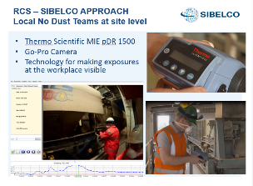
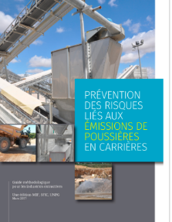
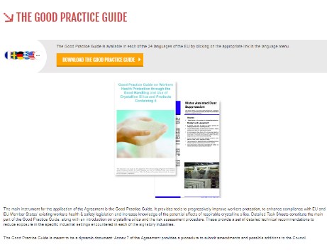
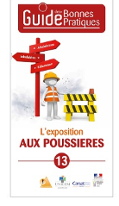
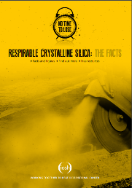
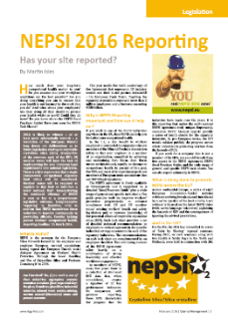
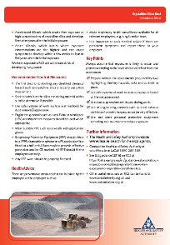
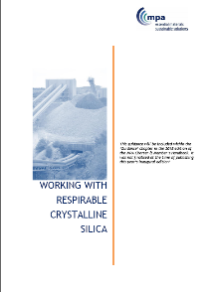
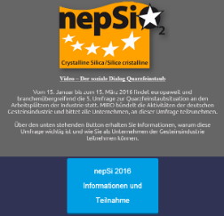
UEPG Sharing and Promoting Good Practices
UEPG RCS WG

Slide 17


Recognition of NEPSI:
NEPSI signatories work together since 10 years
“Setting limit values through EU legislation is instrumental for protection of workers’ health. But it is the quality of implementation and enforcement on the ground - on each factory floor, in each mine, on each construction site – that will determine whether lives are saved. That is where we see the true value of the bottom-up approach, which has driven the success of NEPSI”.
Marianne Thyssen, EU Commissioner for Employment and Social Affairs
"I commend the social partners who, in a preventive approach, negotiate sectoral agreements aiming to better protect the workers from carcinogenic agents. The NEPSI Agreement is an excellent example and I can only hope that others will follow the same way. In the field of health & safety at work, the keywords must be “prevention and dialogue.”
MEP Claude Rolin (PPE, Belgium), Rapporteur CMD 2nd batch

Slide 18
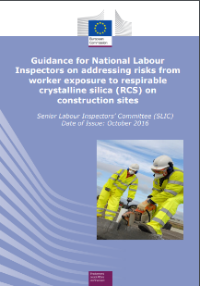
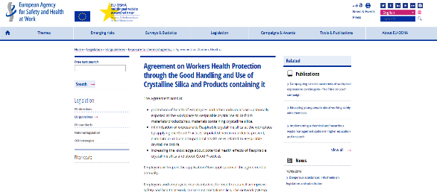
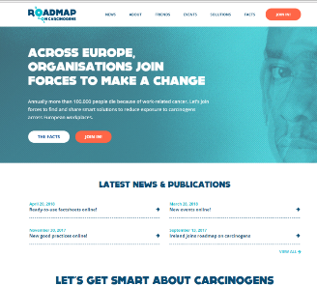
Recognition of NEPSI:
NEPSI signatories work together since 10 years
Guidance for National Labour Inspectors on addressing risks from worker exposure to RCS on construction sites referring to NEPSI Good Practices, available on the
EU- OSHA website
NEPSI part of the solutions and Good practices of the "Roadmap on carcinogens" initiative and website

Slide 19





THANK YOU
European Aggregates Association
Rue d’ Arlon 21, 1050 Brussels
0032 2 233 5300
secretariat@uepg.eu
EU Transparency Register: 15340821653-49
www.uepg.eu
www.nepsi.eu
UEPG (European Aggregates Association)
UEPG European Aggregates Association
@UEPG_Aggregates

