Slide 1




Brexit and the Implications on Supply and Use of Chemicals, Machinery & Products
February 28th 2019

Slide 2


Opening and Welcoming Remarks
Dr. Sharon McGuinness, HSA

Slide 3
Health and Safety Authority Mandate
To regulate and promote the safety, health and welfare of people at work and those affected by work activities
To promote improvement in the safety, health and welfare of people at work and those affected by work activities
To regulate and promote the safe manufacture, use, placing on the market, trade and transport of chemicals
To act as surveillance authority in relation to relevant single European market legislation
To act as the National Accreditation Body for Ireland

Slide 4
Brexit and the Implications on Supply and Use of Chemicals, Machinery & Products
February 28th 2019

Slide 5
Brexit and the implications for REACH
Dr. Majella Cosgrave, HSA

Slide 6
REACH
Most elements of REACH will be impacted by Brexit
Key areas for Irish companies will be registration and authorisation
Non- EU companies and UK-based Only Representatives (ORs) also affected

Slide 7
REACH Registration
Requirement that substance manufactured in EU, or imported into EU at greater than 1 tonne per annum, must be registered
UK registration statistics :
  12,419 registrations
5,749 substances
1,773 companies
30% importers
18% manufacturers
47% Only Representatives (ORs)
5% manufacturers and importers
Many Irish companies may be relying on these UK-based registrations for their own supply (or covered by the UK-based OR)

Slide 8
REACH Registrations after Brexit
UK will be a third country
UK REACH registrations will become non-existent
UK authorities will also no longer:
Participate in EU regulatory and decision making processes
Have access to ECHA databases
Be part of, or send experts to, ECHA or Commission committees

Slide 9
Impacts on IE companies - registration
Currently, if IE company buys chemicals from UK supplier, role under REACH is as a downstream user -> no registration obligations
If IE company continues to buy chemicals from that UK supplier after brexit, role under REACH changes to importer -> registration obligations
Consideration also needs to be given to IE distributors that may supply IE companies – their source could be UK-based

Slide 10
Impacts on registration for IE companies (1)
Scenario: IE company purchasing registered substance from UK registrant
Currently, IE company is downstream user; no registration obligation
After Brexit, IE company can’t rely on the UK registration
Options:
UK supplier:
move operations related to registered substance to legal entity within EU-27/EEA; complete a legal entity change, or
if manufacturer (but not importer), appoint EU-27/EEA based OR and transfer the registration
IE company:
sources another EU-27/EEA based supplier, or
continues to source from UK-based supplier, becomes an importer; registers
If you are in this position, consider your options and talk to your UK supplier now about his intentions post-Brexit

Slide 11
Impacts on registration for IE companies (2)
Scenario: IE company registrant in joint submission with UK lead registrant
Following Brexit, UK registration will cease to exist
Options to ensure functioning joint submission:
Lead registrant moves to EU-27/EEA, or
New lead registrant appointed and LR role transferred before Brexit
If you are in such a position, talk to your UK lead registrant now to determine his intentions post-Brexit

Slide 12
Impacts on registration for ORs
Scenario: UK-based Only Representative who has submitted registrations
After Brexit, OR will no longer be ‘legally established in the EU’
Options :
OR moves to EU-27/EEA, or
Non-EU manufacturer appoints new OR based in EU-27/EEA , or
EU-27 company becomes an importer and registers
If you are dependent on a UK-based OR, speak to your OR and/or your non-EU supplier to determine their intentions post-Brexit

Slide 13
UK companies transferring registrations to EU-27/EEA (1)
Company cannot be set up ‘on paper’ only
Must be result of a legal entity change:
UK company goes through acquisition/relocation to the EU-27/EEA, or
An intra-group transfer of the activity to the EU-27/EEA (e.g. transfer of manufacturing from UK-based mother company to EU-27/EEA-based daughter company)
Responsible staff and relevant documentation must be available for inspection by the IE enforcement authority at premises of registrant
Also applies to ORs

Slide 14
UK companies transferring registrations to EU-27/EEA (2)
Changes must be notified in REACH IT ahead of UK withdrawal
ECHA has guidance on how to transfer registrations
ECHA to open ‘Brexit window’ in REACH IT to allow transfers to take place (March 12th – 29th)
Following the legal entity change, UK legal entity must cease manufacturing/importing until after the UK withdrawal

Slide 15
IE downstream users/distributors sourcing mixtures from UK supplier
Before Brexit:
UK formulator has no registration duties for substances he uses in the formulation (downstream user)
IE downstream user/distributor has no registration duties for the substances in the mixture he sources from the UK formulator
After Brexit:
UK company becomes a non-EU formulator
IE downstream user/distributor becomes an importer (from outside the EU) of the substances in the mixture
IE company potentially has registration duties for the substances in the mixture

Slide 16
IE downstream users/distributors sourcing mixtures from UK supplier
Post-Brexit options :
IE company sources the mixture from a different EU-27/EEA based supplier, or
IE company continues to source the mixture from the UK supplier and takes on registration duties for the substance, as the importer, or
UK company, as non-EU formulator, appoints an EU-27/EEA based OR
In this scenario, IE company would still be a DU, covered by the OR arrangement
Note: Exemption for re-import under article 2(7)(c) of REACH may apply

Slide 17
Exemption for re-imported substances (1)
Exemption from registration for re-imported substances (article 2(7)(c))
Applies to substances registered in the EU, exported by an actor in the supply chain and re-imported back into the EU by the same actor, or a different actor, in the same supply chain
Conditions:
Substance exported and re-imported must be the same
Re-importer must be provided with information on the substance
May be option for IE companies sourcing UK-formulated mixtures
IE company may be seen as a re-importer of substances in the mixture

Slide 18
Exemption for re-imported substances (2)
Scenario: UK formulator sources the substances for his mixtures in the EU and supplies the mixture to an IE company
Substances are registered by the UK formulator’s EU supplier
After Brexit, substances exported out of the EU to the UK formulator
UK formulator prepares the mixture (without chemically modifying the substances) and sells the mixture to IE company
IE company re-imports the substances (in the mixture) back into the EU
In this case, the exemption from registration could apply to the IE company, providing conditions of the exemption are met
You may be in this situation; talk to your UK supplier and determine if he sources EU-registered substances for his mixtures

Slide 19
UK Land Bridge
IE companies may source substances in the EU which are then driven across the UK and delivered to Ireland from the UK
ECHA has provided clarification (Q&A); the fact that an EU-registered substance is transported through a third country is immaterial
No registration duties for IE companies using this route

Slide 20
REACH Authorisation
A manufacturer, importer or downstream user may not place a substance on the market for a use, or use it himself, after a certain date (sunset date) if the substance is included in Annex XIV of REACH
A company who applies for an authorisation can do so for his own use and the uses of his downstream users (DUs)
After Brexit, authorisations granted to UK company will not be valid
If application also covered uses of his DUs, they too will no longer be covered after Brexit
Currently, no adopted decisions falling in this scenario (DU covered by UK applications), but pending ones may be; EU-27 based DUs should assess if the applicant for authorisation for their use is based in the UK

Slide 21
REACH Authorisations after Brexit
Options for UK company;
transfer authorisation/pending application to EU-27/EEA OR, with effect on withdrawal date (note: importer cannot appoint an OR)
transfer authorisation/pending application to EU-27/EEA manufacturer/importer/downstream user of the substance, with uses covered by the application through a legal entity change. (note: must happen before UK withdrawal and change of legal entity cannot extend the scope of original application)
Options for UK-based ORs:
transfer authorisation/pending application to EU-27/EEA OR (must happen before UK withdrawal)

Slide 22
REACH Authorisations after Brexit
Options for IE downstream user relying on a pending UK application for authorisation:
Contact the UK applicant to assess if he will transfer the application before the withdrawal date
If the application for authorisation is a joint application with other EU-27 legal entities, the IE DU may obtain the supply for an EU-based co-applicant
Or, he may need to apply for an authorisation himself

Slide 23
Companies based outside of the EU
Scenario: Non EU manufacturer/formulator has appointed UK-based OR
Options:
Can appoint a new OR in an EU-27 MS/EEA
Requires collaboration between old and new OR for legal entity change
Must take place before the UK withdrawal
Must be notified to ECHA through REACH IT

Slide 24
From a UK perspective….
If a transitional arrangement is agreed, EU law will continue to apply in the UK during that time (subject to terms set out in Withdrawal Agreement)
  But, HSE/DEFRA will no longer participate in EU committees or act as a ‘lead authority’
Limited/no participation by UK in EU institutions, agencies and bodies

Slide 25
UK No Deal Contingency Planning
The EU (Withdrawal) Act became law in June 2018
Will convert EU chemicals regulations to UK domestic law
Contingency Statutory Instruments (SIs) will correct deficiencies to ensure regulations are operable outside EU
SIs ready to come into effect 29 March 2019
A no deal outcome would mean companies wanting to operate in both UK and EU markets will need to deal with both regulatory systems

Slide 26
Preparing for Brexit - REACH
Examine your current supply chain
Do you source substances from a UK-based supplier?
Are you a downstream user, relying on a UK-based only Representative?
Are you reliant on an IE distributor who in turn sources from the UK?
May you be reliant on a future UK company granted authorisation?
Can you change your supplier to an EU-27/EEA one?
Are you in a position to take on the role of importer if you continue to source in the UK post-Brexit?
Speak to your UK suppliers/ORs to determine their plans post-Brexit

Slide 27
REACH Supports
HSA chemicals helpdesk: chemicals@hsa.ie
HSA webpages www.hsa.ie/brexit
ECHA webpages on UK withdrawal (Q&As and guidance) https://www.echa.europa.eu/support/qas-support/browse/-/qa/70Qx/view/topic/theukswithdrawalfromtheeu
European Commission Notices https://ec.europa.eu/info/brexit_en
UK Government Brexit Publications – no deal scenarios https://www.gov.uk/government/brexit
IE Government Departments and Agencies (especially Enterprise Ireland, InterTrade Ireland, Strategic Banking Corporation of Ireland, Revenue)
Trade organisations

Slide 28
Thank you

Slide 29
Brexit and the Implications on Supply and Use of Chemicals, Machinery & Products
February 28th 2019

Slide 30
Supply and distribution of chemical products post-Brexit
Yvonne Mullooly, HSA

Slide 31
Supply & Distribution
REACH
Safety data sheets
Classification, Labelling & Packaging (CLP)
Detergents
Restrictions
Market Surveillance
Export/ Import (PIC)

Slide 32
Trade & Supply between Ireland & UK
Majority of IE chemical products come from UK suppliers
Most IE companies are currently “downstream users” under REACH/CLP/Detergents
When UK leaves, IE companies role may change resulting in higher regulatory obligations and associated costs.
Chemical Products imported from the UK need to be EU compliant.

Slide 33
Chemical Products
Substances- Alcohols, acids, salts
Mixtures- Paints, Degreasers, Pigments, Detergents, Silicone, Adhesives, Coatings
Articles- Jewellery, Shoes, Furniture, Electronic Equipment, Construction panels
DO THE CHEMICAL PRODUCTS YOU SUPPLY or USE COME FROM THE UK ?

Slide 34
Substances, Mixtures & Articles
Substances, mixtures supplied into the EU market must comply with REACH, CLP & Detergents¹ (¹where applicable)
Articles supplied to EU market must comply with REACH
Substances, mixtures & articles supplied to UK market from EU (Ireland) must comply with UK standards
Legal responsibility of distributors and downstream users may change !

Slide 35
Change in role
Distributor/Downstream users
EU Importer

Slide 36
What does it mean to be an
EU Importer of Chemical Products?

Slide 37
MARKET SUPPLY & SAFE USE
Legal Responsibility for safety of the product lies with the 1st EU Importer from the UK
Chemical Product: Substance/mixture
  - Classified, Labelled and Packaged (CLP)
  - Notified to the C&L Inventory
- Supplied with an appropriate Safety Data Sheet (SDS)
Chemical Product: Substance/Mixture or Article
- Register/Notify
- Doesn’t contain prohibited substances (Annex XVII REACH+)

Slide 38
Substances in Articles
After Brexit: Importers of articles from the UK will have a number of duties
Register substances in the articles, if the substance is intended to be released under normal use and present in quantities > 1Tonne per year per importer.
Notify ECHA if the article contains a candidate list substance >0.1% weight by weight and in quantities > 1 Tonne per year (unless the substance is already registered by another EU manufacturer/importer for that use
If a candidate list substance is present above 0.1% (weight by weight) importers will also have to provide enough information to industrial or professional users to allow the safe use of the article. As a minimum the name of the substance.
Consumers can request similar information. The supplier of the article has to provide this information within 45 days, free of charge.

Slide 39
Detergent Products
Detergent Regulations: Household & Industrial.
  Additional labelling & prohibition of certain substances
‘Placing on the market’ means the first making available on the Union market. Import into the Union customs territory shall be deemed to be placing on the market.
‘Making available on the market’ means any supply for distribution, consumption or use on the Union market in the course of a commercial activity, whether in return for payment or free of charge.
Personnel hygiene products (shower gels, shampoos) do not fall within the scope of Detergents

Slide 40
Market Surveillance
Currently majority of “non compliant” chemical products found on the Irish market are referred to UK Authorities to enforce.
Product Recall & EU RAPEX Alert
Major impacts on business resources & reputation
Major impact on Authority and Customs resources

Slide 41
Options
Source another EU supplier willing to supply the Irish market.
Remember labels & SDS’s must be in English & SDS must contain relevant Irish standards!
Source/employ competent person familiar with REACH, CLP & Irish national standards to ensure you can supply compliant chemical products to the Irish/EU market

Slide 42
Important information to note
No “Only Representative” provision in the CLP & Detergent Regulations.
Existing UK C&L notification information will remain available unless it is removed via REACH IT account
Irish companies may need to seek new suppliers of their chemicals within EU – may lead to shortages in supply. Look for business opportunities!

Slide 43
Exporting Chemical Products to the UK

Slide 44
Exporting Chemical Products to UK
Rotterdam Regulation – Prior Informed Consent
Only applies to banned or severely restricted Pesticides & Industrial Chemicals
Customs requires a RIN for custom declaration
Apply via electronic system ePIC- ECHA
Exports < 10 kg/yr/country for R&D/Testing- Special RIN(SAD Box 44)
Yearly notification of quantity shipped per country

Slide 45
Exporting to the UK
Check if any substances listed in PIC Part 1 are in any of your chemical products
NO DEAL
EU Withdrawal starts earlier than March
Export notifications must be submitted 35 days before export
UK Export Notifications will cease to exist from March 2019
As UK still a party to Rotterdam Convention UK companies still have obligations

Slide 46
Export Import
UK Regulations will also apply to Irish products on the UK market
If product requirements are different in the UK
Divergence may occur on the enforcement side if a non-compliance is observed for a UK product on the IE market.
Resolution of non compliant products could fall to the Irish Importer.
http://www.hsa.ie/eng/Chemicals/Export_Import/

Slide 47
Parting advice
Your company will experience change if your business supply chain is in any way linked to the UK
Downstream users: Do you know if your distributor will continue to source your product?
Start your market preparations now! Register in ePIC
  KNOW YOUR PRODUCT SOURCE
  TALK TO YOUR SUPPLY CHAIN
  DIVERSIFY
Follow the withdrawal negotiations to determine your future obligations

Slide 48
Information

Slide 49
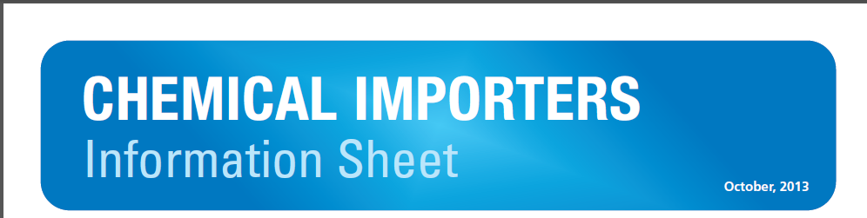
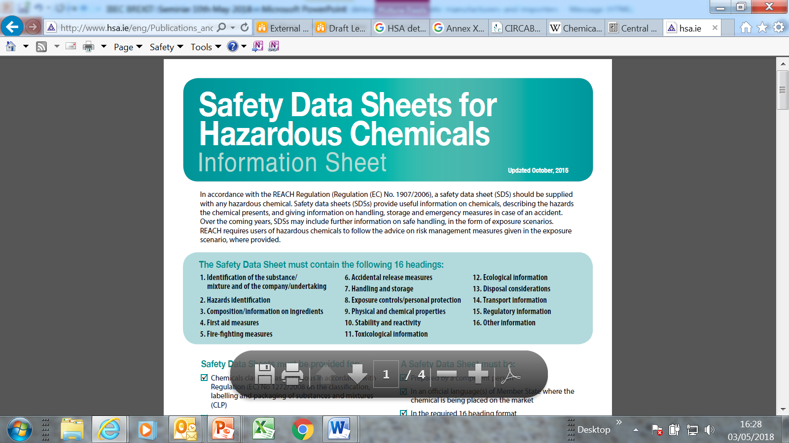
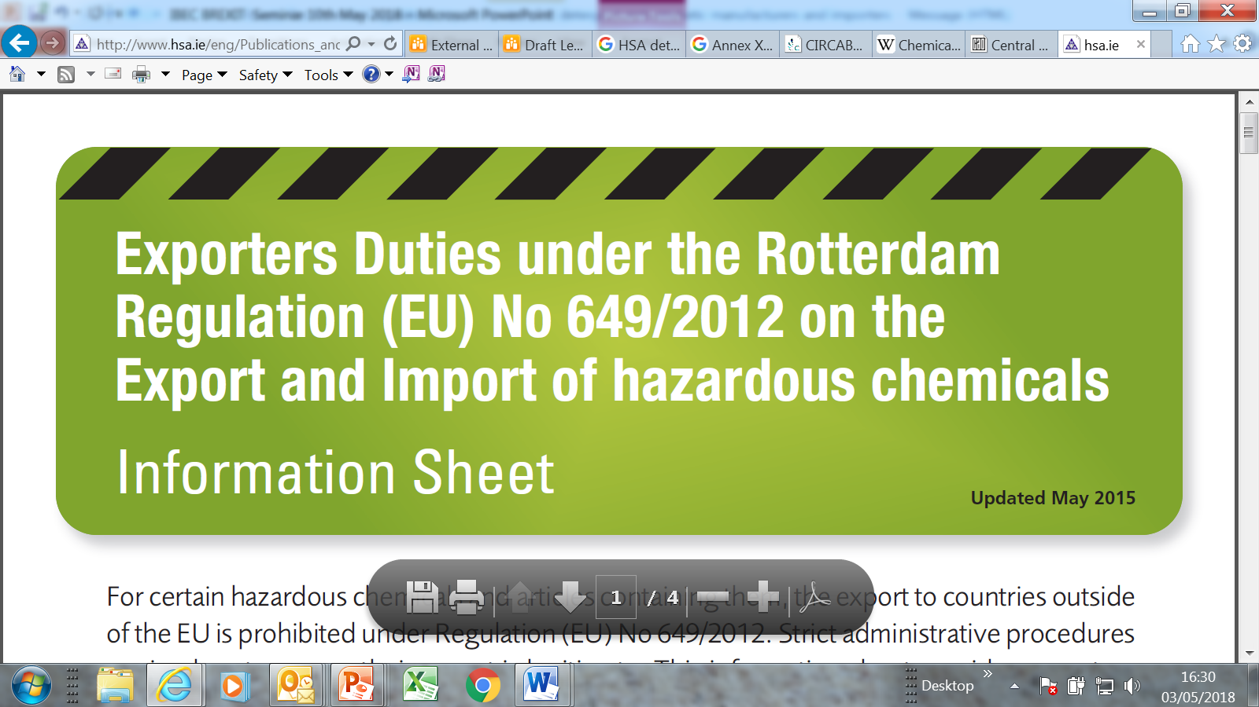
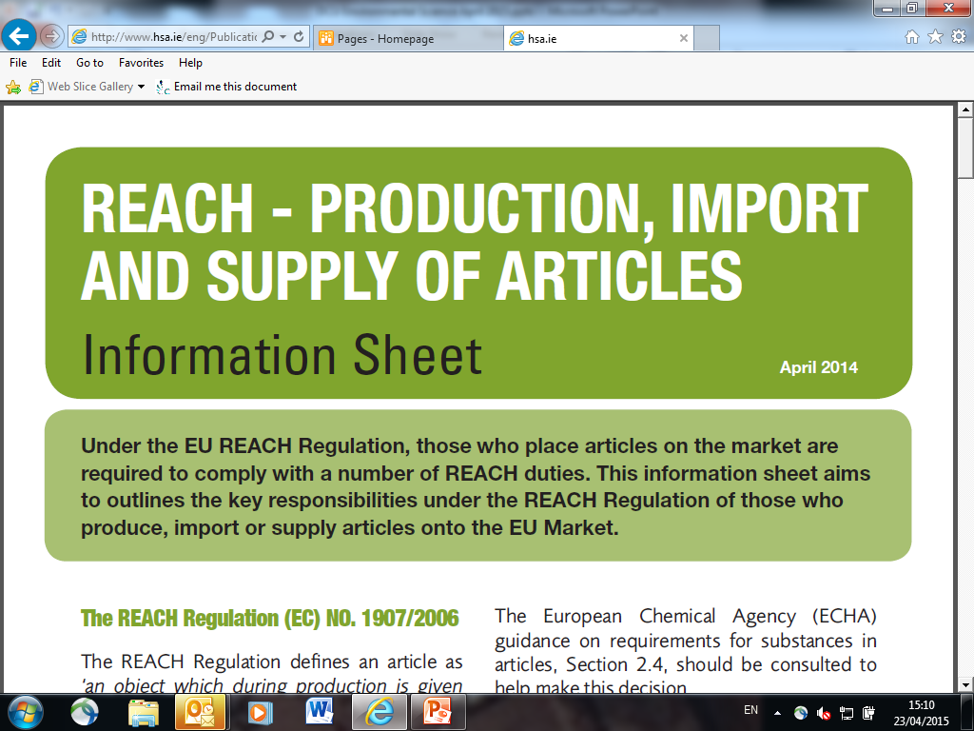
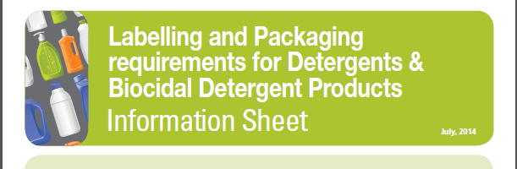
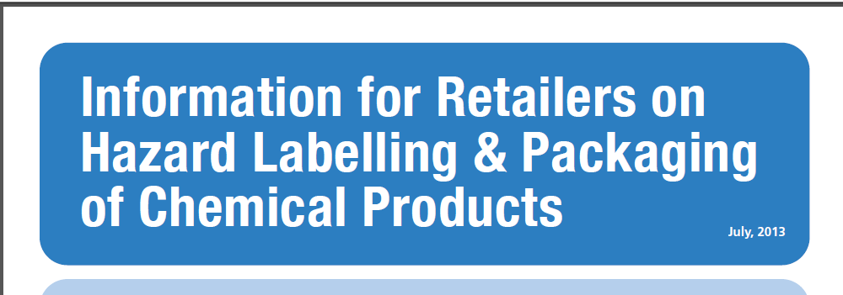
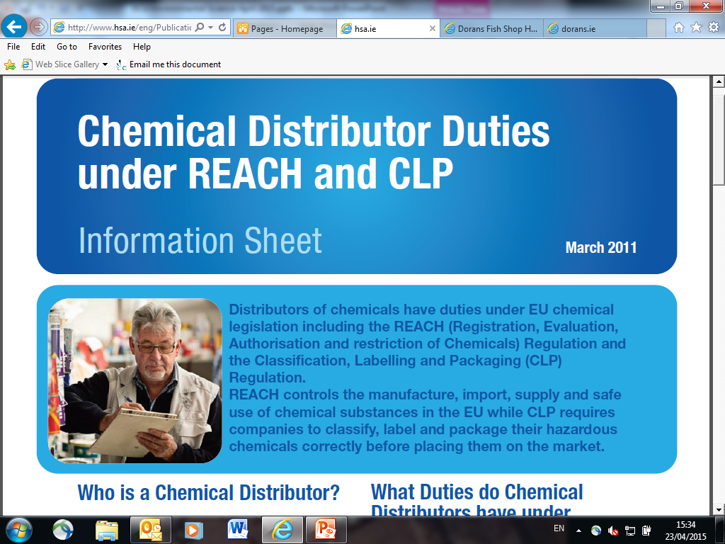

Slide 50
Relevant Publications
Chemical a) Importers b) Exporters c) Distributers
Retailers- Classification, Labelling and Packaging
Classification, Labelling and Packaging of substances and mixtures
Classification, Labelling and Packaging of Detergents
Safety Data Sheets
Import and Supply of Articles
All available at www.hsa.ie/eng/publications/chemicalsand hazardoussubstances
ECHA YouTube Videos
https://www.youtube.com/user/EUchemicals/videos

Slide 51
Support
We are here to help!
HSA Chemicals helpdesk email chemicals@hsa.ie
HSA: UK Withdrawal HSA webpage
ECHA: https://echa.europa.eu/uk-withdrawal-from-the-eu
ECHA How to notify to the C&L inventory: https://echa.europa.eu/support/dossier-submission-tools/reach-it/notification-to-the-cl-inventory.
DBEI: https://dbei.gov.ie/en/What-We-Do/EU-Internal-Market/Brexit/
EU Commission: https://ec.europa.eu/commission/brexit-negotiations_en

Slide 52
“Get Brexit Ready &
Know Your Source”
Thank You

Slide 53
Brexit and the Implications on Supply and Use of Chemicals, Machinery & Products
February 28th 2019

Slide 54
Brexit
Impact on Biocides
Dr Finbar Brown
Pesticide Control Division

Slide 55
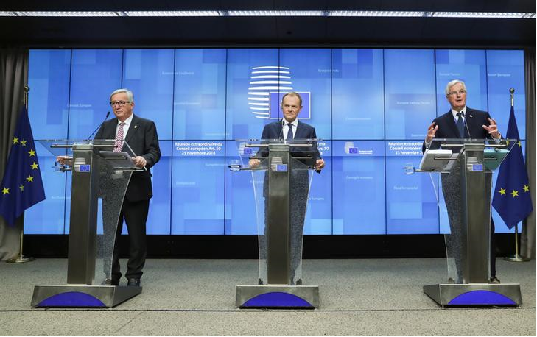
EU-27 Position

Slide 56
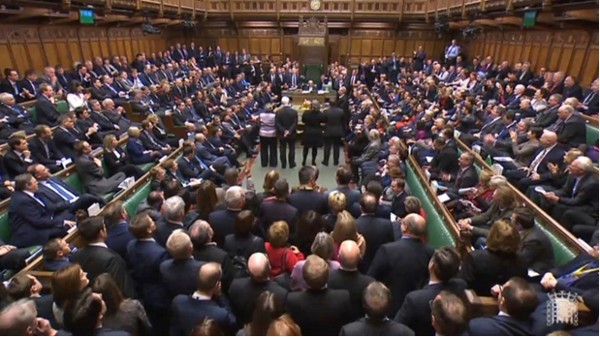
UK Parliament…March?

Slide 57
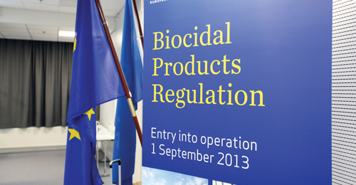
What about Biocides
Regulation (EU) No 528/2012?

Slide 58

Impact – many questions
Effect on active substances (a.s.)?
Effect on products (b.p.)?
Effect on a.s. and b.p. suppliers (Art.95)?
Effect on case owners?
Effect on Authorisation Holders (A.H.)?
Effect on Letters of Access (L.o.A.)?
Effect on data protection?
And so on…..

Slide 59

What is certain?
What is certain come 29th March 2019?
UK can no longer act as an eCA
Applies to both active substances & products
EU-27, EEA and CH have to carry more work
eCAs have to increase capacity
Inevitable delay in MS evaluations
Potential loss of some products to IE market
There is still time to act

Slide 60

Preparation
7 Brexit Technical Seminars
Search for new eCA for a.s.
Change to Review Programme – existing a.s.
Search for new eCA for a.s. renewal
Search for alternative eCAs for products
First authorisations and renewals

Slide 61

Active substances
Applicant is UK based? Still OK.
Manufacturer is UK based? OK.
Will ECHA refuse UK companies right to refer to vertebrate test/study? No outright refusal.
Will a.s. studies retain data protection? Yes.
Status of approved a.s. (UK refMS)? OK.
Art.95 listed supplier is UK based? Not OK.
L.o.A. to data from UK company? OK.
UK a.s. evaluation ongoing? Not OK.

Slide 62

Product Notifications
Registration under Article 89 transitional phase
Brexit impact come 29/3?
Art.95 listed supplier is UK based? Not OK.
Can the notification holder be UK based? Yes*
Can the label be an IE-UK dual label? Yes*
* The understanding of the IE CA would be yes, but await confirmation from EU COM.

Slide 63

Product Authorisations
Authorisation under the BPR
Brexit impact come 29/3?
Art.95 listed supplier is UK based? Not OK.
AH is UK based? Not OK. EU-27, EEA AH base.
Can the label be an IE-UK dual label? Yes*
UK company information on the label? Yes*
L.o.A. to data from UK company? OK.
UK evaluation ongoing? Not OK.
*The understanding of the IE CA would be yes, but await confirmation from EU COM.

Slide 64
Specific type of BPR Authorisations
Brexit impact come 29/3?
National Autorisations
Mutual Recognitions (Sequence & Parallel)
Union Authorisations
Simplified Authorisations and notifications
Same Biocidal Products
Changes (minor/major/admin) to authorisations

Slide 65


National Autorisations
Assets and ongoing cases in UK on 29/3/?

Slide 66





Mutual Recognitions - Parallel
Available agreed SPC/PAR or Authorised 29/3

Slide 67


Mutual Recognitions - Parallel
SPC/PAR will not be agreed by 29/3. Need new refMS.
NA-MRP

Slide 68
Mutual Recognitions - Sequence
Agreed SPC (Evaluate & Decide step) by 29/3?
Evaluate & Decide

Slide 69
Mutual Recognitions - Sequence
No agreed SPC (in MSCA accept or Validate steps) by 29/3?
MSCA
accept

Slide 70
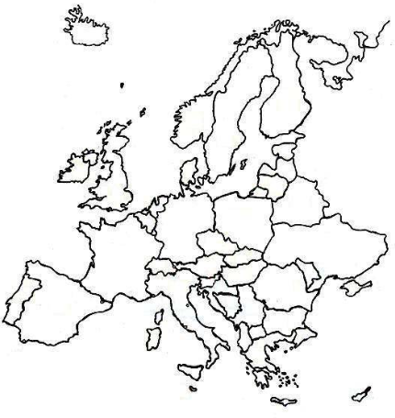

Union Authorisation
Granted before 29/3,but need new eCA for RNL and Change

Slide 71
Union Authorisation
Not likely to be granted before 29/3, need new eCA

Slide 72

Union Authorisation
BPC Opinion adopted before 29/3

Slide 73
Renewal products
UK reference will not be completed before 29/3. Need to find new refMS.

Slide 74
Simplified procedure
If UK was the refMS, need new refMS to authorise before 29/3 and new notifications

Slide 75
Same Biocidal Products
Remain unaffected by 29/3. Standalone auths.

Slide 76
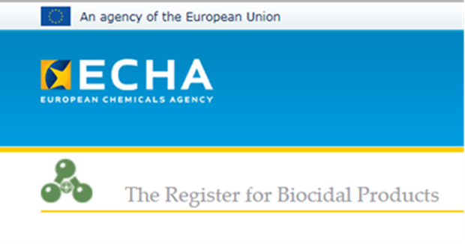

IT Tools – R4BP3 & SPC
Brexit impact come 29/3?
Access to R4BP3 - UK CA? Restrictions.
Access to their data – UK companies? Yes.
UK company submit applications via R4BP3? Yes, but note ‘case owner’ and ‘AH’ difference
ECHA Dissemination website

Slide 77
Useful Resources
ECHA Q & A
https://echa.europa.eu/support/qas-support/browse/-/qa/70Qx/view/topic/theukswithdrawalfromtheeu
EU COM Q & A
https://ec.europa.eu/info/sites/info/files/qa_biocides.pdf
UK Gov. Biocide page
https://www.gov.uk/government/publications/regulating-biocidal-products-if-theres-no-brexit-deal/regulating-biocidal-products-if-theres-no-brexit-deal

Slide 78
Conclusions & take home message
Making the uncomfortable comfortable
Check status of your a.s./products
Check AH location
Check Art.95 supplier listing
Consider a new refMS if necessary
Consider market area for future submissions
There is still time to act
Contact your CA for further information

Slide 79

Thank you!
Contact:
Biocides@agriculture.gov.ie

Slide 80
Questions and Answers
Session 1

Slide 81
Brexit and the Implications on Supply and Use of Chemicals, Machinery & Products
February 28th 2019

