Slide 1




Brexit and the Implications on Supply and Use of Chemicals, Machinery & Products
February 28th 2019

Slide 2


Brexit and the Transportable Pressure Equipment Directive
Alice Doherty, HSA

Slide 3
Overview
Transportable Pressure Equipment Directive (TPED)
What is transportable pressure equipment (TPE)?
How is the TPE directive implemented in IE?
What is required under the TPE directive?
European Commission Notice 22 January 2018
What are the implications of a ‘no deal’ scenario?

Slide 4
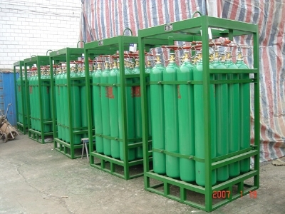
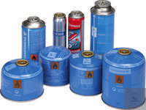
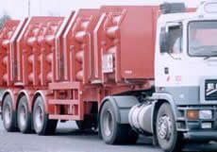
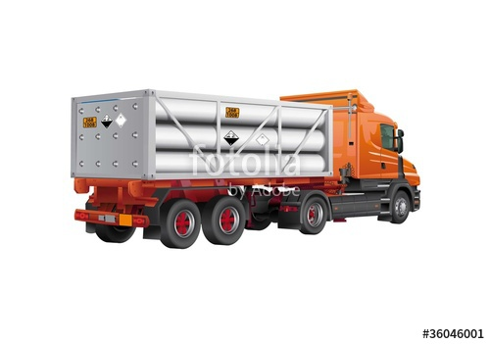
What is transportable pressure equipment?
Transportable Pressure Equipment | Dangerous goods
Pressure receptacles including gas cartridges Chapter 6.2 of ADR | Class 2 gases
 | Annex I of TPED
 | Hydrogen cyanide – Class 6.1
 | Hydrogen fluoride – Class 8
Tanks, battery vehicles/wagons, multiple-element gas containers Chapter 6.8 of ADR | Bromine pentafluoride – Class 5.1
 | Bromine trifluoride – Class 5.1
 | Hydrofluoric acid – Class 8
 | Iodine pentafluoride – Class 5.1

Slide 5
What is not covered by TPED?
Pressure equipment under the PED
Aerosols (UN No. 1950)
Open cryogenic receptacles
Gas cylinders for breathing apparatus
Fire extinguishers (UN No. 1044)
Specific TPE exempted under ADR

Slide 6
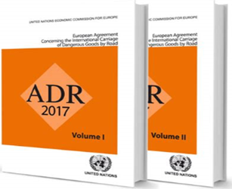
National Regulations
European Communities (Carriage of Dangerous Goods by Road and Use of Transportable Pressure Equipment) Regulations
2011 to 2018
Transportable Pressure Equipment
2010/35/EU
Inland Transport of Dangerous Goods
2008/68/EC
ADR - European Agreement Concerning the International
Carriage of Dangerous Goods by Road

Slide 7


ADR
European Agreement Concerning the International
Carriage of Dangerous Goods by Road
ADR
Geneva, 30 Sept 1957
European Agreement
United Nations Economic Commission for Europe
9 signatories
51 Contracting Parties
Ireland – 12 Oct 2006

Slide 8



Free movement of TPE within the EU
TPED
Economic operators
National Accreditation bodies
Notifying authorities
Notified bodies
Market surveillance authorities

Slide 9
Economic Operators
Economic Operators
Manufacturer
Authorised representative
Importer
Distributor
Owner
Operator

Slide 10
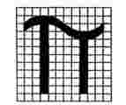
Notified Bodies
Notified Bodies
Conformity assessment
Periodic inspections
Intermediate inspections
Exceptional checks
Reassessment of conformity
Pi marking
Certificates and reports issued by a notified body are valid in all Member States.

Slide 11
Notification Procedure
Notified Bodies
Accreditation
Application for notification
Notification to EU Commission
NANDO
Notified Body Number
Established in a Member State
Designated by a Member State notifying authority
Valid in all Member States

Slide 12
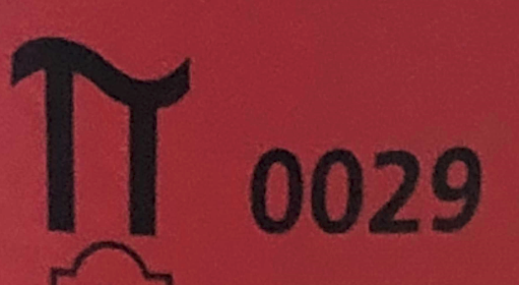
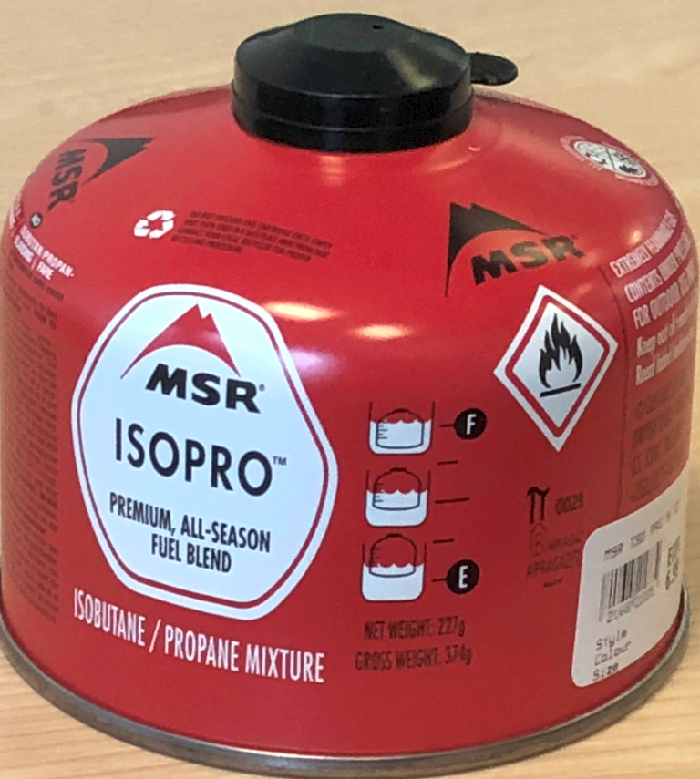
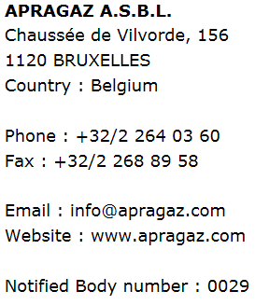
NANDO
New Approach Notified and Designated Organisations Information Systems
http://ec.europa.eu/growth/tools-databases/nando/
Pi mark
Notified body mark

Slide 13
What are the implications
of Brexit?

Slide 14
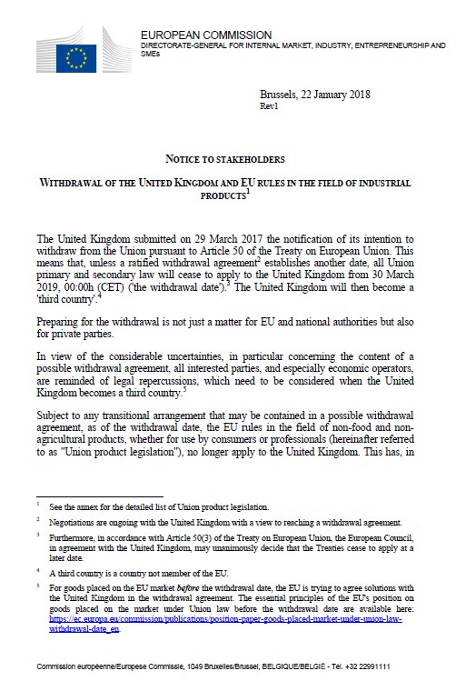
Notice to stakeholders 22 January 2018
Withdrawal of the United Kingdom and EU rules in the field of industrial products
Transportable Pressure Equipment
Pressure Equipment
Lifts and Safety Components for Lifts
Equipment for use in Explosive Atmospheres (ATEX)
Machinery
Gas Appliance Regulation
PPE Regulation

Slide 15
Withdrawal of the United Kingdom and EU rules in the field of industrial products
22 January 2018
https://www.hsa.ie/eng/Topics/Brexit/Market_Surveillance_-_Industrial_and_Consumer_Products/
Consequences for goods placed on the market after withdrawal:
        Identification of economic operators
  Conformity assessment procedures and notified bodies

Slide 16
Economic Operators
Economic Operators
Manufacturer
Authorised representative
Importer
Distributor
‘placing on the market’ – the first making available of TPE on the Union market
‘making available on the market’ – any supply of TPE for distribution or use on the Union market in the course of a commercial public service activity, whether in return for payment or free of charge

Slide 17
Obligations of Economic Operators
Before placing TPE on the market, the importer needs to ensure:
manufacturer - done appropriate conformity assessment procedure and drawn up the technical documentation;
Pi (π) marked;
certificate of conformity (name and address of the importer).
Before making TPE available on the market, the distributor needs to ensure:
Pi (π) marked;
certificate of conformity (contact address for the importer).

Slide 18

Impact of Brexit on UK Notified Bodies (NBs)
Withdrawal of the United Kingdom and EU rules in the field of industrial products
Lose status as EU NBs - removed from NANDO
Unable to do:
        Conformity assessments
        Inspections (intermediate, periodic, exceptional)
        Reassessments of conformity
Advice re: placing on the market after withdrawal date:
    Certificate from EU-27 NB
    Certificates from UK NB prior to withdrawal
          Apply for new certificate from EU-27 NB
          Transfer based on contractual arrangement - manufacturer, UK NB and EU-27 NB

Slide 19
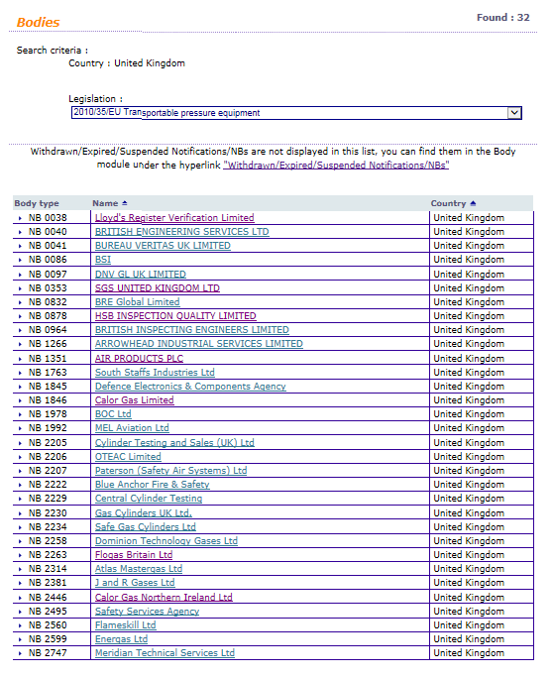
UK Notified Bodies for TPED

Slide 20
What does this mean for you – ‘no deal’ scenario?
Do you use transportable pressure equipment?
Does TPED apply? (π mark)
What is your role as an economic operator?
Are you currently a distributor for UK transportable pressure equipment?
Will you become an importer after Brexit?
If you are an owner or operator under TPED, where is the notified body based? (NANDO)
If the notified body is UK based, what does that mean for you?

Slide 21
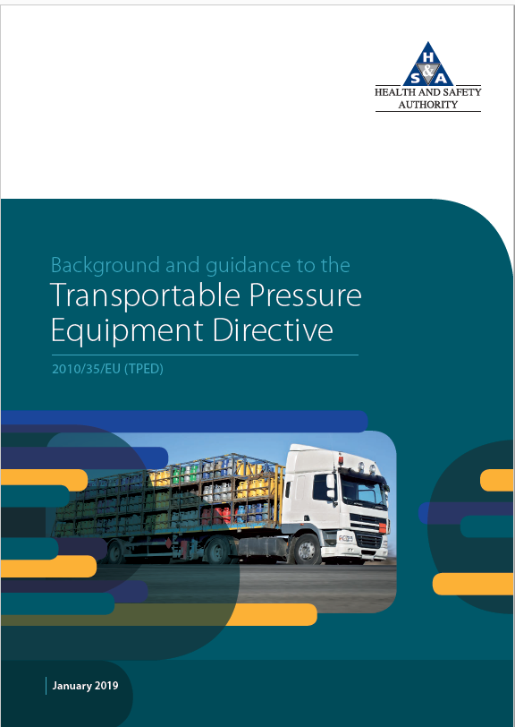
Further Information
www.hsa.ie

Slide 22
Thank you

Slide 23
Brexit and the Implications on Supply and Use of Chemicals, Machinery & Products
February 28th 2019

Slide 24
Brexit and the implications for the supply and use of machinery and products, Alan Costelloe, HSA

Slide 25
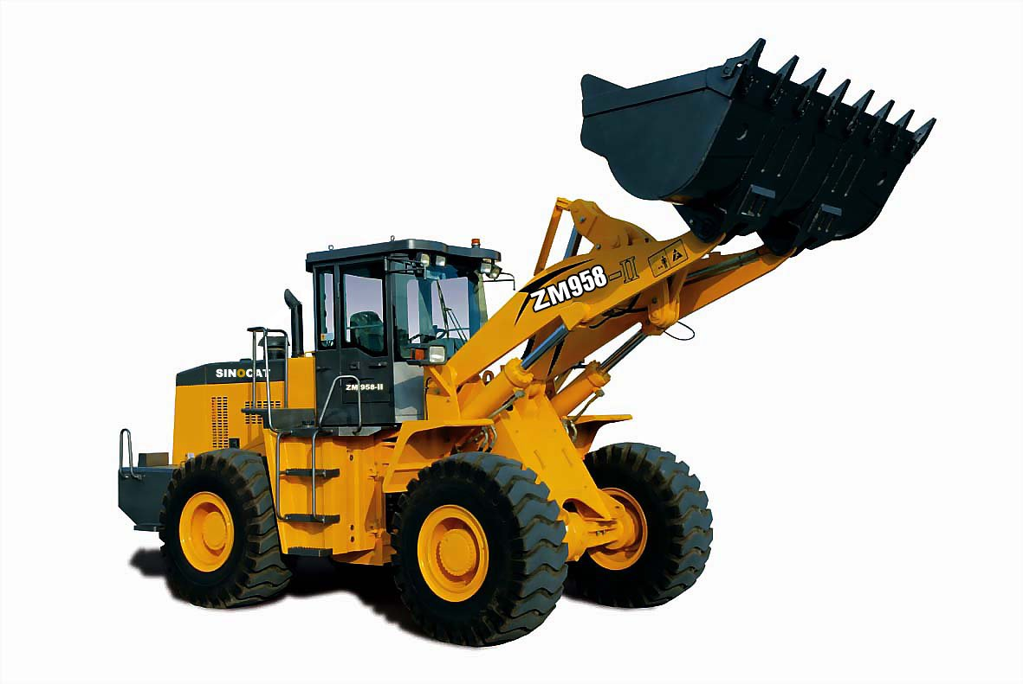
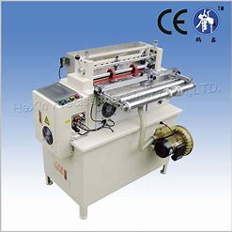
Ireland UK Trade
2017
Ireland imports worth £ 34 B from UK
Ireland exports worth £22 B to UK
Ireland was UK’ s 5th largest export market and 9th largest source of imports.
Over 3 Billion € - Machinery & transport equip imported 2015 to Ireland from UK (CSO)

Slide 26
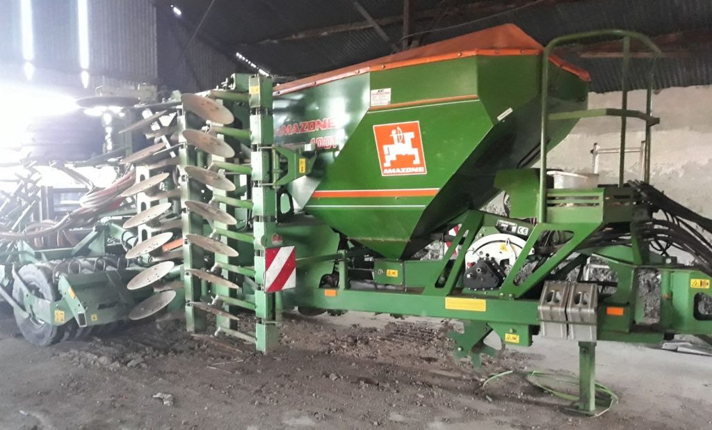

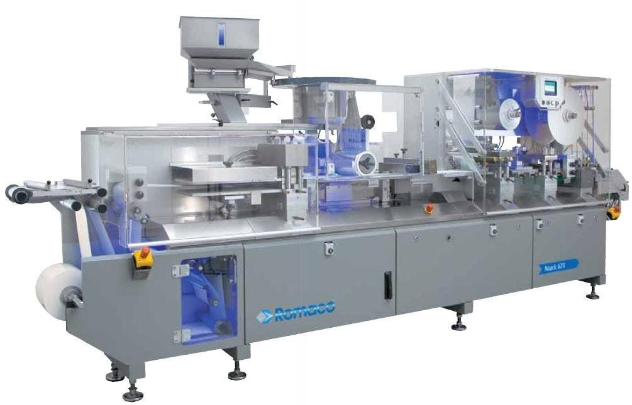
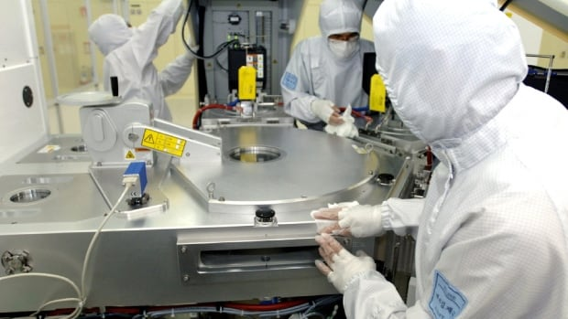
Imports

Slide 27
Requirements of the EU Market
Single Market
Free Movement of Goods
Safe Products for all users
Fair Competition
Ensured by EU Directives and Legislation

Slide 28
HSA – Role as a regulator
The HSA is currently the competent national body responsible for regulation of machinery and machinery products in Ireland.
Its role involves ensuring that machinery and certain products coming on the market are to the required safety standards and comply with the relevant EU law and directives.
The HSA carries out inspections and monitors machinery and products on the market and in the workplace to ensure compliance with the law.

Slide 29
EU Legislation on Machinery and Machinery Products
Machinery Directive
Lifts Directive,
PPE Directive,
ATEX,
Gas Appliances Directive (GAD)
Low Voltage Directive (CCPC)
Directives are aligned in Irish law by Health and Safety Regulations
Market Surveillance Guidance – Blue Guide (C272)

Slide 30
Scope of Machinery
‘MACHINERY’ defined as:
‘an assembly, fitted with or intended to be fitted with a drive system other than directly applied human or animal effort, consisting of linked parts or components, at least one of which moves, and which are joined together for a specific application….’
Machinery Directive includes:
Interchangeable equipment
Safety components
Lifting accessories such as chains, ropes, hooks, slings, and webbing.
Removable mechanical transmission device [Power Take Off - PTO]
Partly completed machinery

Slide 31
Examples
Lathes, Drills,
Manufacturing machines and equipment,
Agricultural machinery, Combine harvesters
Forklift trucks
Escalators
Baling machines,
Meat mincing machines
Construction machinery, eg Diggers, Bulldozers, Teleporters, Dump Trucks,
Equipment and parts
Exclusions – Ag and Forestry tractors, Weapons, Fairground equip, items that are covered by other Directives.

Slide 32
Annex IV Machines
Annex IV machines are considered high risk machines. The safety tests and requirements on these machines are particularly stringent and mandatory before these machines can be placed on the EU market. Some examples:-
Circular saws
Hand fed planning machinery
Band saws
Vehicle Lifts
Chain saws,
Press machines
Roll over protection structures
Devices for lifting persons involving a hazard of falling more than 3 meters

Slide 33
Harmonised Standards
When a product is manufactured it must be designed and built to the required standards, which include stringent safety requirements.
Standards are drafted and approved by the Standards committees, once reviewed and approved by expert groups and ratified by the Directive Working Groups in the EU. They then become harmonised standards.
Harmonised standards are a result of many months of collaboration and discussion by expert groups.
If a product is manufactured and built to a harmonised standards there is a presumption of conformity to the Directives.

Slide 34

CE Marking and Compliance
The “CE” symbol is required on machinery sold in the European Economic Area. The symbol is an indication that the machine is in compliance with the relevant directive.
The manufacturer, the authorised representative who places on the market or puts into service such product is responsible for the compliance and conformity assessment of that product.
Placing on the market means making a product available for the first time in the Community.

Slide 35
What is an Economic Operator
An economic operator means a manufacturer, authorised representative, importer or distributor.
A manufacturer is the person who manufactures the product or has the product designed and manufactured, and markets that product under their trade name.
An importer is a person established within the European Economic Area (EEA) who first places a product from a third country on the market of the EEA.
A distributor (Wholesaler) is any person in the supply chain, other than the manufacturer or importer who makes a product available on the market.
An authorised representative is a person established in the EEA who has received a written mandate from a manufacturer to act on their behalf on specific tasks.

Slide 36
Duty on Manufacturer (Art 5 MD)
Before placing machinery on the market and/or putting it into service, the manufacturer or the authorised representative SHALL
Ensure it satisfies the relevant essential health and safety requirements set out in Annex 1
Ensure that the technical file referred to in Annex VII, is compiled and available,
Provide, instructions and other information as required,
Carry out appropriate procedures for assessing conformity in line with Article 12, ie assess whether it is an Annex IV machine
Draw up the EC Declaration of conformity as per Annex II,
Affix the EC marking in accordance with Article 16.

Slide 37
Duty on Importer
Ensure that the manufacturer has carried out the steps above .
Must put their own name and contact details on the product. This is in addition to the manufacturers markings.
Notify the Authority of any risks or non-compliances with the product if they become aware of any.
Keep a register of complaints.
Keep distributors informed.
Keep copies of Declarations of Conformity (DOC) and technical documentation for 10 years.
Withdraw or recall unsafe or non-compliant products as appropriate.

Slide 38
Duty on Distributor / Wholesaler
Ensure the product bears the CE Mark.
Ensure that the product is accompanied by the required documents and instructions.
Ensure manufacturer and importer markings are on the product.
Notify the Authority of any risks or non-compliances with the product if they become aware of any.
Keep copies of DOCs and technical documentation for 10 years.
Must not supply products that they know are not in compliance with the legislation.

Slide 39
ANNEX IV MACHINES
If manufactured in accordance with harmonised standard
Carry out an assessment of conformity as set out in Annex VIII,
(the product must be manufactured fully in accordance with transposed harmonised standards that cover all relevant EHSRs for the product), or,
The EC Type Examination procedure Annex IX (Notified Body Required), or
The procedure for full quality assurance Annex X (Notified Body assesses & monitors quality assurance system )
If no harmonised standard then additional requirements
The EC Type Examination procedure Annex IX and Point 3 Annex VIII (Notified Body to ascertains & certify compliance) , or
The procedure for full quality assurance Annex X (Notified Body assesses & monitors quality assurance system).

Slide 40
General Duties
Importing from UK Now
Wholesaler is a distributor within the European Economic Area - EEA
Manufacturer or Importer in UK bears most of the obligations
Wholesaler / Distributor may be entitled to rely on the “presumption of conformity” that is afforded by correct CE marking and the provision to the end user of the Declaration of Conformity
Not necessary to check the whole design of the machine against the essential health and safety requirements of Directive before supplying (once technical file is located with the Community)
You can pass machinery on in the same package, accompanied by an appropriate DOC and Instruction Manual to other distributors.

Slide 41
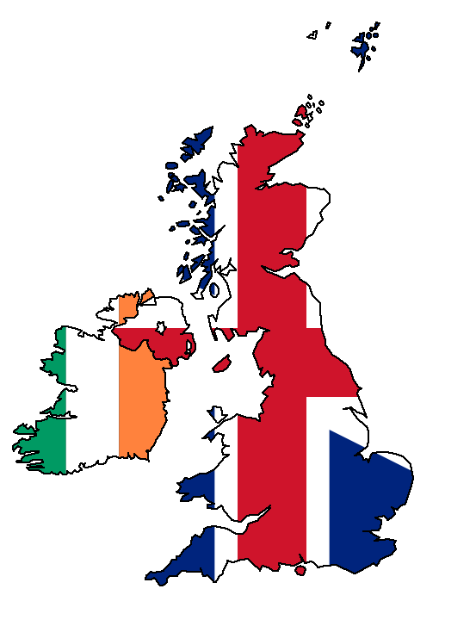
Duties
Importer / Wholesaler Importing from UK After Brexit
In the event of a Hard Brexit, the UK will
become a 3rd Country (like USA, China). The following will apply:
A distributor / wholesaler of machinery originating from the UK now becomes the Importer.
Irish Importer / Wholesaler, now must ensure that the full conformity assessment has been carried out by the manufacturer.
Irish Importer / Wholesaler needs full access to the complete technical file for the product showing how design and construction meets all EHSRs.
Person responsible (manufacturer) for the product must draw up and sign an “EC Declaration of Conformity” stating products are in compliance.

Slide 42
Notified Bodies
Notified Bodies are conformity assessment bodies which have been officially designated by their national authority to carry out the procedures for conformity.
Notified Bodies are required for testing and certification under various Directives, particularly, Machinery Directive, Lifts Directive, Pressure Equipment Directive and others.

Slide 43
Notified Bodies after Brexit
After Brexit UK Notified Bodies will NOT be authorised to carry out the function stated.
Importer must ensure the machine or product when placed on the market after Brexit (where required) is certified by an EU Notified Body.
Notified Bodies must have a legal presence in an EU country.
Notified Bodies must be independent of the Client.
There are currently 14 NB registered for Machinery Directive in the UK.
NANDO web site lists all EU approved notified bodies for various Directives,
Notified Bodies are approved for specific Directives or part of a Directive.
Following a Hard Brexit UK notified bodies will be removed from NANDO.

Slide 44
Notified Bodies Extract from EU Guidance (1st Feb 2019)
Where economic operators hold certificates issued by a UK Notified Body prior to the withdrawal date and plan to continue placing the product concerned on the EU-27 market as from the withdrawal date, they are advised to consider either applying for a new certificate issued by an EU- Notified Body, or
arranging for a transfer – of the file and the corresponding certificate from the UK Notified Body to an EU- Notified Body, which would then take over the responsibility for that certificate.
This responsibility depends on the specific conformity assessment procedure required for the product concerned under the applicable product legislation.

Slide 45
ARE YOU BREXIT READY ?
To prepare you should carry out the following steps:
Analyse your business and carry out a Brexit Risk Assessment taking the following questions into account:
Do you obtain your machinery and equipment from a UK manufacturer,
Does your supply chain come from a 3rd country but placed on the market firstly in the UK,
Do you need to source a new EU supplier,
Do you use a UK Notified Body for compliance,
Can you source an EU Notified Body after Brexit
Are you aware of you responsibilities as an Importer from a 3rd country,
Are you competent to carry out your duties,
If exporting to the UK, are you aware of UK requirements after Brexit.

Slide 46
IRISH NATIONAL ACCREDITATION BOARD

Slide 47
Irish National Accreditation Board
For most product directives, the Irish Authorities have deemed that accreditation by the national accreditation body is mandatory.
In Ireland, accreditation is provided by the Irish National Accreditation Board, INAB – part of the Health and Safety Authority
INAB carry out the accreditation process for Notified Bodies in Ireland.
Notified Bodies in UK are relocating to other Member States
Manufacturers can select the services of any Notified Body based in EU27
Tradition of relying on Notified Bodies in the UK
Some re-establishing in Ireland (as new entities), a number of applications have been submitted to INAB in recent months.

Slide 48
Notified Bodies Accreditation
INAB has accredited or is in the processing of accrediting Irish Notified Bodies for:
  Machinery (MD)
  Personal Protective Equipment (PPE)
  Construction products (CPR)
  Transportable Pressure Equipment (TPED)
  Pressure Equipment (PED)
  Radio equipment (RED)
  Electromagnetic capability (EMC)
  Marine Equipment (MED)

Slide 49
FURTHER INFORMATION
Should you require further information on applicability of the Directives and your responsibility after Brexit please go to our web site at
www.hsa.ie
or contact our Workplace Contact Unit at 1890289389, email wcu@hsa.ie
INAB – further information go to www.inab.ie
Nando http://ec.europa.eu/growth/tools-databases/nando/

Slide 50
Thank you

Slide 51
Brexit and the Implications on Supply and Use of Chemicals, Machinery & Products
February 28th 2019

Slide 52
Questions and Answers
Session 2

Slide 53
Closing remarks

Slide 54
Brexit and the Implications on Supply and Use of Chemicals, Machinery & Products
February 28th 2019

