Slide 1
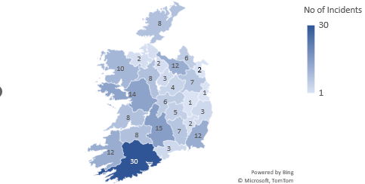
Farming Fatalities 2013 - 2022 Total Fatalities: 191
Gender
County
Male
Female
180
181
10
10
Trigger
Age Group
Employment Status
128
Self Employed
25
Non Worker
23
Family Worker
13
Employee
2
Trainee

Slide 2
Farming Fatalities 2013 – 2022 Total Fatalities: 191

Slide 3
Farming Fatalities 2013 – 2022 Vehicle Fatalities: 86

Slide 4
Farming Fatalities 2013 – 2022 Livestock Fatalities: 34

Slide 5
Farming Fatalities 2013 – 2022 Falls Fatalities: 22

Slide 6
Farming Fatalities 2013 – 2022 Machinery Fatalities: 14

Slide 7
Farming Fatalities 2013 – 2022 Heavy Load Fatalities: 14

Slide 8
Farming Fatalities 2013 – 2022 Drowning Fatalities: 12

Slide 9
Farming Fatalities 2013 – 2022 Over 65 years: 90

Slide 10
Farming Fatalities 2013 – 2022 Children / Young Person: 21

Slide 11
Farming Fatalities 2013 – 2022 Involving Construction work on Farms: 13

Slide 12
Farming Fatalities 2013 – 2022 Total Fatalities by Age Group: 191

Slide 13
Fatalities per Month on Farms 2013 - 2022

