Slide 1

Chemical Agents Risk Assessment:
a practical side
Michelle McDermott
Notes:
.

Slide 2


Chemical Agent Risk Assessment

Slide 3

CHEMICALS- Identification
READ the label

Slide 4
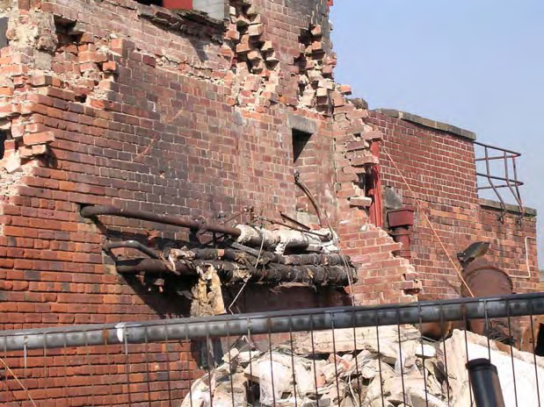
BUT …. Not all chemicals have labels

Slide 5





Slide 6

Are sensitive risk
groups included ?
e.g. children in creche
E.g. pregnant employees
Notes:
Household chemicals - Probably not an issue in most workplaces but if you work in childcare ……..

Slide 7
Compliance
www.irishstatutebook.ie
Safety, Health and Welfare at Work, (Chemical Agents) Regulations 2001
Safety, Health and Welfare at Work, (Chemical Agents) (Amendment)Regulations 2015
Only the courts can interpret statutory legislation with any authority

Slide 8



Hazardous Properties
e.g. H2O
Notes:
Form of chemical - SOLID. LIQUID, GAS
Quantity
Location
Activity

Slide 9

Information
Examples Include ?
  Asbestos Survey
  Incidents
  Equipment Manuals
  Maintenance Requirements
  Regulatory Websites
  Safety Alerts
  Noise Survey
  Etc….
Notes:
+ as may reasonably be required to complete the risk assessment
Regulation 4 (1)(b)
Old legislation

Slide 10
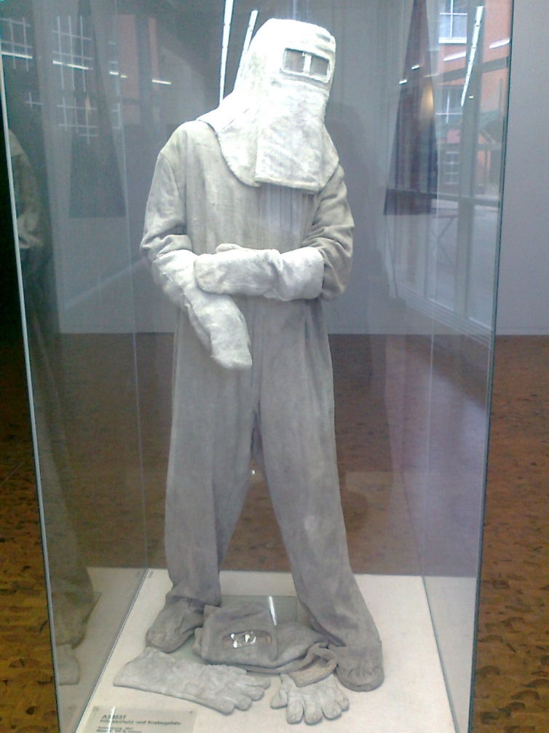

Level, Type & Duration of Exposure

Slide 11

+ Dermal Exposure– “Sk”

Slide 12

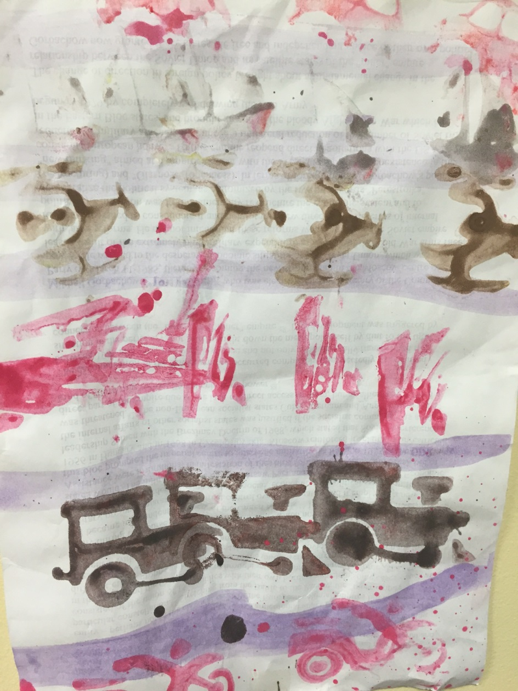

Circumstances of work

Slide 13
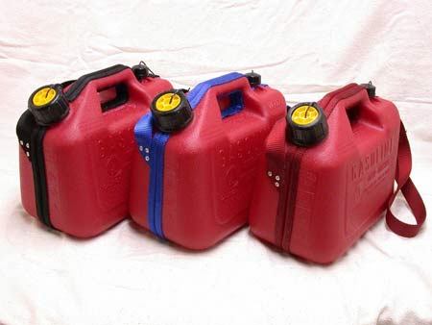
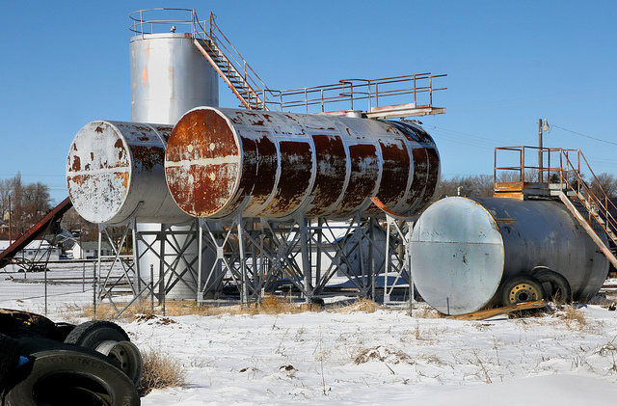
Quantities- use & stored

Slide 14

OEL, BLV
Examples from Monitoring reports
“total inhalable dust ….7.3mg/m3….the results are within the limits.. no risk to employees…”
BUT Wood dust limit is 5mg/m3
&
“We used the standard NIOSH method 12345 modified with PVA filters ….”
Occupational_Hygiene_Report_Writing_Information_Sheet
Difference between Environmental Monitoring and Occupational Hygiene Monitoring
Combined and Sequential Exposure

Slide 15

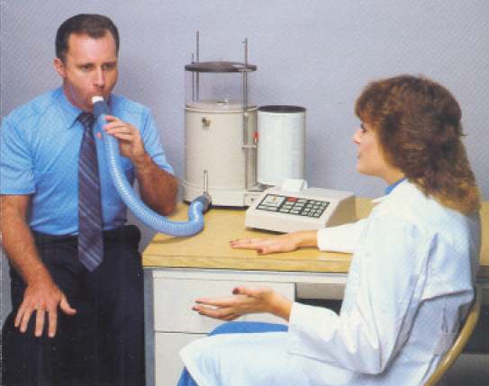
Controls & Surveillance
Notes:
- / + Preventive Measures

Slide 16
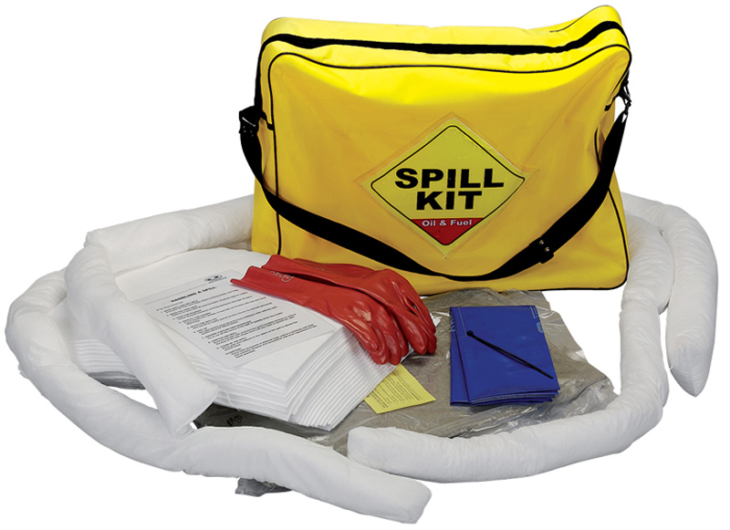
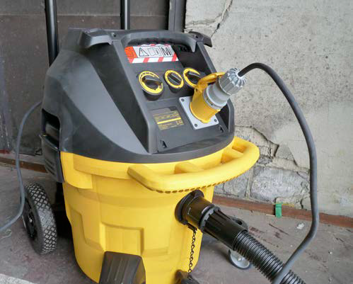
Maintenance and Accidental Release

Slide 17
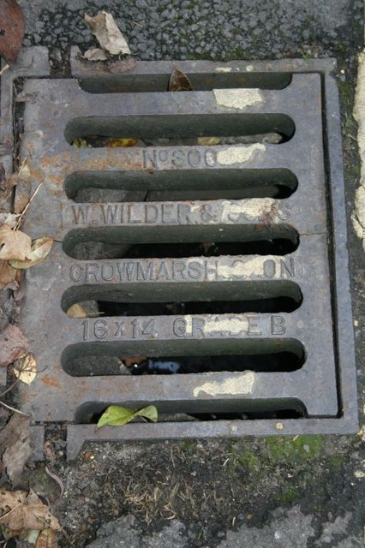
Storage
Transport

Slide 18


Slide 19



Slide 20



Slide 21

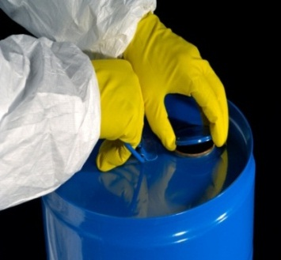
Assess the exposure
WHAT IS THE EXPOSURE?
WHO uses the chemical?
HOW is the chemical used?
HOW will user be exposed?
Can NON-USERS be exposed?
HOW MUCH is used?
HOW LONG is user exposed to chemical?
HOW OFTEN is chemical used?
Consider:

Slide 22
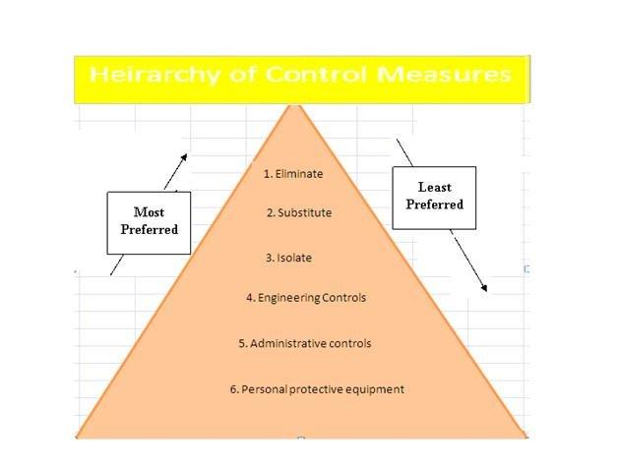


Slide 23
Risk Assessment
Risk Assessment
SDS & Label & Other
Environment
Controls
Process ?
CHECK
LEV ?
PPE ?
Process / Task
Training
Maintenance
Monitoring – audit, air, HS
Who & How?
Notes:
Please find below a links to Sampling Strategy Guidance together with some statistics software.
The BOHS/NVvA (Dutch occupational hygiene society) published in 2011 'Testing Compliance with OELs for Airborne Substances' guidance on sampling strategy, downloadable from http://www.bohs.org/library/technical-publications/
AIHA software New IHSTAT with Multi-Languages from http://www.aiha.org/insideaiha/volunteergroups/EASC/Pages/EASCTopics.aspx . It is necessary to “enable macros” to make this work.
HSG173, Monitoring strategies for toxic substances is available from www.hse.gov.uk

Slide 24
Can you combine with other documents ?
Cleaning Regime?
SOP?
NOP?
Method Statement ?
Quality Procedure?
Laboratory Protocol?

Slide 25
HAZARD | WHO | RISK (Severity and Likelihood) | CONTROLS IN PLACE | FURTHER ACTION | PRIORITY | ACTION DATE | ACTION BY
Example Pouring Sodium Hydroxide Solution from bulk tank | 3 process employee | Splashing – skin/eye burns (very likely & extreme harm) Unacceptable Risk | PPE only Face shield gloves | Consider eliminating pouring. Restructure process | 1 | Immediate | MD

Slide 26
HAZARD | WHO | RISK (Severity and Likelihood) | CONTROLS IN PLACE | FURTHER ACTION | PRIORITY | ACTION DATE | ACTION BY
Example Pouring Sodium Hydroxide Solution from bulk tank | 3 process employee | Splashing – skin/eye burns (very likely & extreme harm) Unacceptable Risk | PPE only Face shield gloves | Consider eliminating pouring. Restructure process | 1 | Immediate | MD
Area is restricted to those trained in the processes carried out in the Darkroom.
Only items used for the processing of screens to be kept in this area.
No food or drink to be consumed in this area.

Slide 27
HACCP
Hazard Analysis & Critical Control Point
          food safety management system
          identify and control any hazards that could pose a danger to the preparation of safe food.
          It involves identifying what can go wrong, planning to prevent it and making sure you are doing it.
A big folder on a shelf is not a food safety management system! https://www.fsai.ie/food_businesses/haccp/haccp.html
Are you using chemicals as part of your controls?
Can your chemical agents risk assessment be included?

Slide 28
Formulation XYZ Risk Assessment
Add 50l water to Tank A
Weigh and add 50kg powder to tank |  | Wear dust mask, wear goggles, wear gloves
Close lid and turn on mixer |  | No PPE required
Add 5L of solvent directly to tank |  | Wear half face mask and safety glasses
Weigh and add 34kg powder to tank |  | Wear dust mask, goggles and wear gloves
Mix and slowly add 10l of solvent to tank |  | Wear half face mask, eye protection, gloves
Is this compliant ? ? ? ? ?

Slide 29
Hazard information
Powder contains silica - Exposure to silica dust during weighing , addition to tank and sweeping – can cause silicosis Solvent vapours can cause headaches, dizziness, and defatting of skin Process takes approximately 1 hour and is carried out 6 times per day There is 1 hour clean up at end of shift – dry sweeping of dust, rinsing of tank using solvent containing benzene which causes cancer Manual handling of powder and solvent drums There is an annual maintenance and clean of the tank In event of malfunction contact Service Technician immediately.

Slide 30
Controls
Wear powered respirator with A2P3 filter Wear nitrile rubber gloves to EN374, 1 mm thick. Dispose of after each cycle. The powder is delivered to weighing location by pallet truck. The solvent is piped directly to area beside tank. Powder to be weighed in 10kg batches. In event of spill, continue wearing PPE and use spill material located in area and dispose of waste in chemical shed containers Health surveillance provided– all staff trained on skin checks and lung function questionnaire once per year with follow up as required

Slide 31
Risk Reduction Plan
Correct RPE and training – immediately Eliminate Dry sweeping Investigate elimination of weighing and measuring– can powder be purchased in preweighed bags or automatic dispensing of powder or liquid? Local exhaust ventilation to be investigated Consider monitoring as part of above project – see Code of Practice for Chemical Agents. Alternative methods for cleaning to be investigated | New RPE to be purchased and personnel trained - A. N. Other Vacuum with HEPA filter to be purchased by 13 November 2015- A. N. Other - 5 Project for A Baker (advice of a competent occupational hygienist to be sought) Initial report due by 13 December 2015

Slide 32
Risk Reduction Plan
Eliminate Dry sweeping Investigate elimination of weighing and measuring– can powder be purchased in preweighed bags or automatic dispensing of powder or liquid? Local exhaust ventilation to be investigated - Responsibility of A Baker by 13 December 2015 (advice of a competent occupational hygienist to be sought) Consider monitoring as part of above project – see Code of Practice for Chemical Agents. Alternative methods for cleaning to be investigated | New RPE purchased and personnel trained - A. N. Other - COMPLETE- Vacuum with HEPA filter to be purchased by 13 November 2015- COMPLETE- risk assessment of use and emptying and training carried out – Documented in Clean up SOP & 4 & 5 - Project for A Baker Initial report due by 13 December 2015 Initial report indicates: preweighed bags - cost €X, Automatic dispensing of powder - cost by €Y Bulk purchase of solvents and a solvent line with in line metering will cost €Z Possible elimination of RPE so reduction in fit test costs, cost of filters and health surveillance Alternative cleaning method identified with no benzene – See Carcinogens Regulations, Cost neutral as increased cost of new method off set against reduced disposal (waste is non-hazardous)

Slide 33
Life Cycle Risk Assessment
Emergency & Interaction
Ordering
Delivery
Storage
Transport
Use
Disposal

Slide 34
Life cycle risk assessment
Ordering- Consider legislation that may impact supply and use e.g. REACH, active substances, C& L Notification obligations apply regardless of quantity and Get Safety Data Sheet first
Delivery e.g. ADR, Manual Handling, TREM cards
Storage e.g. ATEX, compatibles
Transport e.g. manual handling
Use – what, where, when, who, how etc.
Emergency e.g. First Aid, leak, multiple spills down drains etc.
Disposal e.g. EPA, Local Authority requirements

Slide 35
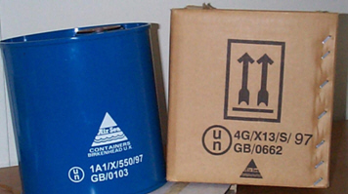
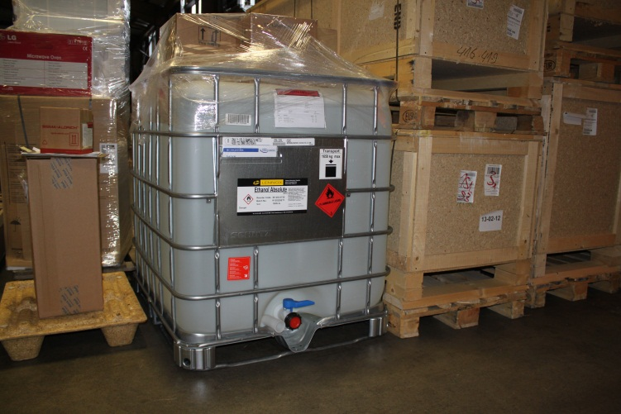
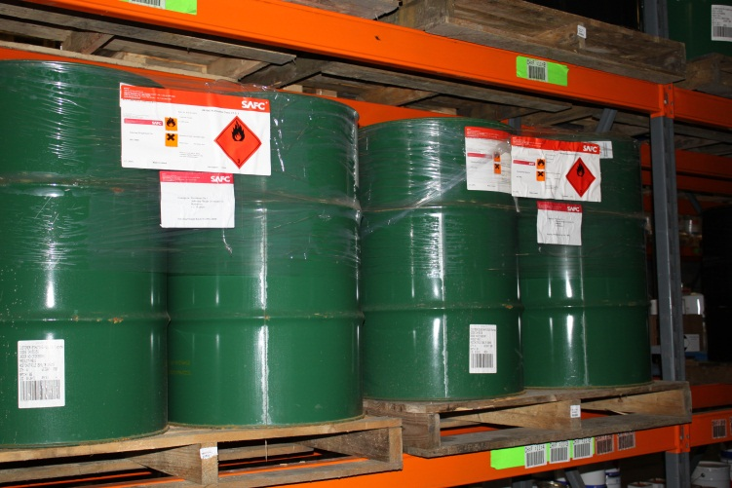
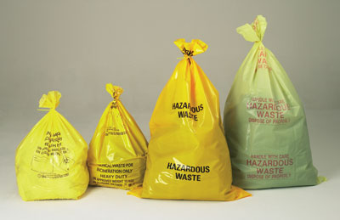
Packaging
DGs may only be carried in appropriate packaging – generally
“UN” approved.

Slide 36
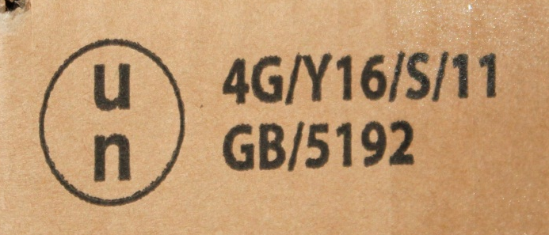
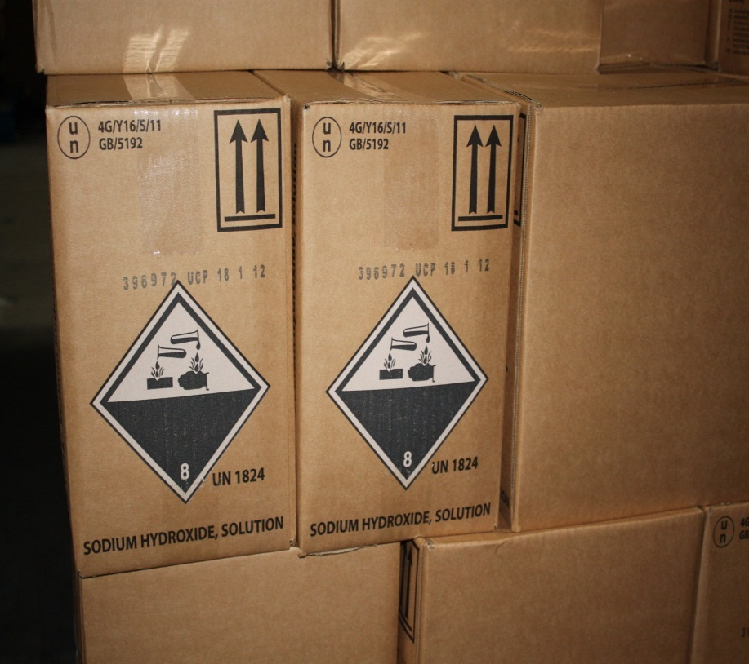
UN Package Testing and Marking
UN mark identifies packaging as tested and approved
Code provides further important information, e.g.
4G - type of package
Y - packing group suitability
S – packaging intended for solids or inner packagings

Slide 37
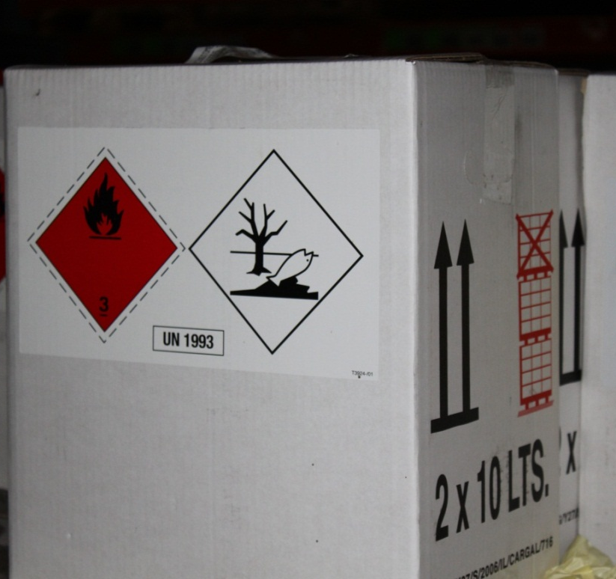
Labelling/Additional Marking
Provides immediate
warning to all (e.g. handlers/
users/emergency services)
Packaging must be labelled with
Hazard class label(s) (min 100mm)
UN number
additional marks as necessary

Slide 38


CLP Article 33
Classified for transport and supply
Outer & Inner packaging
Product identifier
Signal word
Hazard statements
Precautionary statements
Contact details
Product identifier
Signal word
Hazard statements
Precautionary statements
Contact details

Slide 39
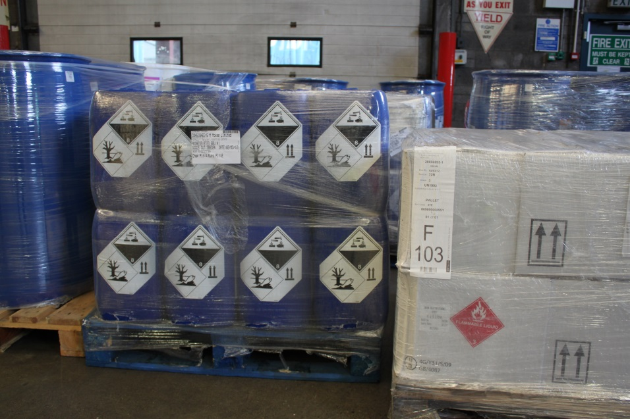
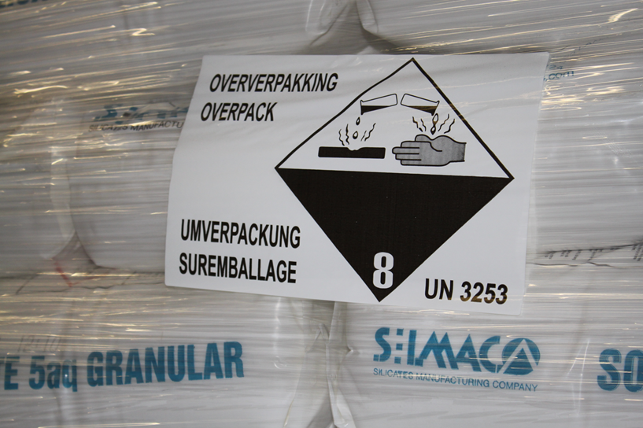
Overpacks

Slide 40
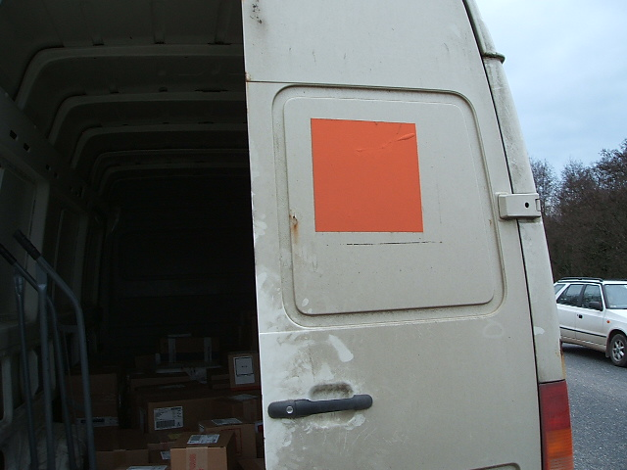
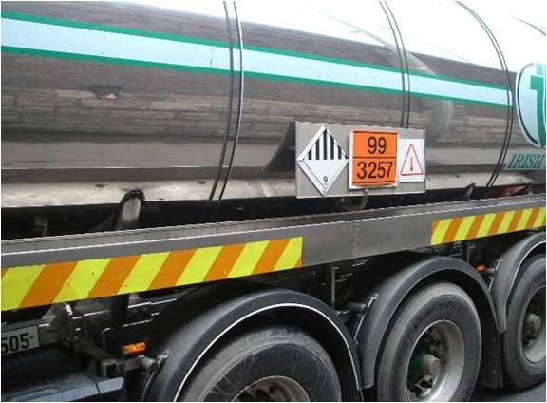
Vehicle/tank marking and placarding

Slide 41
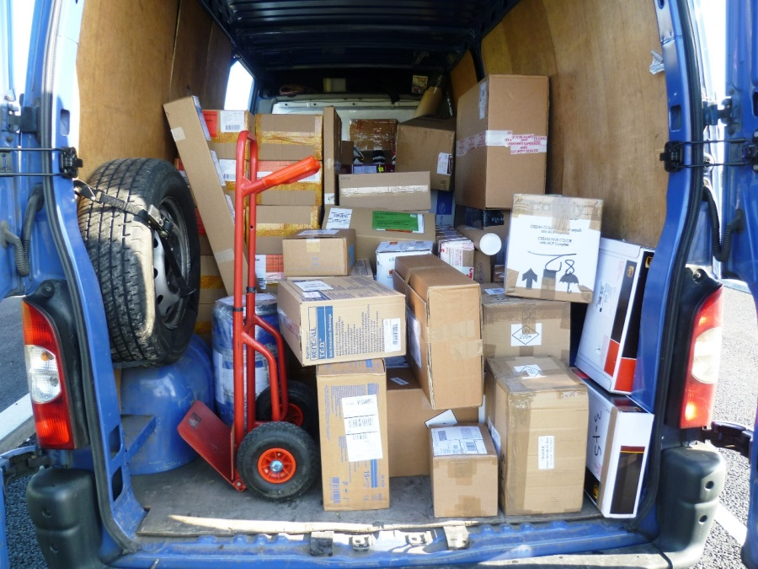

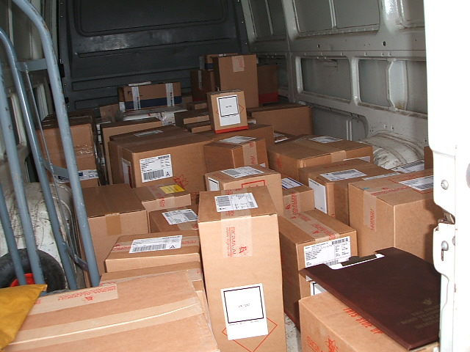
Load security still applies !

Slide 42
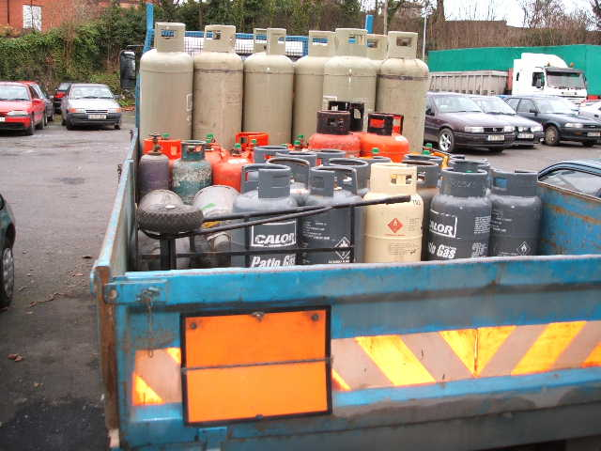
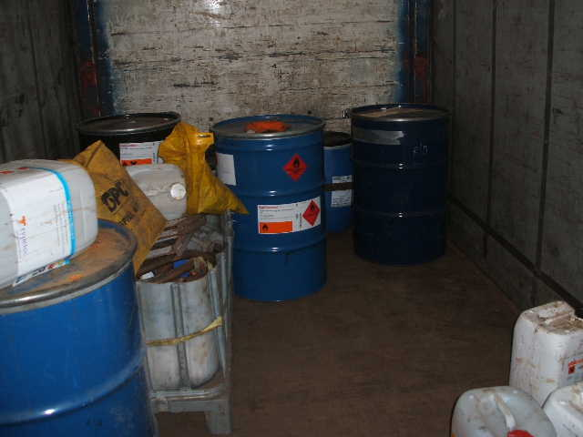
Load security
    Guidelines:
    EU Best Practice for Cargo Securing
    IRU international guidelines for safe load securing

Slide 43
Dangerous waste
Chemical waste
Batteries
Clinical waste
Aerosols
Asbestos

Slide 44
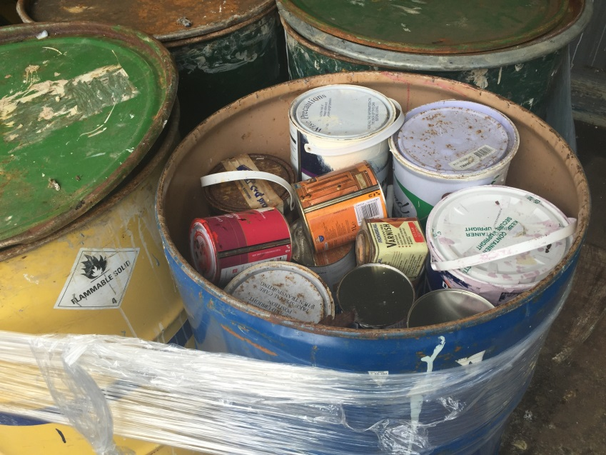
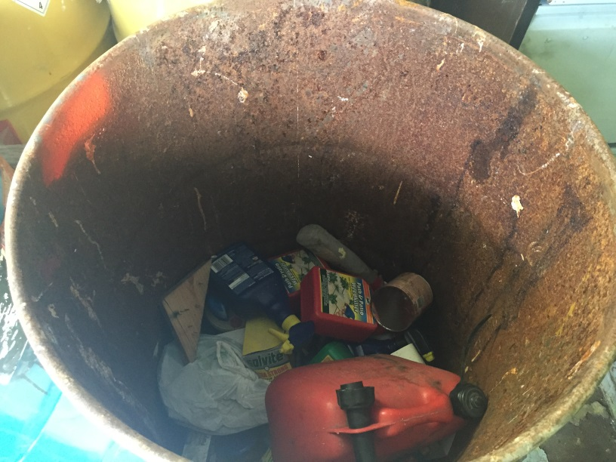
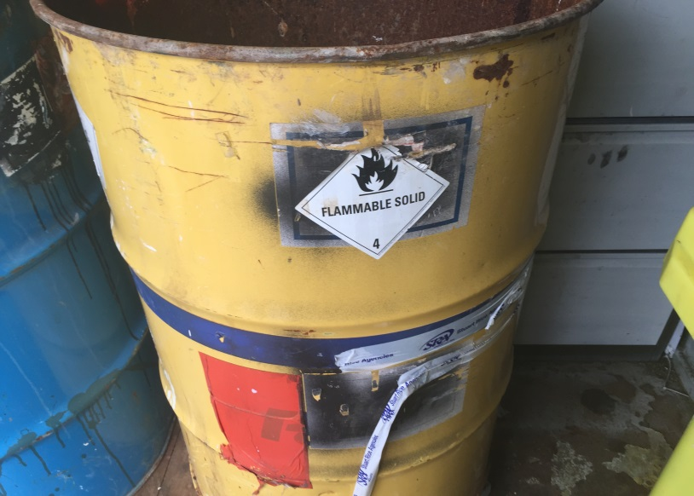
Waste chemicals – public amenity site

Slide 45
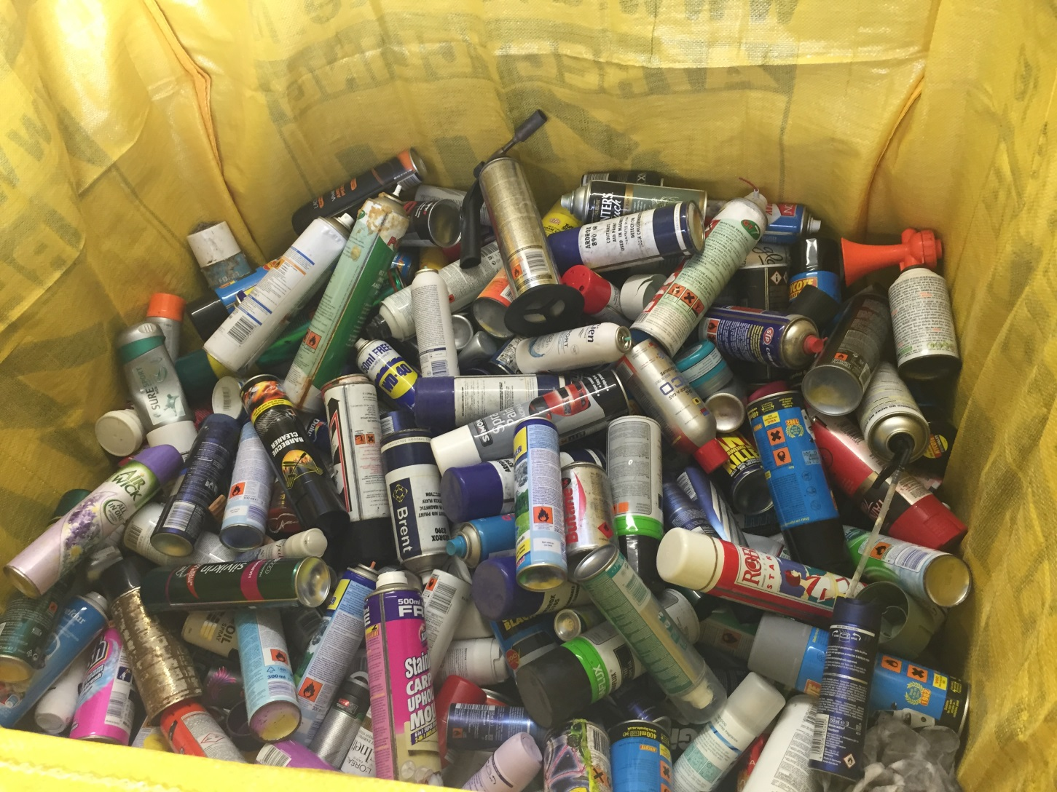
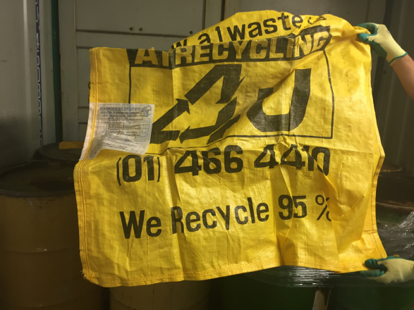
Waste Aerosols – SP 327, P207?

Slide 46
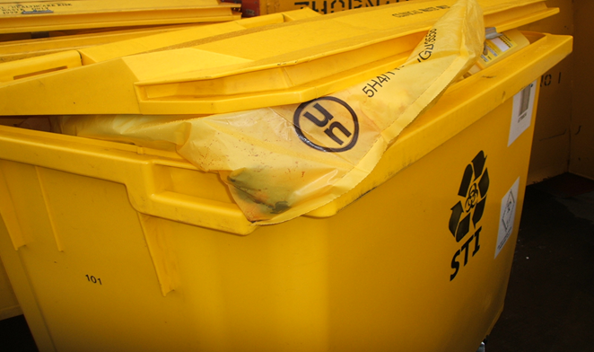
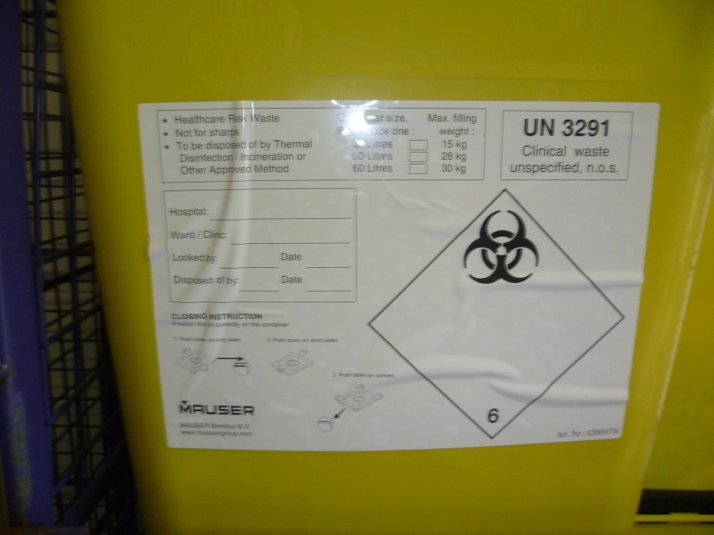
Clinical waste

Slide 47
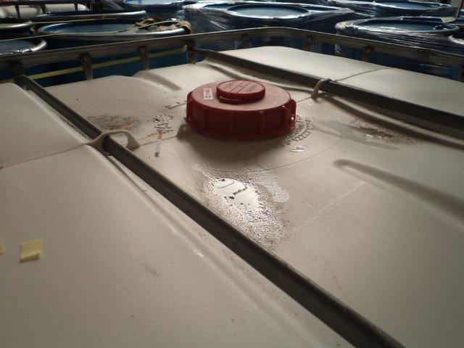
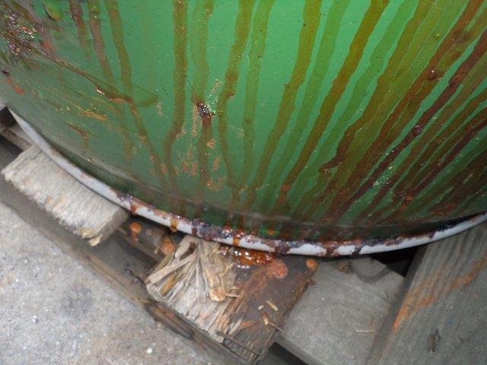
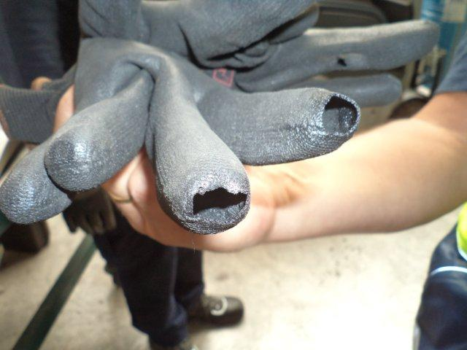
Chemical waste

Slide 48
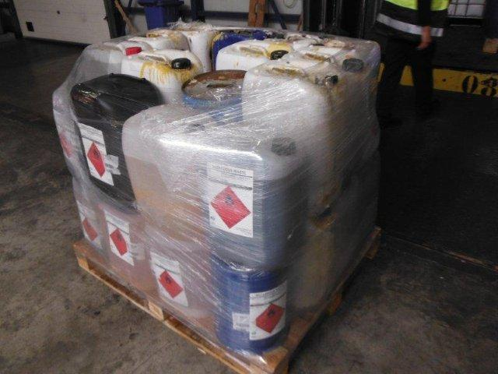
Overpacks for hazardous waste

Slide 49


