Slide 1


Slide 2

Understanding hazard communication
in the workplace
Caroline Walsh
Notes:
CLP 2015, SME support for REACH 2018, making guidance on mixture classiﬁcation easier to navigate and understand, alignment of 5 Directives with CLP, REACH processes including authorisation and much more.

Slide 3
Content
Chemical Safety
Classification
Labelling
Packaging
Information sources

Slide 4
Chemical Safety
Hazard Identification
Hazard Classification
Hazard Communication
Risk Assessment
Risk Management
Chemical safety

Slide 5

Hazard Communication

Slide 6

Hazard Classification

Slide 7




Physical Hazards
Substance or Mixture meeting hazard criteria in parts 2 of Annex I
Physical hazards:
Gather all relevant and reliable information
16 classes: Explosive, Flammable gases, Aerosols, Oxidising liquids , Oxidising solids, Gases under Pressure, Flammable Liquids, Flammable solids, Self reactive, pyrophoric liquids, pyrophoric solids, self-heating, organic peroxides, corrosive to metals
Notes:
Visual changes:
Orange squares to white diamonds with red border
Physical hazards new endpoints – gases under pressure (explosive, flammable, oxidising)
Changes in eg boiling point
5 hazard classes under Dir 67/548/EEC:
16 hazard classes under CLP Regulation in linw with ADR transport regulation:
Located in Part 2 of annex I
Hazard classes are divided in categories or groups or divisionsMaintains the current level of protection by including EU “left-overs” not yet covered by the GHS for example EUH001 “Explosive when dry” and EUH044 “Risk of explosion if heated under confinement” EUH006 — ‘Explosive with or without contact with air’
e.g. substances like acetylene and ethylene oxide
In all physical hazards when applying your data you should consider the following points
Health hazards –
Major change – X St Andrews cross changes to exclamation mark for irritant harmful sensitiser
Corrosive toxic
New exploding man
changes in STOT-SE and STOT-RE
Worth taking time to look at associated hazard statements to familiarise yourself with new pictograms for training information for employees
The aim of classification and labelling is to identify the hazardous properties of a substance
or a mixture by applying specific criteria to the available hazard data (classification)
Hazard classification is a process involving identification of the physical, health and
environmental hazards of a substance or a mixture, followed by comparison of those hazards
(including degree of hazard) with defined criteria in order to arrive at a classification of the substance or mixture. Under CLP, a manufacturer, importer or downstream user will apply
the following three steps to arrive at a self-classification of a substance or a mixture:
- identification and examination of relevant data regarding the potential hazards of a
substance or mixture;
- comparison of the data with the classification criteria; and
- decision on whether the substance or mixture shall be classified as hazardous in
relation to the hazard classes provided in CLP Annex I, and the degree of hazard,
where appropriate.
Classification according to CLP is based on intrinsic hazards, i.e. the basic properties of a
substance as determined in standard tests or by other means designed to identify hazards. As
CLP is hazard-based it does not take exposure into consideration in arriving at either a
classification or appropriate labelling, unless for specific exceptions when a chemical can be
considered as not being biologically available such as the derogation not to label a metal in
the massive form.
Hazard classification is the process of assigning a substance to a particular hazard class. This involves an
evaluation of the available information on the hazardous properties of substances against the specific
classification criteria set out in Annex I to CLP. There are two types of classification under CLP,
harmonised classification and self‐classification
to provide any appropriate hazard labelling and information on safety measures.

Slide 8




Health Hazards
Substance or Mixture meeting hazard criteria in parts 3 of Annex I
Human Health:
Gather all relevant and reliable information
11 classes: Acute toxicity, skin corrosion/irritation, serious eye damage/eye irritation, respiratory sensitisation, skin sensitisation, germ cell mutagenicity, carcinogenicity, reproductive toxicity, specific target organ toxicity- single exposure, specific target organ toxicity- repeated exposure, aspiration hazard,
Notes:
Visual changes:
Orange squares to white diamonds with red border
Physical hazards new endpoints – gases under pressure (explosive, flammable, oxidising)
Changes in eg boiling point
5 hazard classes under Dir 67/548/EEC:
16 hazard classes under CLP Regulation in linw with ADR transport regulation:
Located in Part 2 of annex I
Hazard classes are divided in categories or groups or divisionsMaintains the current level of protection by including EU “left-overs” not yet covered by the GHS for example EUH001 “Explosive when dry” and EUH044 “Risk of explosion if heated under confinement” EUH006 — ‘Explosive with or without contact with air’
e.g. substances like acetylene and ethylene oxide
In all physical hazards when applying your data you should consider the following points
Health hazards –
Major change – X St Andrews cross changes to exclamation mark for irritant harmful sensitiser
Corrosive toxic
New exploding man
changes in STOT-SE and STOT-RE
Worth taking time to look at associated hazard statements to familiarise yourself with new pictograms for training information for employees
The aim of classification and labelling is to identify the hazardous properties of a substance
or a mixture by applying specific criteria to the available hazard data (classification)
Hazard classification is a process involving identification of the physical, health and
environmental hazards of a substance or a mixture, followed by comparison of those hazards
(including degree of hazard) with defined criteria in order to arrive at a classification of the substance or mixture. Under CLP, a manufacturer, importer or downstream user will apply
the following three steps to arrive at a self-classification of a substance or a mixture:
- identification and examination of relevant data regarding the potential hazards of a
substance or mixture;
- comparison of the data with the classification criteria; and
- decision on whether the substance or mixture shall be classified as hazardous in
relation to the hazard classes provided in CLP Annex I, and the degree of hazard,
where appropriate.
Classification according to CLP is based on intrinsic hazards, i.e. the basic properties of a
substance as determined in standard tests or by other means designed to identify hazards. As
CLP is hazard-based it does not take exposure into consideration in arriving at either a
classification or appropriate labelling, unless for specific exceptions when a chemical can be
considered as not being biologically available such as the derogation not to label a metal in
the massive form.
Hazard classification is the process of assigning a substance to a particular hazard class. This involves an
evaluation of the available information on the hazardous properties of substances against the specific
classification criteria set out in Annex I to CLP. There are two types of classification under CLP,
harmonised classification and self‐classification
to provide any appropriate hazard labelling and information on safety measures.

Slide 9

Environmental Hazards
Substance or Mixture meeting hazard criteria in parts 4 -5 of Annex I
Environmental Hazards :
Gather all relevant and reliable information
3 classes: Hazardous to the aquatic environment, short- term ( Acute), Hazardous to the aquatic environment, long term ( Chronic), Hazardous to the ozone layer
Notes:
Visual changes:
Orange squares to white diamonds with red border
Physical hazards new endpoints – gases under pressure (explosive, flammable, oxidising)
Changes in eg boiling point
5 hazard classes under Dir 67/548/EEC:
16 hazard classes under CLP Regulation in linw with ADR transport regulation:
Located in Part 2 of annex I
Hazard classes are divided in categories or groups or divisionsMaintains the current level of protection by including EU “left-overs” not yet covered by the GHS for example EUH001 “Explosive when dry” and EUH044 “Risk of explosion if heated under confinement” EUH006 — ‘Explosive with or without contact with air’
e.g. substances like acetylene and ethylene oxide
In all physical hazards when applying your data you should consider the following points
Health hazards –
Major change – X St Andrews cross changes to exclamation mark for irritant harmful sensitiser
Corrosive toxic
New exploding man
changes in STOT-SE and STOT-RE
Worth taking time to look at associated hazard statements to familiarise yourself with new pictograms for training information for employees
The aim of classification and labelling is to identify the hazardous properties of a substance
or a mixture by applying specific criteria to the available hazard data (classification)
Hazard classification is a process involving identification of the physical, health and
environmental hazards of a substance or a mixture, followed by comparison of those hazards
(including degree of hazard) with defined criteria in order to arrive at a classification of the substance or mixture. Under CLP, a manufacturer, importer or downstream user will apply
the following three steps to arrive at a self-classification of a substance or a mixture:
- identification and examination of relevant data regarding the potential hazards of a
substance or mixture;
- comparison of the data with the classification criteria; and
- decision on whether the substance or mixture shall be classified as hazardous in
relation to the hazard classes provided in CLP Annex I, and the degree of hazard,
where appropriate.
Classification according to CLP is based on intrinsic hazards, i.e. the basic properties of a
substance as determined in standard tests or by other means designed to identify hazards. As
CLP is hazard-based it does not take exposure into consideration in arriving at either a
classification or appropriate labelling, unless for specific exceptions when a chemical can be
considered as not being biologically available such as the derogation not to label a metal in
the massive form.
Hazard classification is the process of assigning a substance to a particular hazard class. This involves an
evaluation of the available information on the hazardous properties of substances against the specific
classification criteria set out in Annex I to CLP. There are two types of classification under CLP,
harmonised classification and self‐classification
to provide any appropriate hazard labelling and information on safety measures.

Slide 10
How to classify
5 steps to classification
Identify all the relevant information for ALL relevant hazard classes/categories
Examine all the information for validity/relevance
Evaluate against the CLP criteria ( Annex I to CLP)
Decide on the classification- then label/package/prepare SDS
Review when new information/change in criteria

Slide 11
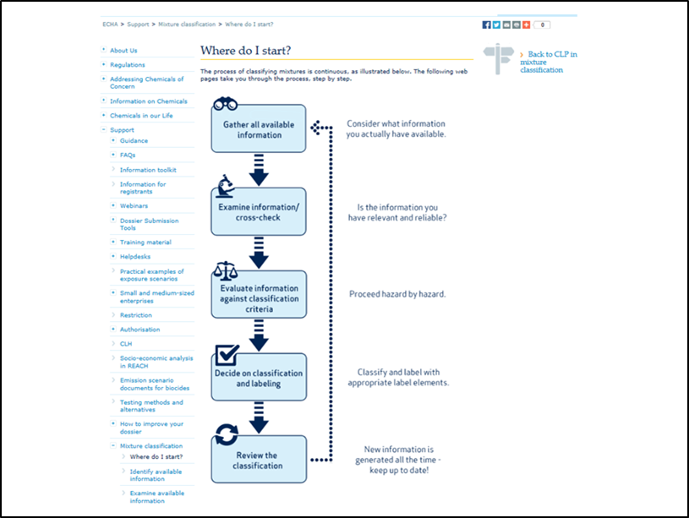

Slide 12
C&L Inventory
Database with 6 million notifications to date
For >122,641 notified substances
  Also includes registered substances received from manufacturers & importers
  Includes harmonised classifications
  Established and maintained by ECHA
  30,000 substances have different C&L
  Platform available to reach agreements on differences
Notes:
ECHA will make certain info from the inventory publicly available on its website including Substance name, Classification, Labelling
Any relevant SCLs or M factors
It will indicate if there is a harmonised classification for the entry or if its an agreed entry between M/I
Or if the entry is a joint entry between registrants of the same subs
Or if the entry differs from another entry on the Inventory for the same subs

Slide 13
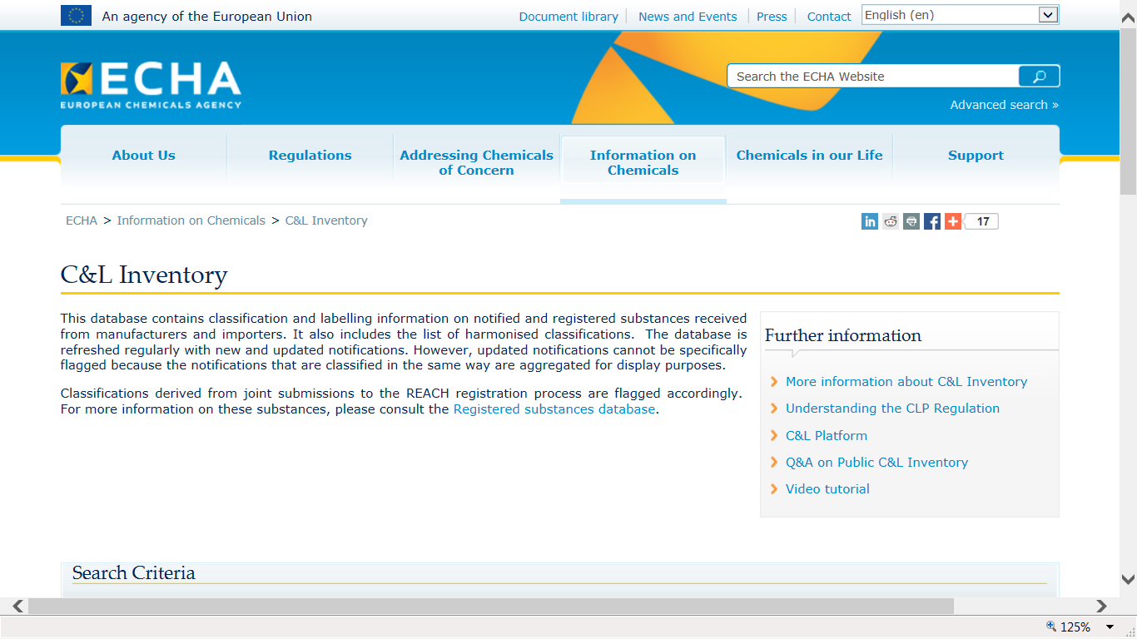

Slide 14
Classification in practice
Most classifications are done by suppliers themselves
Self Classification of tens of thousands
of substances
Self Classification of millions
of mixtures
Importers
Formulators
Importers
Manufacturers
Competent Authority
Manufacturer
Importer
Downstream User
Harmonised classification
of substances ( Annex VI)

Slide 15
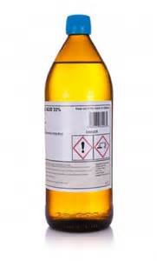
Harmonised Classification (HCL)
        Substances can be part- harmonised and part self- classified
        Example : Hydrochloric Acid %
          HCL = H314, H335
          CL* = H290
        * self- classified by notifiers/registrants
Notes:
HCL substances are agreed by CLP Competent Authorities
HCL substances are listed in Annex VI to CLP ( Table 3.1)
4522 HCL substances to date- 3.6 % of all chemicals (include those from DSD)
Only certain high risk endpoints are harmonised ( different from DSD)
CMRs, respiratory sensitisers,
Active substance ( Biocides., PPP) – normally all end points are harmonised
Case by case basis

Slide 16
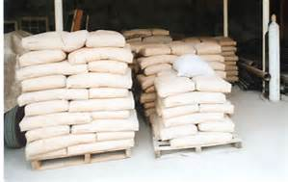
Self-Classification
        Most substances are self- classified
        Example : Portland Cement
          H318, 315, H317, H335

Slide 17
Hazard Communication
Label
Tools for using chemicals safely
SDS

Slide 18
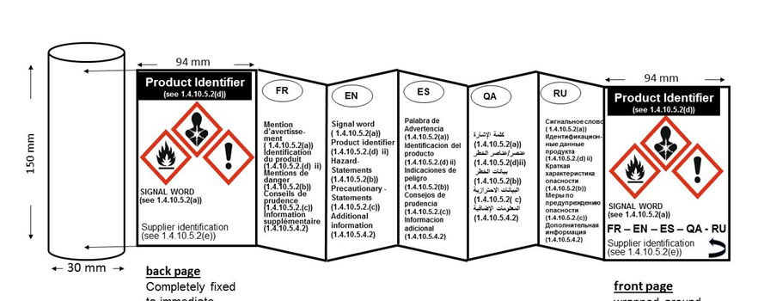
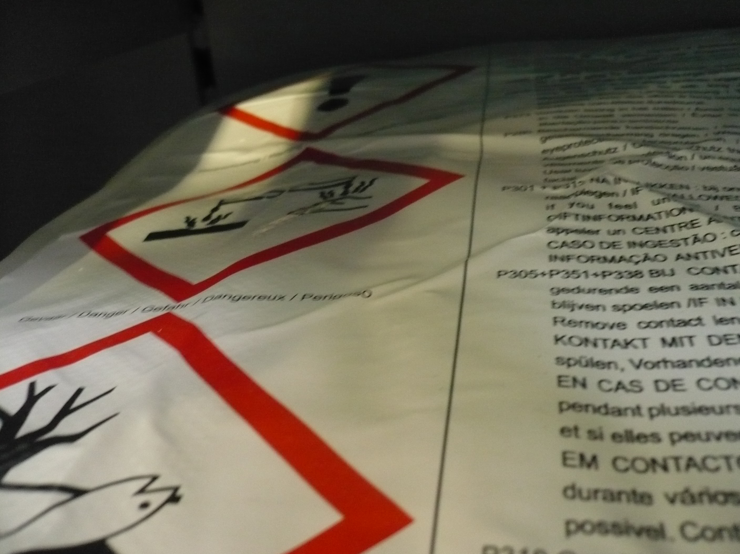
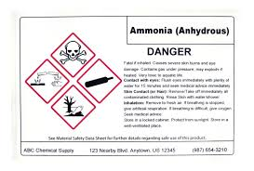
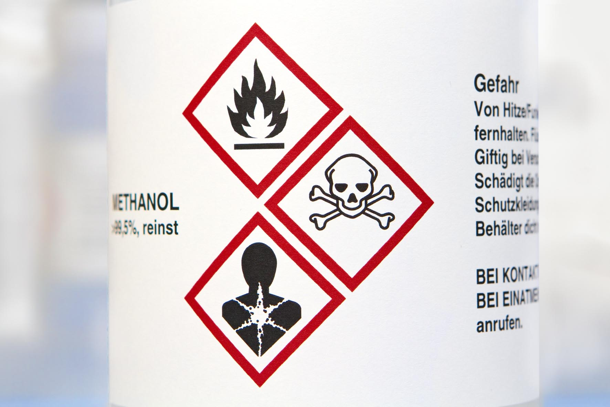
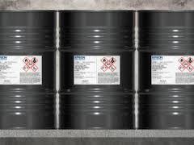
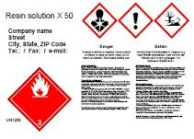

Labelling

Slide 19
Label elements
Name, address & telephone number of supplier
Nominal quantity
Product identifier
Hazard Pictogram(s)
Signal word
Hazard (H) Statements
Precautionary (P) Statements
Supplemental information
Official language = English
Article 17
Notes:
Here are the label elements listed in Article 17 of CLP, the basic principles of labelling under CLP are the same as those for the existing CPL, What has changed is the pictograms and terminology from R&S phrases to H&P statements but in essence the same thing.
There is a new concept within the label elements known as supplemental information which I will explain more about later, but this is information consists of what we call EU Leftovers which we were allowed to maintain thanks to the UNGHS building block approach
I mention most of these labelling elements in detail aside from the nominal quantity which is required for products sold to the general public.
Also the official language is mentioned here but it has not yet been determined the fate of Ireland’s two official languages so our administrative provisions are not yet in place. We assume the same rules that applied to our existing CPL Regulations will also apply to CLP

Slide 20

Labelling
Product Identifier
PRODUCT ABC Danger Highly flammable liquid and vapour. May be fatal if swallowed and enters airways. Causes skin irritation. May cause drowsiness or dizziness. Very toxic to aquatic life with long lasting effects. Keep away from heat/sparks/open flames/hot surfaces. – No smoking. Avoid breathing dust/fume/gas/mist/vapours/spray. Wear protective gloves/protective clothing/eye protection/face protection. IF SWALLOWED: Immediately call a POISON CENTER or doctor/physician. IF ON SKIN: Wash with plenty of soap and water. IF INHALED: Remove victim to fresh air and keep at rest in a position comfortable for breathing. Avoid release to the environment. Contains substance XYZ 200 L*
Company X Y Z Alphabet Street Number Town Code ABCD Phone: +353 1 0000000
Supplier
Information
Hazard Pictogram
Signal Word
Hazard & Precautionary Statements
Space for Supplemental information
Nominal quantity
Notes:
This is a mock up of a CLP label, for the most part the only obvious change is the pictograms..

Slide 21
Labelling rules
Article 31
Firmly affixed to immediate packaging
Readable horizontally when set down
Hazard pictogram stands out clearly
Text easy to read
“Non-Toxic” “Non-Harmful” “Non-polluting” or other misleading statements NOT to be used on Label
Must be in official language(s) of Member State
Notes:
Here are the label elements listed in Article 17 of CLP, the basic principles of labelling under CLP are the same as those for the existing CPL, What has changed is the pictograms and terminology from R&S phrases to H&P statements but in essence the same thing.
There is a new concept within the label elements known as supplemental information which I will explain more about later, but this is information consists of what we call EU Leftovers which we were allowed to maintain thanks to the UNGHS building block approach
I mention most of these labelling elements in detail aside from the nominal quantity which is required for products sold to the general public.
Also the official language is mentioned here but it has not yet been determined the fate of Ireland’s two official languages so our administrative provisions are not yet in place. We assume the same rules that applied to our existing CPL Regulations will also apply to CLP

Slide 22
Updating the label
Article 30
New requirement under CLP
  Supplier to ensure label is updated without undue delay if a more severe C&L required
  Other changes within 18 months
  PPP and Biocides label update in accordance with their Directives

Slide 23
Supplier details
Article 17
Must be an EU legal entity
More than one supplier possible
Name : Company X Y Z
Address: Alphabet Street
Number Town
Code ABCD
Telephone :+123 4 000000
Notes:
Here are the label elements listed in Article 17 of CLP, the basic principles of labelling under CLP are the same as those for the existing CPL, What has changed is the pictograms and terminology from R&S phrases to H&P statements but in essence the same thing.
There is a new concept within the label elements known as supplemental information which I will explain more about later, but this is information consists of what we call EU Leftovers which we were allowed to maintain thanks to the UNGHS building block approach
I mention most of these labelling elements in detail aside from the nominal quantity which is required for products sold to the general public.
Also the official language is mentioned here but it has not yet been determined the fate of Ireland’s two official languages so our administrative provisions are not yet in place. We assume the same rules that applied to our existing CPL Regulations will also apply to CLP

Slide 24
Product identifier
Article 18
Product Identifier for substance or mixture on the label must be the same as that used on the SDS
Product Identifier for a mixture consists of Trade name or designation of the mixture
The identity of the substances contribute to the classification of mixture if:
  Acute toxicity, skin corrosion, serious eye damage, CMR’s, STOT, skin or respiratory sensitisation, aspiration Hazards
  Max of 4 names required unless more needed to reflect severity of hazards
Notes:
Here are the label elements listed in Article 17 of CLP, the basic principles of labelling under CLP are the same as those for the existing CPL, What has changed is the pictograms and terminology from R&S phrases to H&P statements but in essence the same thing.
There is a new concept within the label elements known as supplemental information which I will explain more about later, but this is information consists of what we call EU Leftovers which we were allowed to maintain thanks to the UNGHS building block approach
I mention most of these labelling elements in detail aside from the nominal quantity which is required for products sold to the general public.
Also the official language is mentioned here but it has not yet been determined the fate of Ireland’s two official languages so our administrative provisions are not yet in place. We assume the same rules that applied to our existing CPL Regulations will also apply to CLP

Slide 25
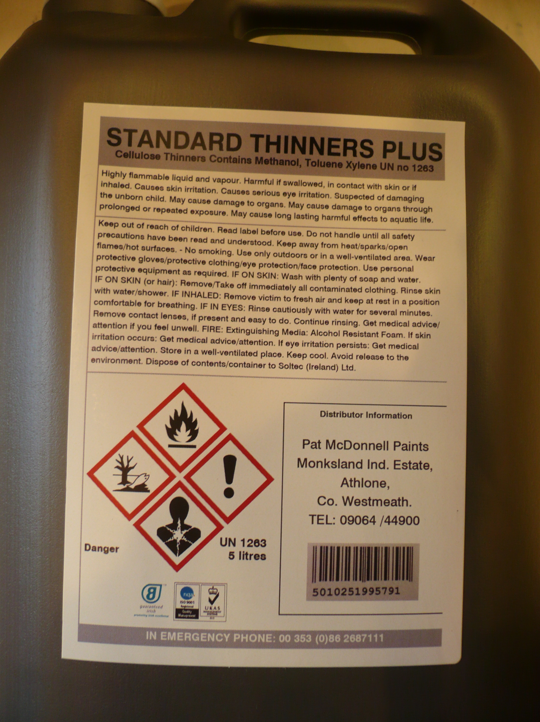
Label example
Product
identifier
Supplier details

Slide 26
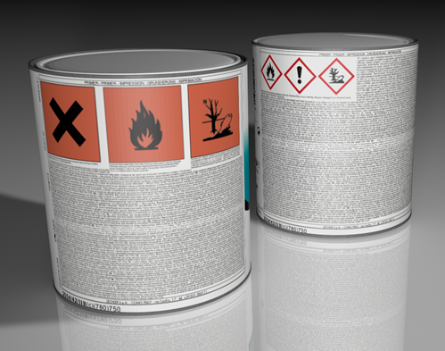


Label issue

Slide 27
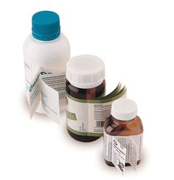
Exemptions
Article 29(1)
Packaging so small or such a shape or form impossible to meet requirements of Article 31
Fold out, tie on and outer packaging

Slide 28
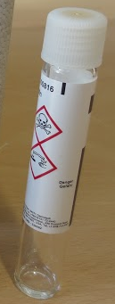
Exemptions
Article 29(2)
Labelling of packaging where the contents do not exceed 125ml -depends on classification
No labelling of soluble packaging at <25ml
Reduced labelling of inner packaging <10ml : RD&E and QA
Supplied to general public without packaging- cement

Slide 29

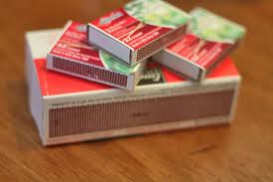

Labelling of articles
A number of articles are required to be labelled in accordance with CLP
Considered part article-part substance/mixture
Includes scented candles, matches, air- fresheners

Slide 30
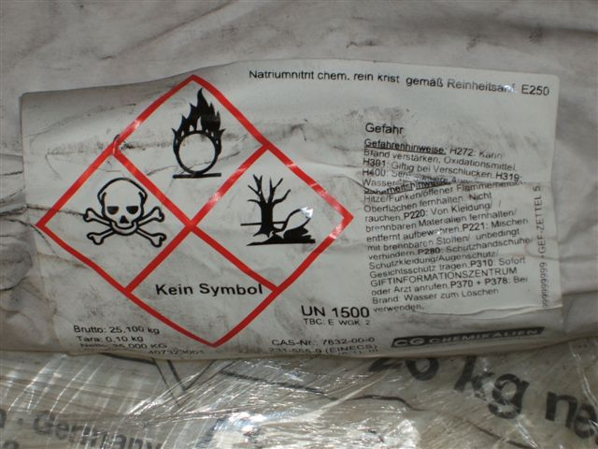
Labelling errors
Durablity of label
Notes:
Even with new regimes we face issues, such as the language, ( no English), use of blank pictograms and the quality of the paper used on the label. Blank pictograms should be blanked out.. There is no need to use the codes of the H&P statements, which is taking up precious space on the label and there is a legal requirement to have the CLP label in English.

Slide 31
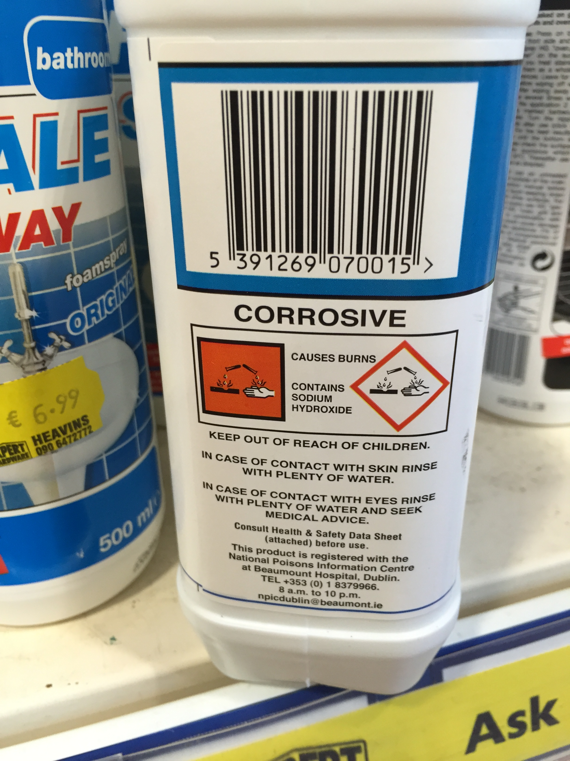
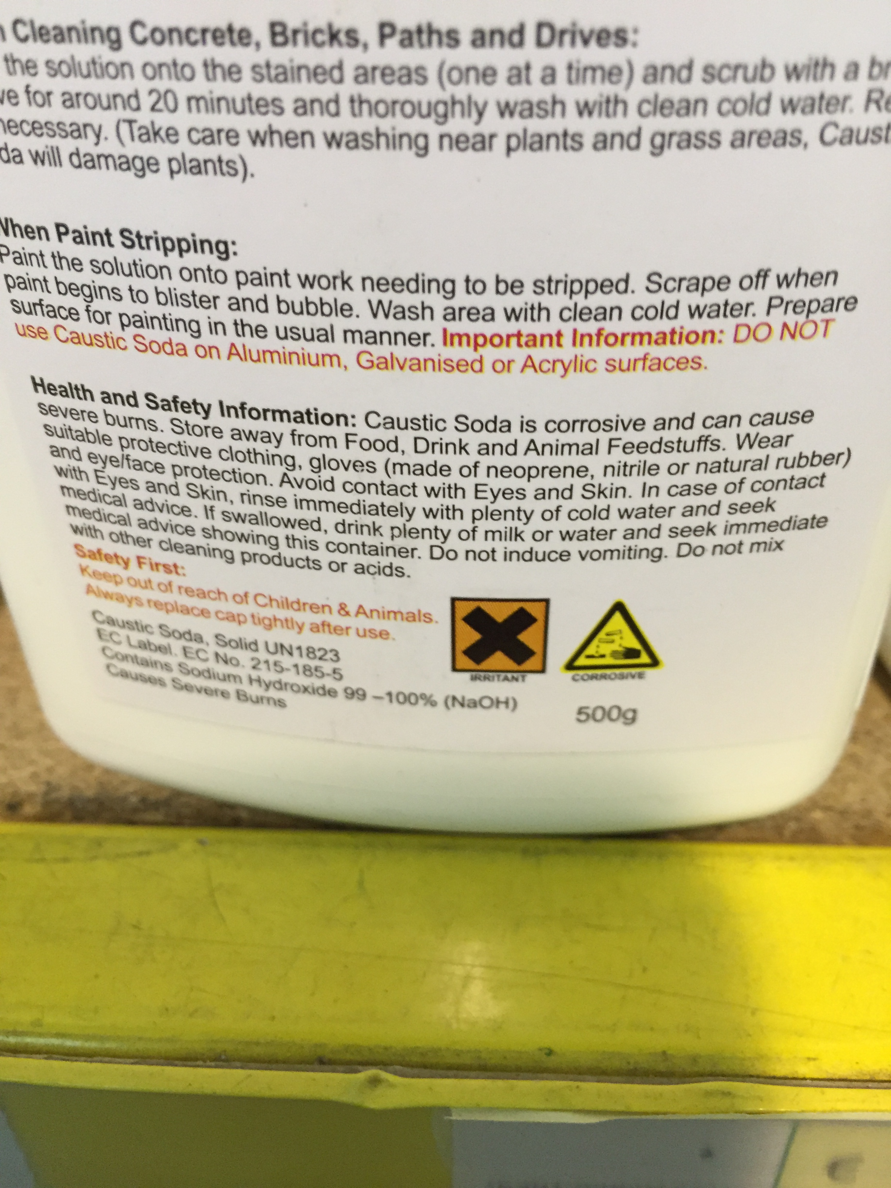
Labelling errors
Supplier details
Supplier details

Slide 32
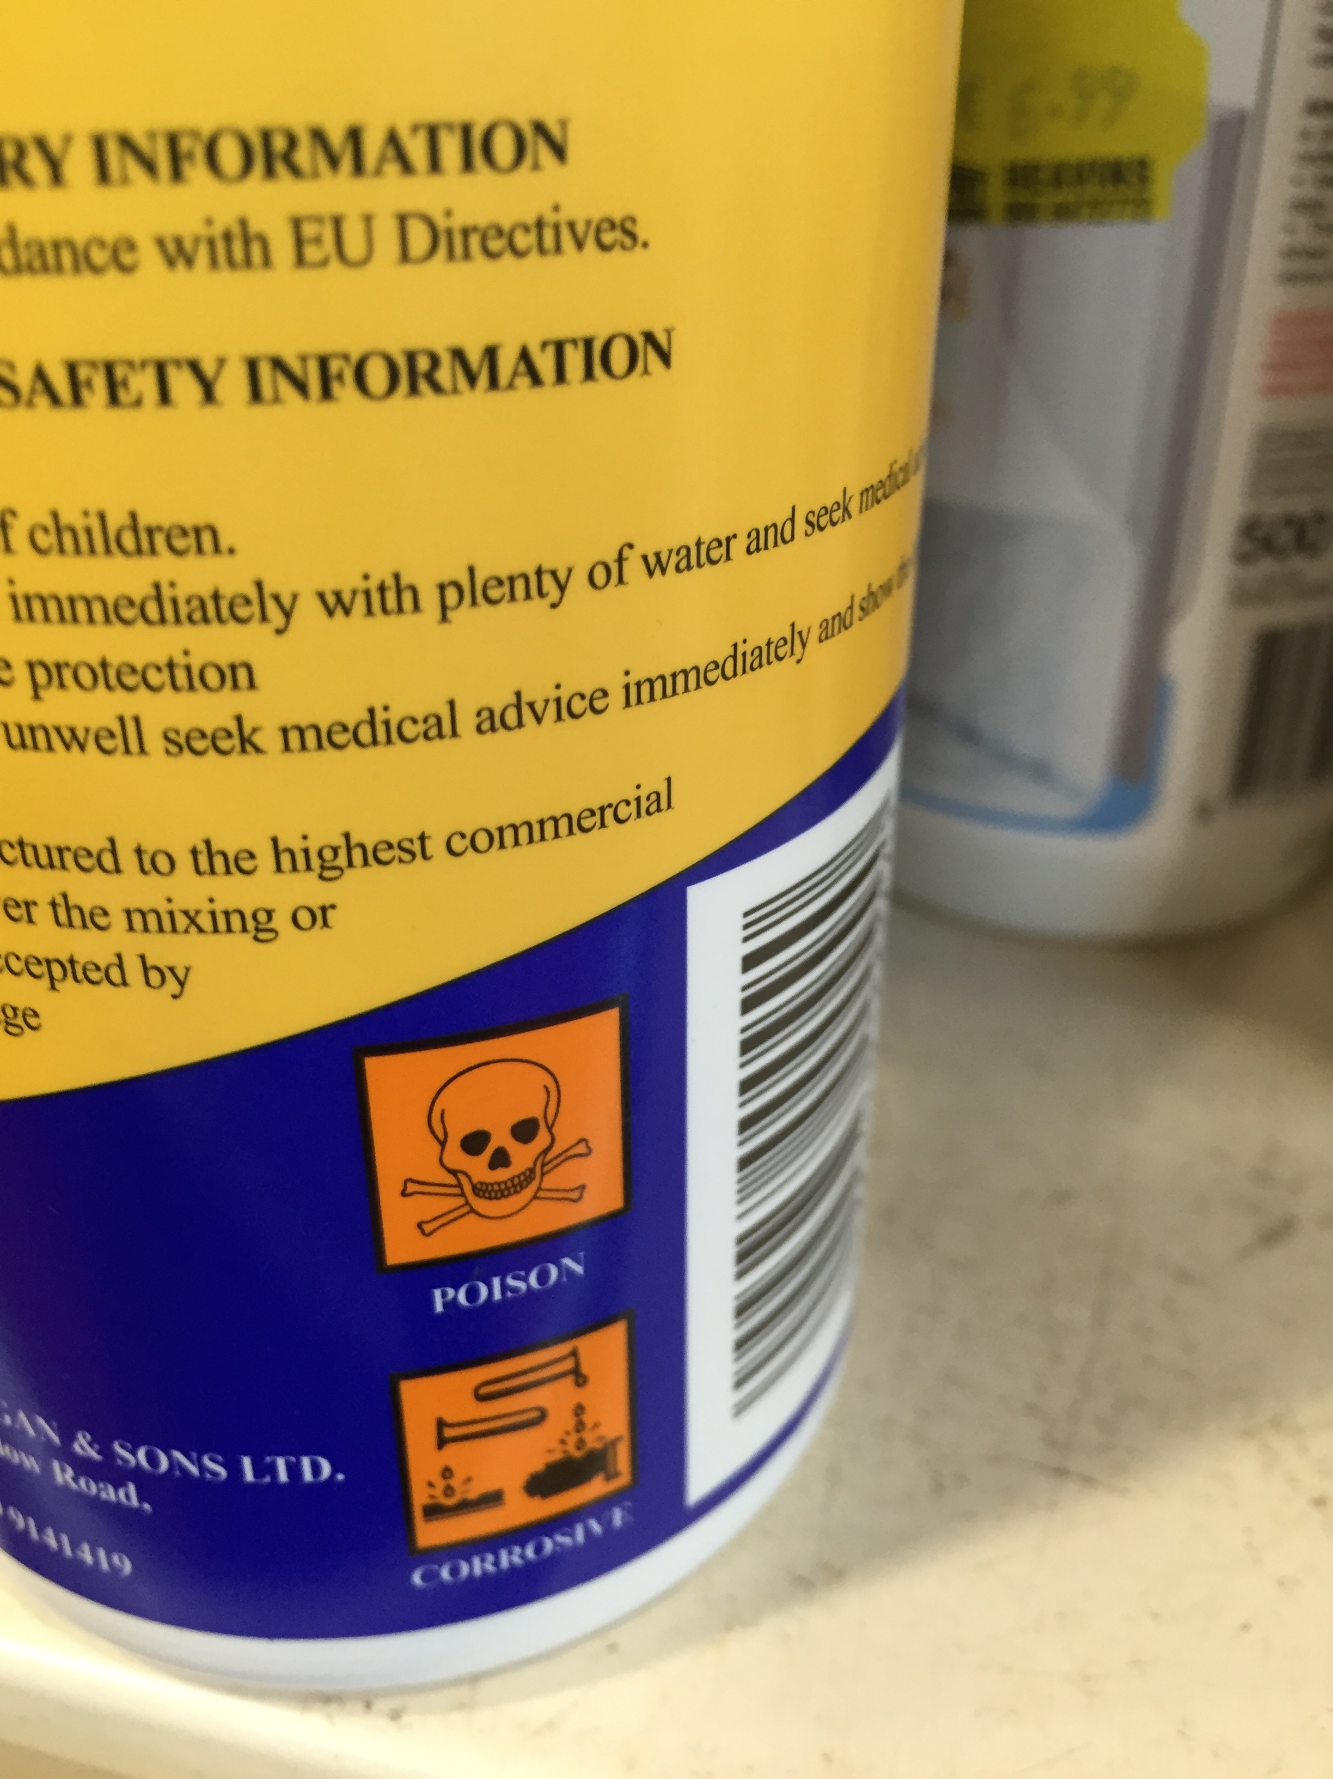
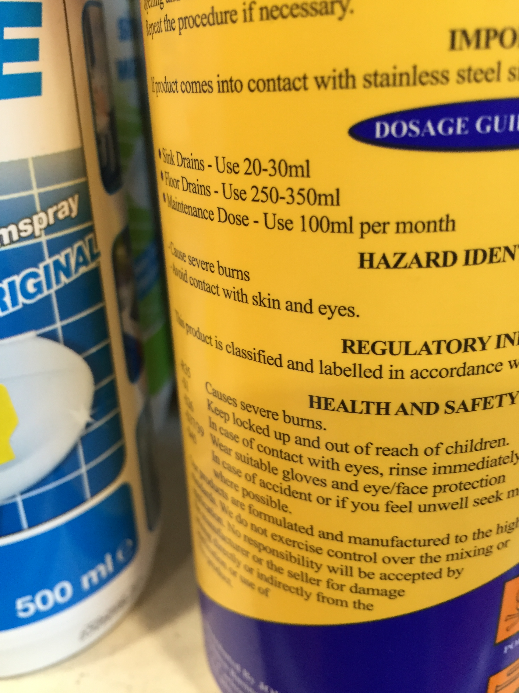
Labelling errors

Slide 33




Supply & transport labelling
TOXIFLAM Manufactured by Compa , Company X Y Z Alphabet Street Number Town Code ABCD Phone: +353 1 0000000 9 | Danger Highly Flammable liquid. Causes skin irritation. May cause respiratory irritation May cause damage to liver, testis through prolonged or repeated exposure May be fatal if swallowed and enters airways. Very toxic to aquatic life Very toxic to aquatic life with long lasting effects. Keep out of reach of children. Keep away from heat/sparks/open flames/hot surfaces. No smoking. Wash hands thoroughly after handling. Use only outdoors or in a well-ventilated area. Wear protective gloves/protective clothing/eye protection/face protection | UN9999 & Proper Shipping Name
Product Identifier
GHS pictogram
Supplier Details
Transport Information
Signal word
Space for supplemental information
Notes:
This is an example of the precedance rules outlined in Article 33 (3) whereby if you use the transport pictogram then you don’t need the supply pictogram for the same hazard. This would be typically used on 200L drums where currently the supply and transport information is separate but in the future it could look like this.

Slide 34
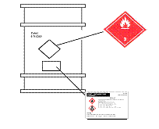
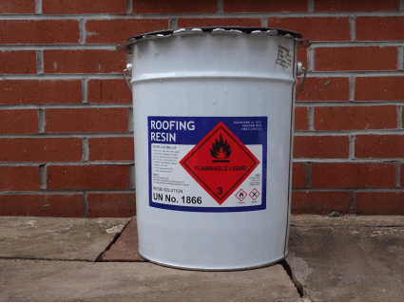
Supply & transport labels
Supply and transport labels can be combined

Slide 35
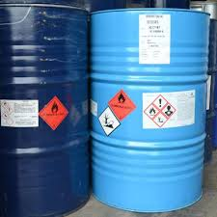

Supply & transport labels
Supply and transport labels can remain separate

Slide 36
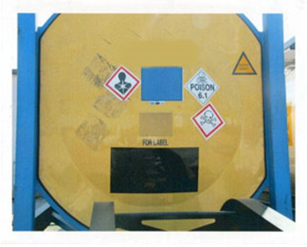
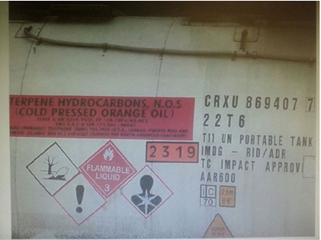
Supply & transport labelling
Issue arising with supply and transport labels being addressed by GHS
CLP pictograms cannot be used on their own on transport containers

Slide 37
Labelling transition
Chemicals ‘on the shelf’ on 1st June 2015 do not need to be relabelled and repackaged until 1st June 2017
1 June 2015 1 June 2017
CLP for mixtures Transition period
in force for mixtures ends
Notes:
Article 33 in CLP is there to outline the relationship between transport and supply label and how the two can work together to be mutually beneficial.
This will depend on the type of packaging being used be it inner, outer or single packaging and indeed what happens to the outer packaging when the transport rules don’t apply.
The basic principle being that the pictogram for supply and transport for the same hazard will not appear together on a signal packaging and the transport pictogram will always take precedence over the supply pictogram for the same hazard.
The 3 points within Article 33 outline the various scenarios that apply and how they will present themselves on the label, in the next few slides I aim to show you in practical terms how this will work
NEXT SLIDE

Slide 38
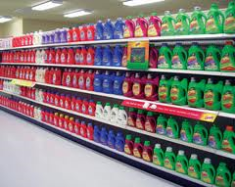
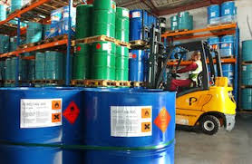
Labelling transition
Chemicals ‘on the shelf’ on 1st June 2015 do not need to be relabelled and repackaged until 1st June 2017..
Notes:
Article 33 in CLP is there to outline the relationship between transport and supply label and how the two can work together to be mutually beneficial.
This will depend on the type of packaging being used be it inner, outer or single packaging and indeed what happens to the outer packaging when the transport rules don’t apply.
The basic principle being that the pictogram for supply and transport for the same hazard will not appear together on a signal packaging and the transport pictogram will always take precedence over the supply pictogram for the same hazard.
The 3 points within Article 33 outline the various scenarios that apply and how they will present themselves on the label, in the next few slides I aim to show you in practical terms how this will work
NEXT SLIDE

Slide 39

Long life chemicals
Long life chemicals in the workplace
do not need to be relabelled unless a
workplace risk assessment warrants it
as they are not in the ‘supply chain’.
They are not being placed on the market
Notes:
Article 33 in CLP is there to outline the relationship between transport and supply label and how the two can work together to be mutually beneficial.
This will depend on the type of packaging being used be it inner, outer or single packaging and indeed what happens to the outer packaging when the transport rules don’t apply.
The basic principle being that the pictogram for supply and transport for the same hazard will not appear together on a signal packaging and the transport pictogram will always take precedence over the supply pictogram for the same hazard.
The 3 points within Article 33 outline the various scenarios that apply and how they will present themselves on the label, in the next few slides I aim to show you in practical terms how this will work
NEXT SLIDE

Slide 40
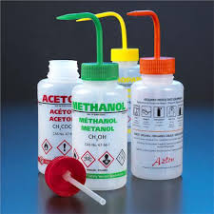

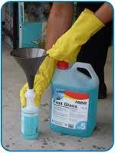
Decanted chemicals
Decanted laboratory chemicals
  Decanted workplace chemicals
Labelling requirements are based on
  workplace risk assessment where
  workplace signs and chemicals agents apply.
Notes:
Article 33 in CLP is there to outline the relationship between transport and supply label and how the two can work together to be mutually beneficial.
This will depend on the type of packaging being used be it inner, outer or single packaging and indeed what happens to the outer packaging when the transport rules don’t apply.
The basic principle being that the pictogram for supply and transport for the same hazard will not appear together on a signal packaging and the transport pictogram will always take precedence over the supply pictogram for the same hazard.
The 3 points within Article 33 outline the various scenarios that apply and how they will present themselves on the label, in the next few slides I aim to show you in practical terms how this will work
NEXT SLIDE

Slide 41


Workplace signage
Removed the St Andrew’s cross safety sign
Exclamation mark sign to be used for
stores of chemicals only and not for
Chemicals assigned GHS07
Notes:
The Chemicals Handling Directive was published in February 2014 and will be transposed into Ireland by 1st June 2015 making changes to 5 directives, four of which come under the remit of the HSA. Most of the changes are purely related to changes in terminology. Legal references. A much larger project is underway in the EU which is looking at updating all 24 OSH Directives.

Slide 42

Packaging
Come from DSD/DPD
Designed so its contents don’t
damage it or react with contents & fastening remain intact
during normal use
Designed not to arouse curiosity of children/mislead consumers or have similar presentation or design that looks like food.
Notes:
Title VI of CLP contains just one article on packaging, all of these provisions come from the existing CPL regime and don’t exist yet in the UNGHS. Again the BBA allowed Europe to retain these provisions built up over many years which are now just beginning to be developed at UN level.
Aside from the replacement fastening devices if a package meets all the requirements for transport it is deemed to meet the requirements of this article.

Slide 43
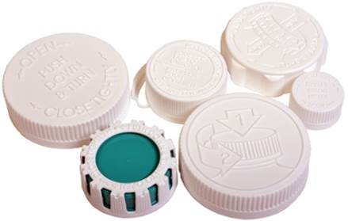
Child resistant fastening
Article 35
Supplied to general public with specified hazards or listed substances
Reclosable packages– EN ISO standard 8317
Non-reclosable packages - CEN standard EN 862
Evidence of conformity required from
Laboratories with standard EN ISO/IEC17025

Slide 44
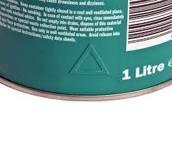
Tactile warning
Article 35
Raised triangle on packaging
Supplied to general public with specified hazards
Does not apply to aerosols when only classified as extremely flammable or flammable aerosols hazards
Must conform to EN ISO 11683

Slide 45

Packaging issue
Notes:
Here is another example of a hazardous chemicals that looks like sweets.

Slide 46

Packaging issue
Liquid consumer laundry detergent
Article 35 & Annex II 3.3 ( NEW)
Outer Packaging
  Must be opaque and obscure
  Must bear the mark ‘Keep out of reach of children’
  Impedes ability of young children to open
  Easily reclosable and self standing
  Maintains it functionality after repeated opening and closing

Slide 47

Packaging issue
Liquid consumer laundry detergent
Article 35 & Annex II 3.3 ( NEW)
Outer Packaging
  Must be opaque and obscure
  Must bear the mark ‘Keep out of reach of children’
  Impedes ability of young children to open
  Easily reclosable and self standing
  Maintains it functionality after repeated opening and closing

Slide 48






Professional end user
distributor
end user
Industrial end user
Consumer
Notes:
Where you sit in the supply chain will determine what you have to do to comply with CLP. The formulator and the importer are the two key players when it comes to CLP

Slide 49
Roles & Obligations
 | Classify | Label | Package | Notify | Keep info 10 yrs
Manufacturer | ✓ | ✓ | ✓ | ✓ | ✓
Importer | ✓ | ✓ | ✓ | ✓ | ✓
Downstream User | ✓* | ✓ | ✓ | ✗ | ✓
Distributor | ✗** | ✓ | ✓ | ✗ | ✓
*If DU changes composition, must classify. If not, use classification other actor
**Dist may use classification of another actor
Notes:
M/I:
Classify, Label, Package substances/mixtures placed on market
Classify substances not placed on market subject to registration or notification in REACH
Notify C&L to C&L inventory if placing substances on market
Be aware of new scientific/technical information: re-evaluate classification, update labelling
carry out a new evaluation of the relevant classification aware of new scientific or technical inform
update the label following any change to the classification and labelling of that substance or mixture, certain
new information which may lead to a change of the harmonised classification and labelling elements of a substance you should submit a proposal to the Competent Authority in one of the Member States in which the substance is placed on the market
Keep information relating to C&L (CLP) for at least 10 years after last supply
assemble and keep available all the information required for the purposes of classification and labelling under CLP for a period of at least 10 years after you have last supplied a substance or mixture. This information should be kept together with the information required in Article 36 of REACH
DU: includes formulators, re-importers
Classify, Label, Package substances/mixtures placed on market
May use classification already derived by another actor in chain provided composition not changed
If composition changed then Classify, Label, Package
Be aware of new scientific/technical information: re-evaluate classification, update labelling
Keep information relating to C&L (CLP) for at least 10 years after last supply
Distributor:
Not obliged to classify themselves
May use classification already derived by another actor in chain
Ensure substances/mixtures placed on market are (re-)labelled &(re-)packaged
Keep information relating to C&L (CLP) for at least 10 years after last supply
Includes retailer
You should assemble and keep available all the information
required for the purposes of classification and labelling under CLP
for a period of at least 10 years after you last supply a substance
or mixture. This information should be kept together with the
information required in Article 36 of REACH (CLP Article 49).
In case you take over the classification for a substance or mixture
derived by another actor up in the supply chain, you should
ensure that all the information required for the purpose of
classification and labelling (e.g. Safety Data Sheet) is kept
available for a period of at least 10 years after you last supply the
substance or mixture.
Mention articles
a producer of an article that complies with the definition of an explosive article as
set out in section 2.1 of Annex I to CLP has the obligation to classify, label and
package these articles according to CLP before placing them on the market

Slide 50

Keep information
10 years
Notes:
There is a legal requirement to keep information for 10 years.

Slide 51

Administration
In Ireland
Chemicals Act, 2008 & 2010
  EU Regulations – Direct Acting throughout
  Administrative & Enforcement provisions
  EPA, PRCD and NPIC also named in acts
  No requirement for transposition
  Also includes CLP, REACH, Export/Import and Detergents

Slide 52

Chemicals Helpdesk
All chemical related queries
chemicals@hsa.ie
1890 289 389
Scope
Notes:
All RFI from CBS use chemicals@hsa.ie only
All queries use standard subject line in email
Response to [subject] query REF [RFI no]
Standard signature used
Those within ‘scope’ of Helpdesk recorded in Excel file and monthly report prepared

Slide 53
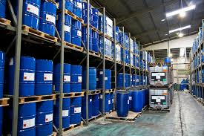
Worker supports
Notes:
Consumers will be our target audience from June 2015 onwards. While we are not widely recognised as an organisation as having responsibility for consumers under REACH and CLP we do and therefore have to raise awareness on what is happening to product labels.

Slide 54
Chemicals Webpages
  Safe Supply, Use and Management of Chemicals
  www.hsa.ie/chemicals
  Targeted at chemical manufacturers, suppliers, users
  Includes a Latest News and Quick links section
  Updated with news from ECHA
  Incorporates ALL aspects of occupational chemical safety incl. REACH and CLP

Slide 55
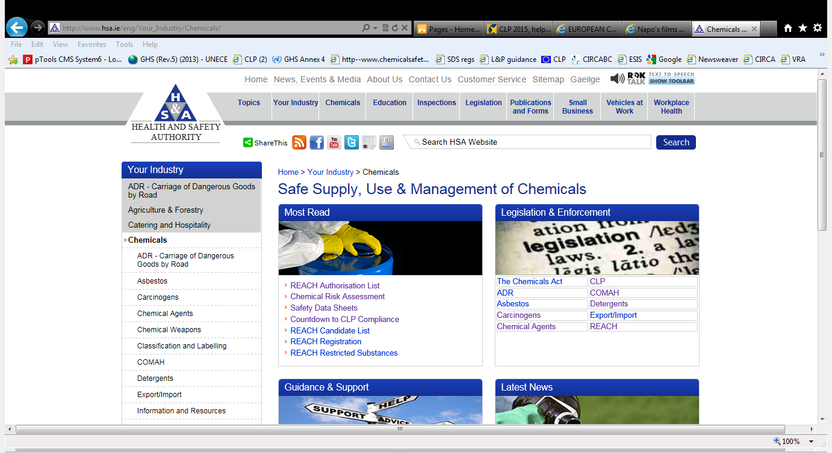
Chemicals Webpages

Slide 56
E-Bulletin and Newsletters
Quarterly chemicals E-bulletin produced by helpdesk team
          Covers all updates on chemical issues
          Subscriber service
Articles on REACH, CLP and other chemical topics included in separate quarterly HSA newsletter
Countdown to CLP E-Bulletin issued regularly up to 1st June 2015

Slide 57
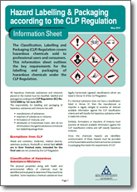

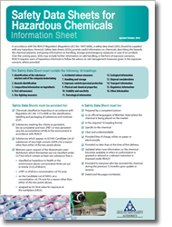

Chemical e-learning
https://hsalearning.ie

Slide 58

European Commission
DG Employment
Responsible for OSH Directives
Worker awareness on CLP
Chemical Handling Directive 2014/27/EU
Publish series of leaflets, posters ,guidance .
Go to link
Notes:
Targeted at importers, formulators and workers during 2014
IE working with Commission and ECHA to raise awareness
All mixtures to be reclassified by 1st June 2015
Starting campaign on 1st June 2014 with ‘12 months to go’ tag line
Special newsletter being published and increase in social media activity
EXPECT and increase in CLP queries

Slide 59

EU-OSHA
EU- OSHA
Worker awareness on CLP
NAPO man short videos
see link..
NAPO man poster see link
Notes:
Targeted at importers, formulators and workers during 2014
IE working with Commission and ECHA to raise awareness
All mixtures to be reclassified by 1st June 2015
Starting campaign on 1st June 2014 with ‘12 months to go’ tag line
Special newsletter being published and increase in social media activity
EXPECT and increase in CLP queries

Slide 60

Conclusion
NEW: Hazard communications for chemicals
Need to clearly identify roles and duties
Keep up to date with REACH and CLP information
Raise awareness about labels and SDSs
READ THE LABEL before using the chemicals
Notes:
All RFI from CBS use chemicals@hsa.ie only
All queries use standard subject line in email
Response to [subject] query REF [RFI no]
Standard signature used
Those within ‘scope’ of Helpdesk recorded in Excel file and monthly report prepared

Slide 62
Information is the key to chemical safety
Sinead McMickan

Slide 63

How (not) to manage chemicals!?

Slide 64
You are a user of chemicals….
……..therefore you need a risk assessment
……..& you need to make sure you can continue your business
Why?
Health – you/employees/co-workers, your family
Safety
Business sense
Legally

Slide 65
You need a risk assessment & to check your use
What info do you need?
Where do you look for the info?
How do you find it?
What if info is incorrect?
How are you going to double check?
What if info is missing?
Why didn’t you receive a SDS?
What do you do with an Exposure Scenario?

Slide 66
What do you need to know to start your Risk Assessment?
Hazards
How to control hazards/manage risks
How to handle/store chemicals
Emergency measures
Others…Transport info,
        Use(s), Disposal etc…
Notes:
Michelle will go into detail – I’ll help by explaining what info must be available under REACH

Slide 67
Where do you look?
REACH – how will it help?
Obligatory communication both up and down supply chain…
Safety Data Sheets (SDSs)
Exposure scenarios
Communication where NO SDSs required
Information to workers
Most importantly…
Keep yourself informed
Notes:
Caroline dealt with Classification and Labels under CLP
SDSs/ESs under REACH
Caroline has explained about the labelling and packaging and the importance of information on the label
Now we’ll talk about how REACH Information can help us
Keeping yourself up to date – save the websites as your favourites
Sign up to bulletins, newsletters

Slide 68
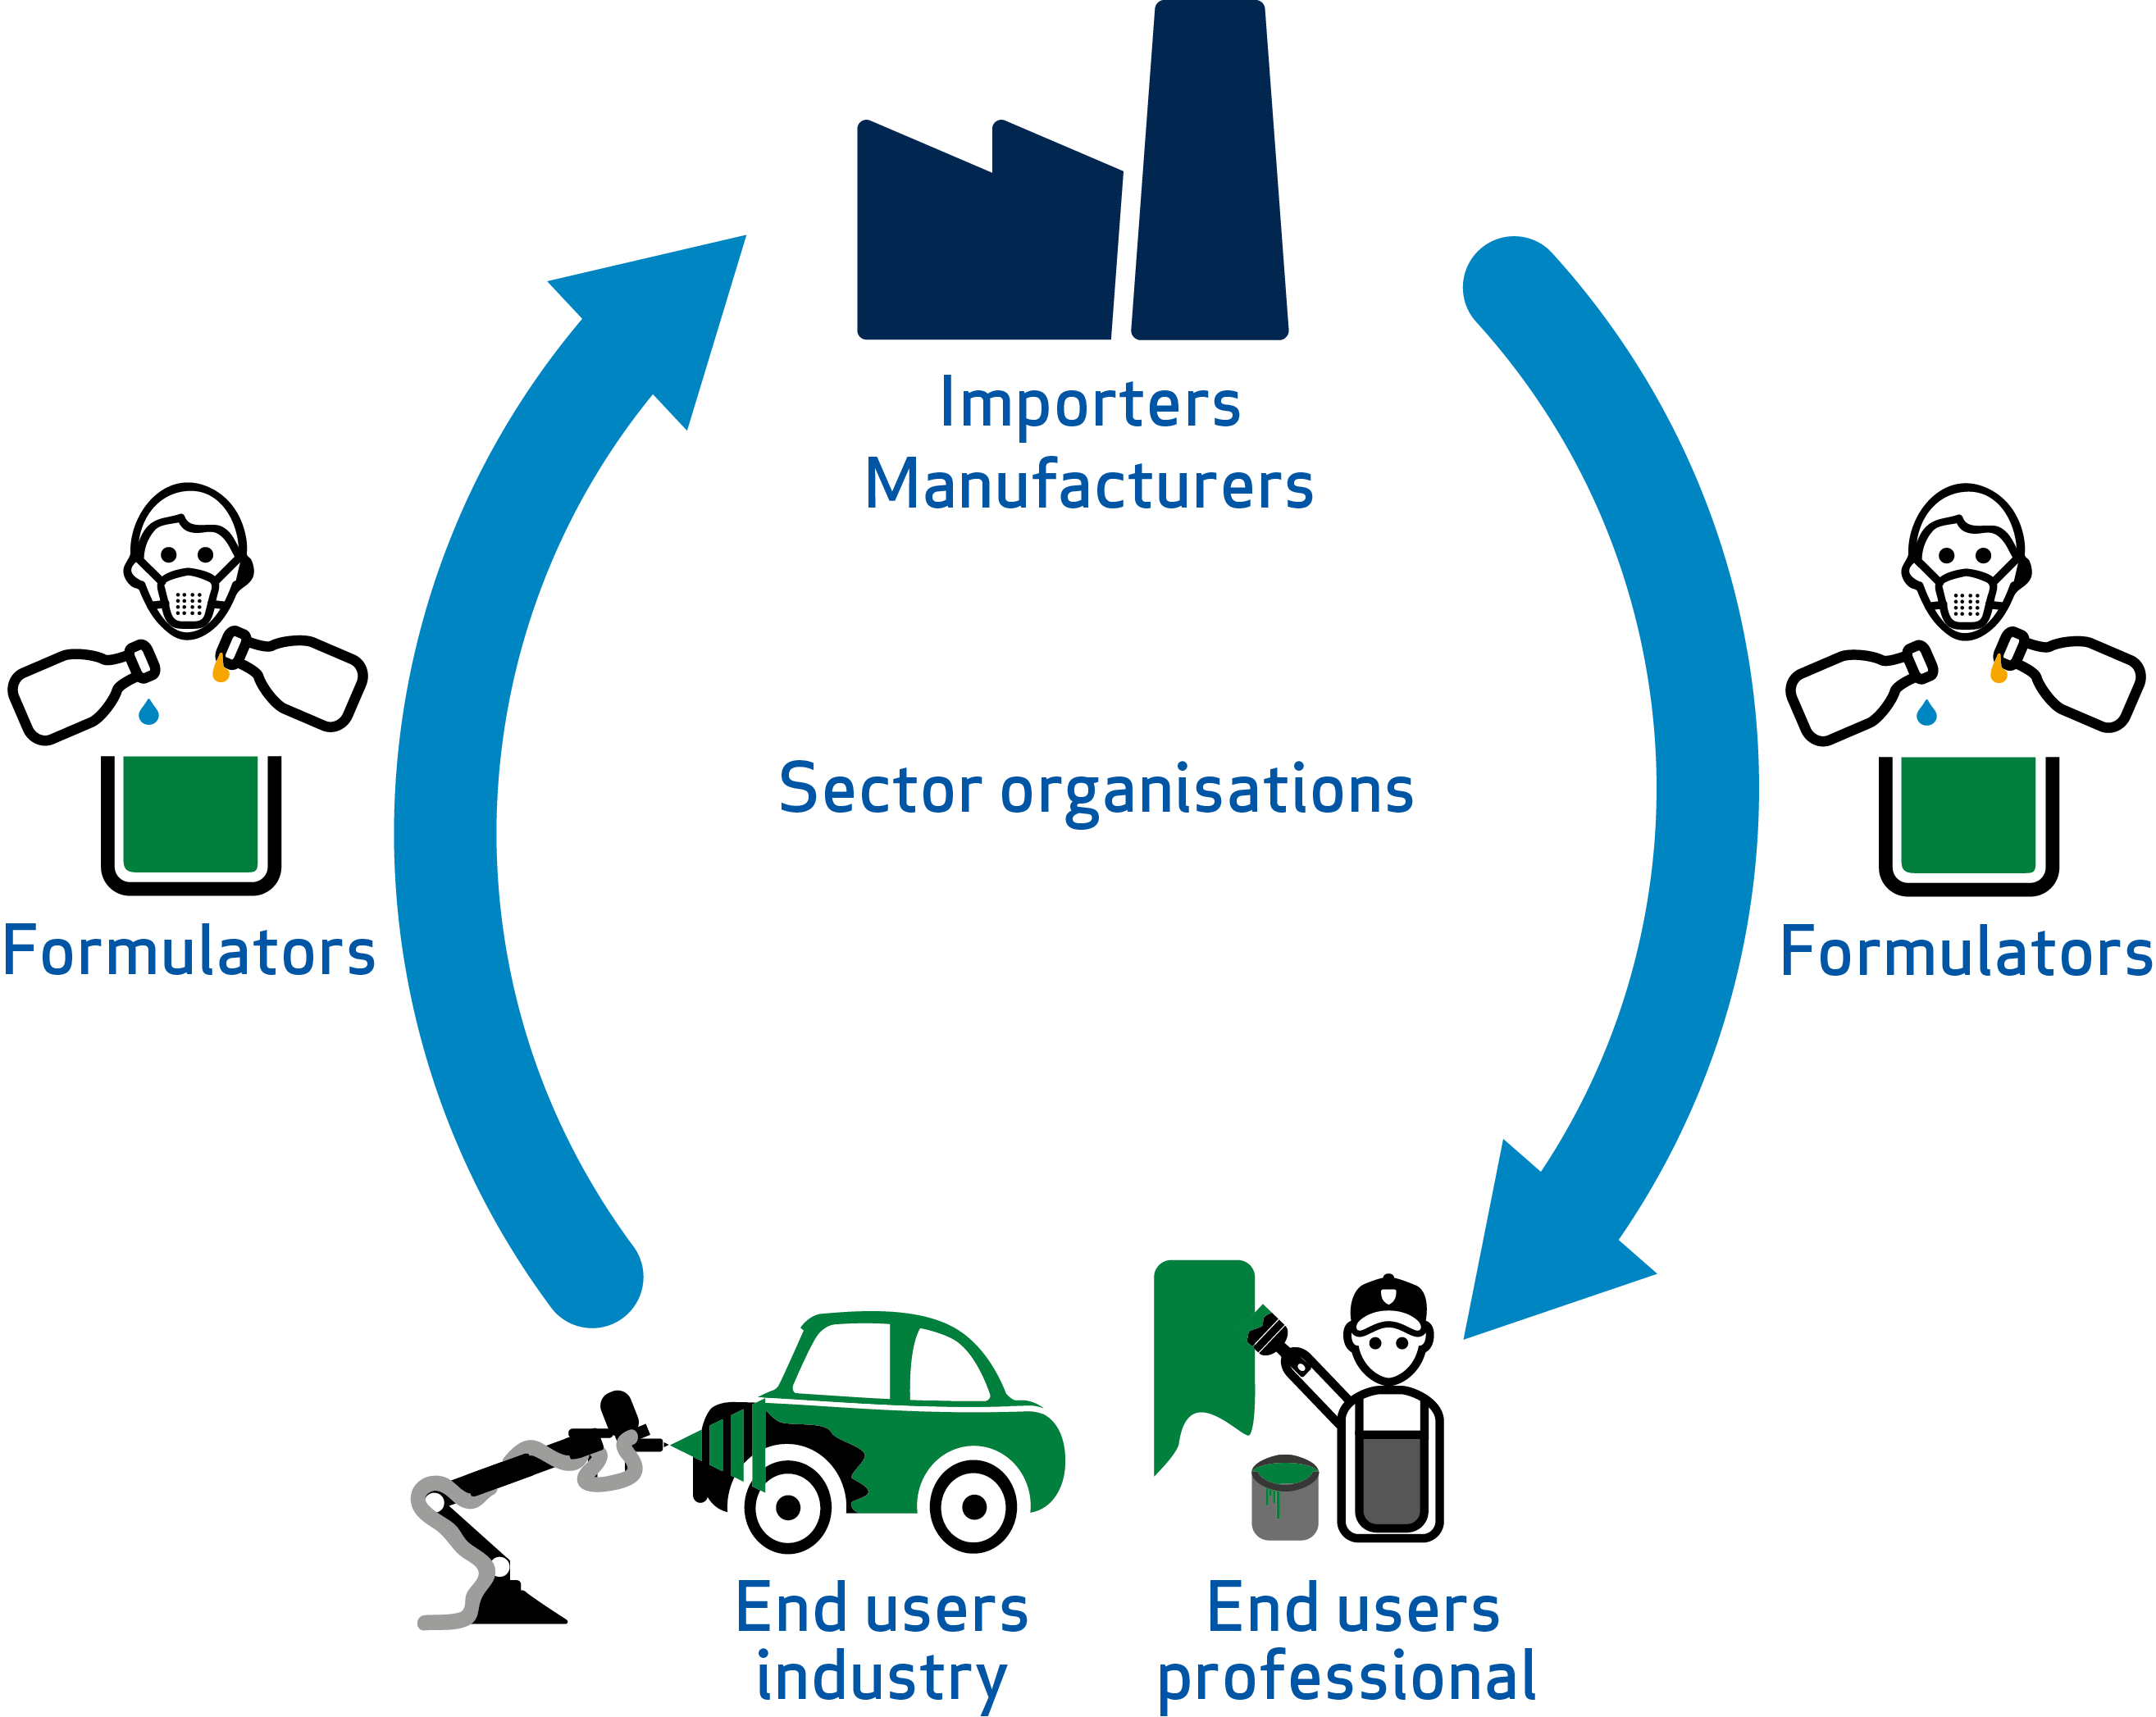




Communication in the Supply Chain
INFORMATION
FOR
REGISTRANTS
Info on uses
Notes:
Will come back to this

Slide 69
Safety Data Sheets
substance/mixture classified as hazardous or mixture contains hazardous substance(s)
REACH compliant
16 headings
English
clear, understandable
provided 1st delivery & update
consistent with label

Slide 70
SDS Format
SDS Required Headings
1. Identification of the substance/mixture and of the company/undertaking | 9. Physical and Chemical Properties
2. Hazard Identification | 10. Stability and Reactivity
3. Composition/Information on Ingredients | 11. Toxicological Information
4. First Aid Measures | 12. Ecological Information
5. Fire-Fighting Measures | 13. Disposal Considerations
6. Accidental Release Measures | 14. Transport Information
7. Handling and Storage | 15. Regulatory Information
8. Exposure Controls/Personal Protection | 16. Other Information
Notes:
Format hasn’t changed under 453. Laid out in Art 31
but there are many more subsections

Slide 71
What version of SDS?
New amendment: Reg. No. 2015/830 (CLP)
But older SDSs ok
Dated from 2010 onwards
If provided before 1 June 15, OK in these formats..

Slide 72
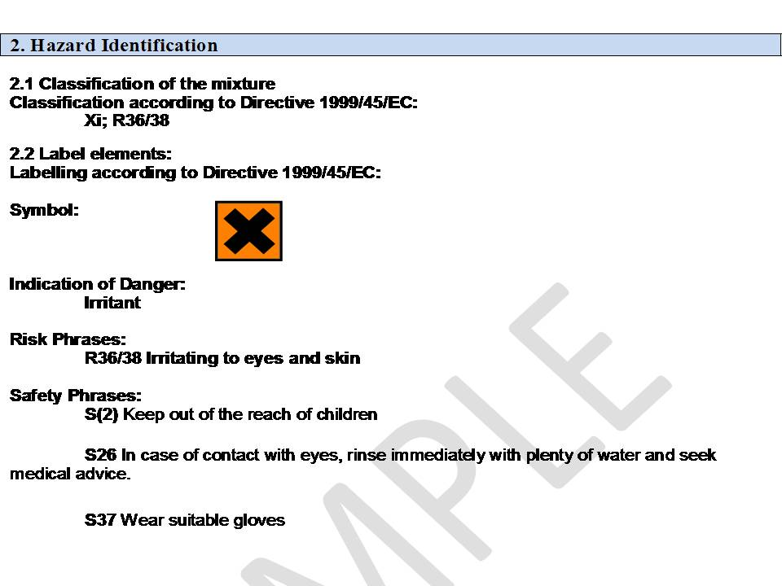
SDS for Mixtures
DPD
DPD

Slide 73
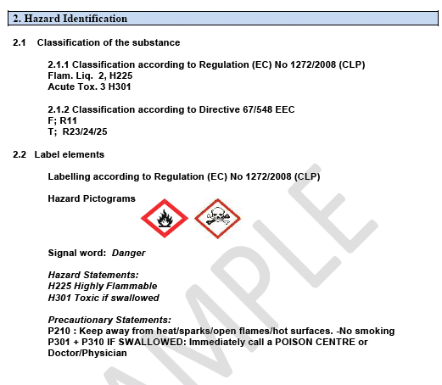

Current SDSs for Substances/Mixtures
CLP & DPD
CLP Only
Notes:
Classification and Label elements will appear in section 2
Old and new classifications in parallel until 1st June 2015
So you will see both classifications here
But Label elements according to CLP only
Different rules apply to mixtures to cover the transition period.

Slide 74
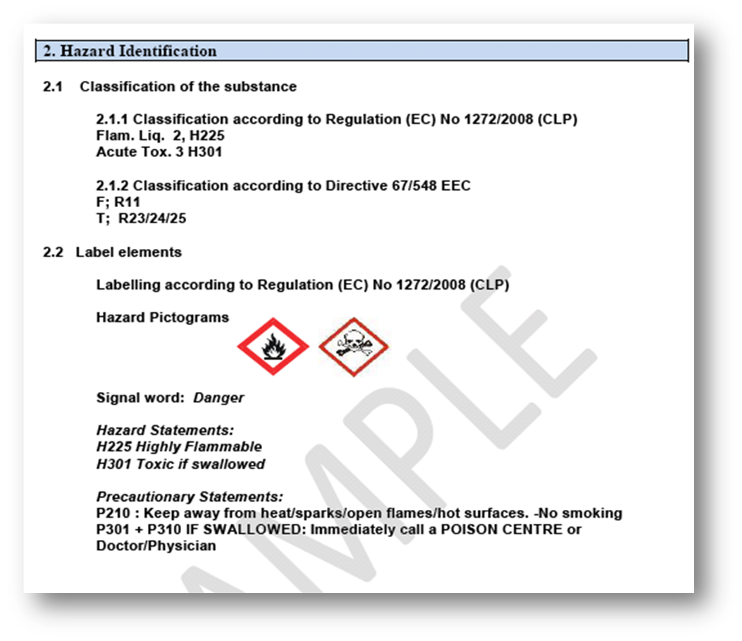
SDS for Substances & Mixtures from 1 June 2015/2017
CLP ONLY
Reg. 2015/830

Slide 75

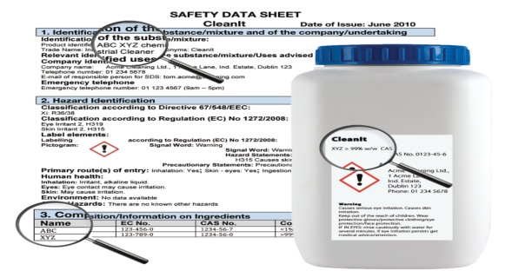
Where do you need to look for……..Hazard info
Label
SDS:
          Sections 2 and 3
          Section 9
          Sections 10 (and 7)
          Section 15
          (Sections 11 & 12)

Slide 76

How well do you know your hazards?
Irritant or suspected to cause cancer?
BOTH! And more………………………………......
READ the wording!

Slide 77
What should you look for?
Cancer causing - carcinogen
Mutagen – disturbs genetic material
Reproductive toxin – fertility (male & female), risk to unborn child
Respiratory sensitiser – chronic lung diseases
Skin sensitisers
Corrosives
Prolonged effects

Slide 78
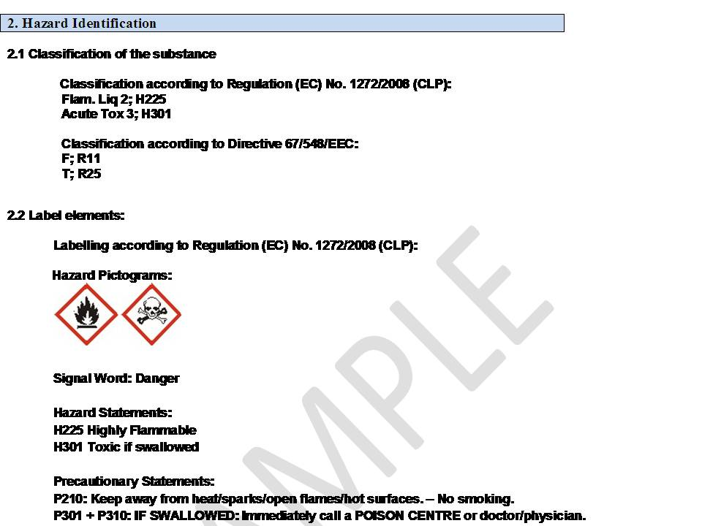
Section 2
Classification e.g. Highly flammable
Notes:
Section 2:
Hazards Identification:
Classification of substance or mixture
Brief clear description of hazards
Label Elements
Other Hazards: eg. dustiness, strong odour

Slide 79
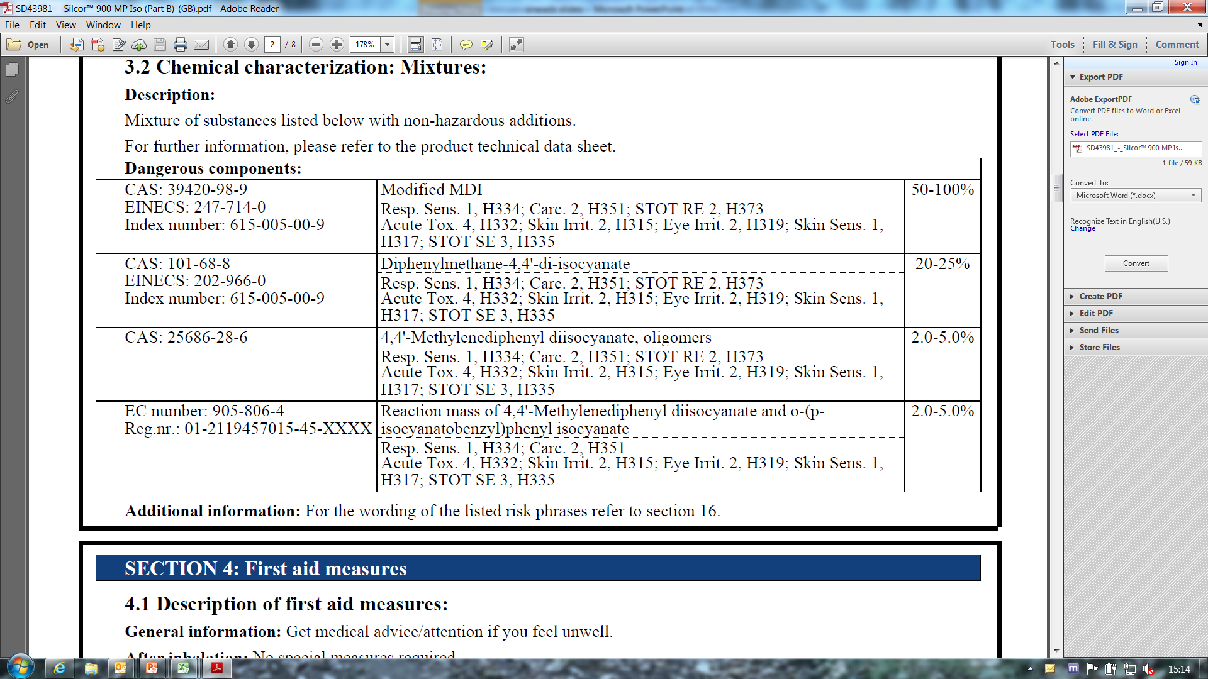
Identify all hazardous ingredients: name, CAS, EC nos.
Section 3 details
Concentration
Classification details

Slide 80
Section 9: hazard info
Physical and Chemical Properties:
pH: If ≤2 ≥11.5 should be H314 (R34/35)
Flammability information (flash point)
Form (powder or liquid?)
Also:
Boiling point
Melting point/freezing point
Upper & lower Flammability or Explosive limits
Solubility
Odour threshold etc.

Slide 81
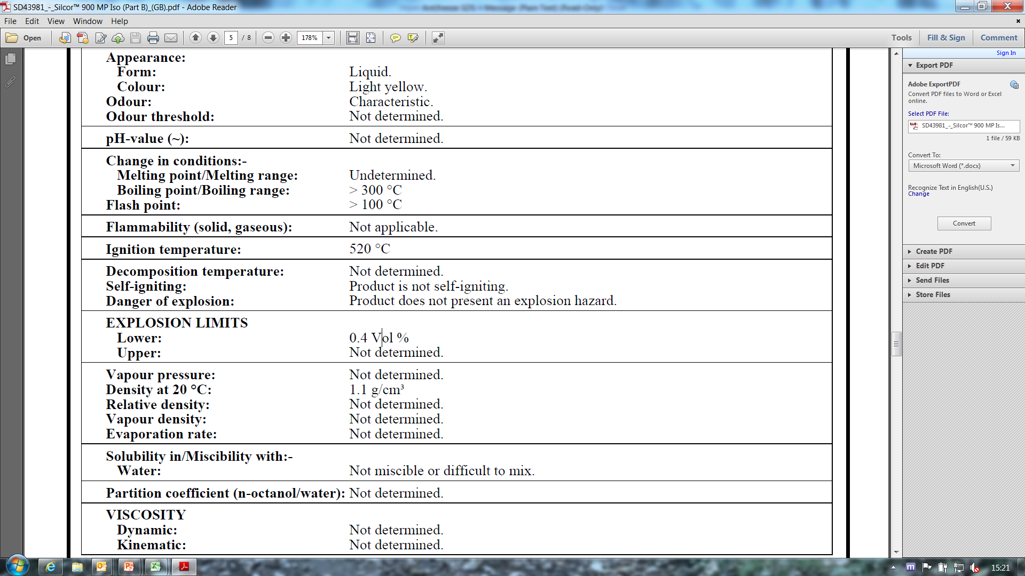
Test methods?
Specs of units
Reasons for n/a
Notes:
Legislation states properties must be clearly identified including:
Reference to the test methods used
Specs of unit measurements used and/or reference conditions

Slide 82
Section 10: hazard info
  Reactivity hazards
  Chemical stability (& relevant storage/handling conditions – see Section 7 also)
  Possibility of hazardous reactions
  Conditions to avoid
  Incompatible materials
  Hazardous decomposition products

Slide 83
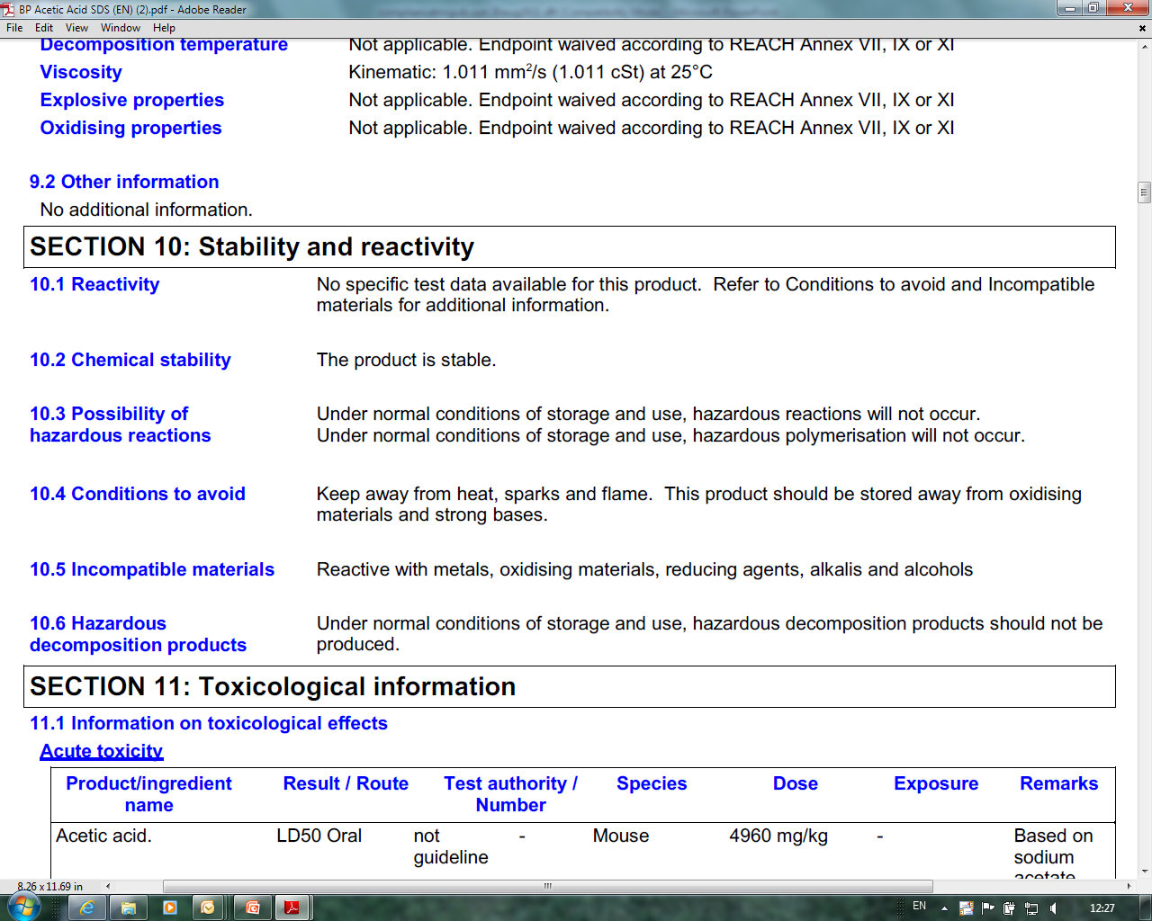

Slide 84
Section 15: hazard info
Regulatory info:
Legislation specific for subs/mix
  Not included elsewhere e.g. Export/Import, Seveso category, Detergents
  Authorised substance
  Restriction applies

Slide 85
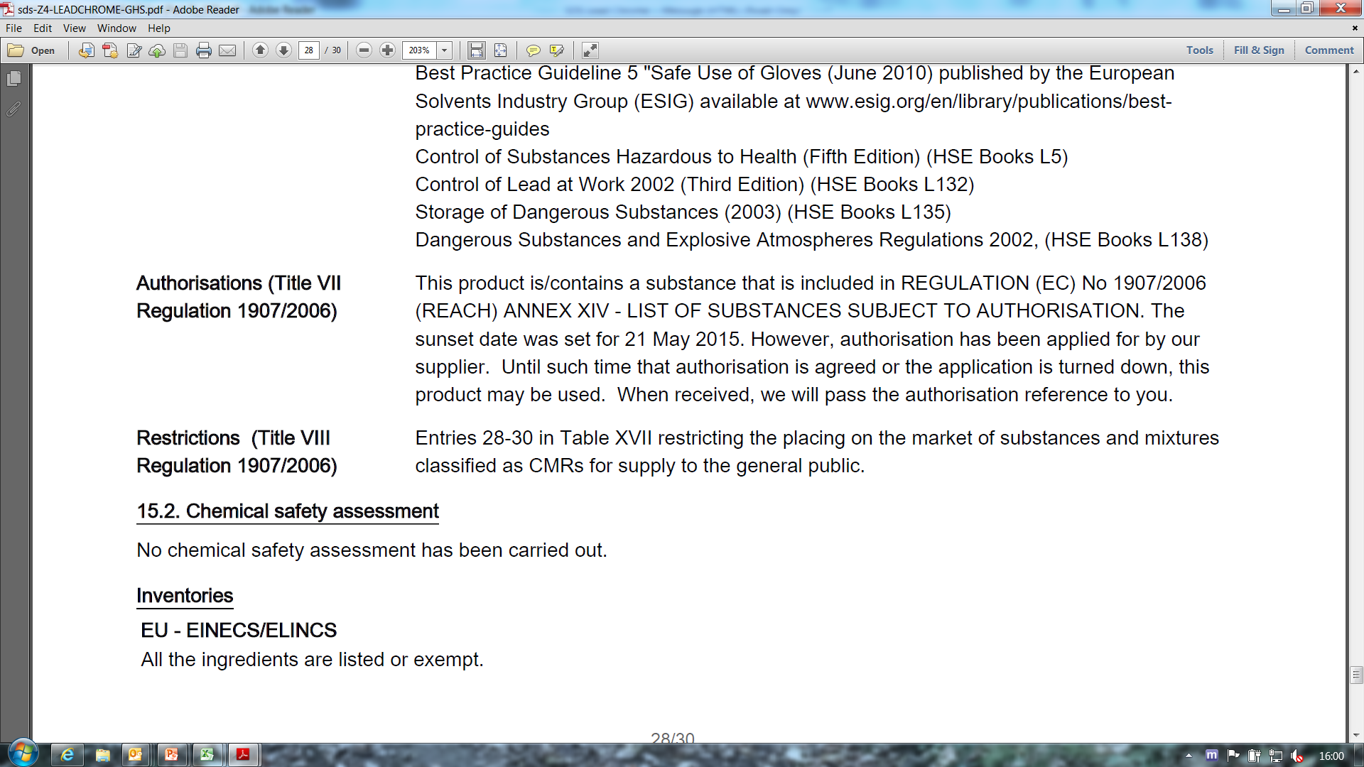
Contains substance subject to authorisation
Sunset date is 21 May 2015
Restricted for sale to professional users only (CMR)

Slide 86

Authorisation under REACH
Control risks from Substances of Very High Concern (SVHCs)
Replace with alternatives
SVHCs:
Carcinogenic, Mutagenic or toxic for Reproduction (CMRs)
Persistent, Bioaccumulative and Toxic (PBT)/ very Persistent & very Bioaccumulative (vPvB) in environment
other serious effects e.g. endocrine disruptors

Slide 87
Authorisation contd.
SVHCs may be included in Authorisation List (Annex XIV)
Manufacturers, importers or users must apply for authorisation to use substance on list
These substances cannot be placed on market or used after sunset date, unless authorisation granted for specific use (or use is exempted from authorisation)

Slide 88


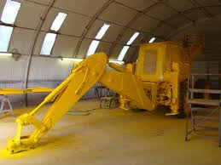
Example substance subject to Authorisation
Lead sulphochromate pigment (yellow)
Used in paints
Classified as hazardous (SVHC) – toxic to reproduction Cat. 1A; carcinogen Cat. 1B
Included because it is:
          widely used
          very hazardous

Slide 89
Restriction under REACH
limit or ban manufacture, placing on market or use of substance
Member State or ECHA propose restrictions where risk to be addressed
Added to Annex XVII of REACH
Examples:
Acrylamide in products for grouting applications
Toluene in glues/spray paints
Polyaromatic hydrocarbons (PAH’s) in tyres
Lead sulphate in paint
Chromium VI in cement

Slide 90
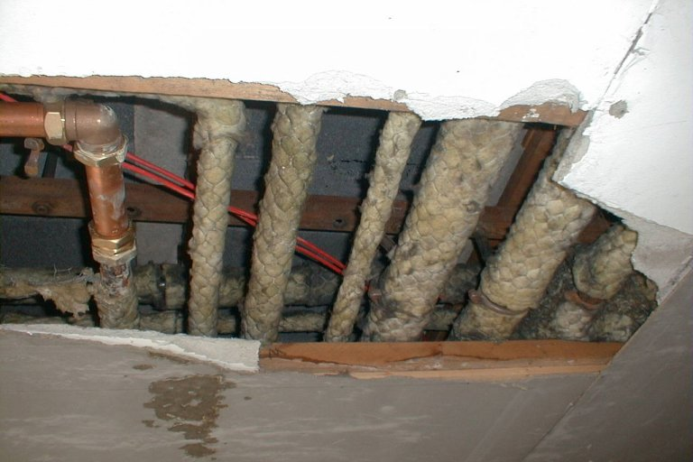
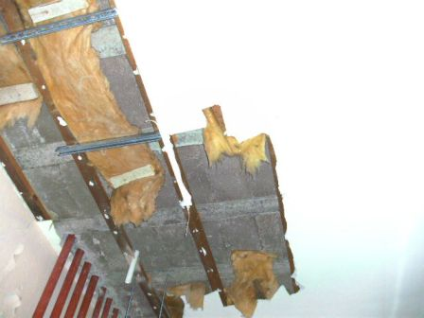
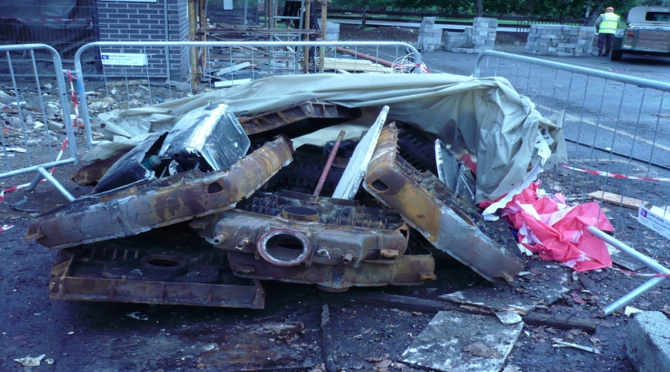

Examples of restricted substances
Asbestos
Notes:
prohibited to use, re-use, sell or supply asbestos or asbestos containing materials or products
however products or materials containing asbestos, which were already installed or in service prior to prohibition, may remain in place until they are disposed of or reach the end of their service life
Therefore, still potential for exposure to asbestos due to the large quantities of asbestos used in buildings in the past
Naturally occurring mineral fibres
both heat and chemical resistant
used in past in insulation and fire proofing
three main types - chrysotile (white asbestos), amosite (brown asbestos) and crocidolite (blue asbestos)
fibres can become released into air and inhaled
can lead to asbestos-related diseases (mainly cancers of the chest and lungs - mesothelioma)
can take from 15 – 60 years to develop
Note if asbestos in good condition & no disturbance or damage, no risk to health as fibres will not be released

Slide 91
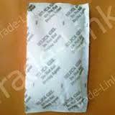

DMFu burn
Notes:
Dimethylfumurate (DMFu)
contained in little pouches inside furniture, shoeboxes
evaporates and impregnates product protecting it from moulds
affected consumers in contact with DMFu
caused painful skin contact dermatitis difficult to treat
in some cases, acute respiratory trouble
a serious risk
Shall not be used in articles or any parts thereof in concentrations greater than 0,1 mg/kg.
Articles or any parts thereof containing DMF in concentrations greater than 0,1 mg/kg shall not be placed on the market.

Slide 92
“Restricted to professional users”
CMRs (Cat 1A and 1B)
Not for general public
Covered in Appendices 1-6 of Annex XVII

Slide 93


Where to look for……
Info on how to control hazards
-Every day exposure controls/risk management measures:
Section 8
Section 7
Exposure scenario
-Emergency controls:
Sections 1, 4, 5 and 6

Slide 94

Section 8: Exposure Controls/Personal Protection
  Control parameters:
  National Occupational Exposure Limit Values (OELVs) for substances in S3
2016 Code of Practice
Notes:
Monitoring procedures eg. room monitoring, personal monitoring. Specific standard should be referenced
Derived no effect level
Predicted no effect concentration
According to the International Labour Organisation, Control Banding can be described as follows: It is a complementary approach to protecting worker health by focusing resources on exposure controls. Since it is not possible to assign a specific Occupational Exposure Limit to every chemical in use, a chemical is assigned to a "band" for control measures, based on its hazard classification according to international criteria, the amount of chemical in use, and its volatility/dustiness. The outcome is one of four recommended control strategies:
1. Employ good industrial hygiene practice
2. Use local exhaust ventilation
3. Enclose the process
4. Seek the advice of a specialist
It should be noted that use of the control banding approach is not mandatory.
However, when it is used in addition to the legally required information as explained above then sufficient detail must be given to enable effective management of the risk and the context and limitations of the specific control banding recommendation must be made clear.

Slide 95


Slide 96



Section 8 information
Exposure controls:
  Engineering controls
    Work processes, ventilation etc (RA)
Notes:
Engineering controls aim to separate your employees from the chemical hazard by placing a physical barrier between them and the chemical.
Examples of such controls include:
Carrying out your process in closed containers which are vented to a safe place.
Using local exhaust ventilation (LEV) at the source of the hazard.
Using isolation/containment hoods or booths.
A spray booth used in spray painting or a local exhaust system to remove welding fumes is an example of an engineering control.
The correct design and installation of engineering controls which are suitable for your specific use is crucial if it is to give you adequate control. Therefore, you may need to obtain expert advice if you need to install engineering controls.

Slide 97



Section 8 information
Personal Protective Equipment (PPE):
    PPE with EN standards:
    Glove material type & breakthrough time
    Respiratory Protective Equipment: specific type & filter info
    Other PPE: Goggles, overalls, suits
    SPECIFICS
Notes:
The use of PPE should be the last line of defence and not regarded as an alternative to other suitable control measures which are higher up the hierarchy. It should provide adequate protection against the risk from the hazardous chemicals to which the wearer is exposed, for the duration of the exposure, taking into account the type of work being carried out.
In practical terms, you may have to apply a number of control measures. For example, even with good engineering controls you may still need to examine whether administrative controls and PPE are also needed. The further up the hierarchy you take action the better. You do not want to be in a situation where you are highly reliant on PPE for protection from chemical hazards.
Section 8 of the SDS gives advice on steps needed to reduce exposure, including advice on appropriate PPE. Personal protective equipment can include:
Eye/face protection (e.g. safety glasses, goggles, face shields).
Skin protection (e.g. chemical resistant footwear – shoes/boots/wellingtons, clothing –aprons/suits).
Hand protection (e.g. gloves or gauntlets, disposable or otherwise, which are suitable for the job).
Respiratory protection (e.g. respirators, masks or hoods that give adequate protection).
Thermal protection (employees may need to be protected from excess heat or cold with appropriate clothing).

Slide 98

EN standards, material type, breakthrough time, filter type etc

Slide 99

Exposure scenario
Check the exposure scenario (if you receive one)

Slide 100


Slide 101


Slide 102

Section 7: control info
  Handling and Storage:
  Precautions for safe handling e.g. any incompatibilities, general hygiene
  How to store safely e.g. Flammability hazards
Notes:
Part of administrative controls:
Storage
Hazardous chemicals should be stored under appropriate conditions, taking into account the chemicals’ specific properties. Instructions on safe storage of chemicals can be found in Section 7 of the SDS.
It is also important to note if there are conditions under which hazardous reactions may occur. For example, chemicals that can react together to form unstable or toxic products, or produce heat, should be kept segregated. Flammable liquids stored near a heat source could result in a fire. Section 10 of the SDS gives advice on such conditions that you should take into account when storing your chemicals.
Chemicals known to be carcinogenic, mutagenic or toxic to reproduction should be kept under strict control.
Chemicals with typical properties and characteristics that are relevant include:
Flammable chemicals.
Toxic or corrosive chemicals.
Chemicals that emit highly toxic fumes in the event of a fire.
Chemicals which, in contact with water, give off flammable gas.
Oxidising chemicals.
Explosives.
Unstable chemicals.
Compressed gases.
When storing chemicals you should consider:
The compatibility of different chemicals. For example, oxidizing chemicals should be kept separate from flammable liquids or other flammable chemicals.
Limiting the quantities of chemicals to be stored.
Ensuring there is adequate security of and access to storage areas. Potential ignition sources should be prohibited or controlled.
A safe location for storage areas. In order to minimise the effects of an incident, storage areas for chemicals should be kept separate from process areas, occupied buildings and other storage areas.
The appropriate construction, nature and integrity of storage containers.
Safe loading, unloading and transport around the workplace.
Adequate precautions and procedures in case of spillage.
Temperature, humidity and ventilation arrangements. Ventilation arrangements should ensure that there is no accumulation of gases, vapours or fumes in enclosed areas.

Slide 103


Slide 104
And for emergencies…
Section 1
Details of supplier of the safety data sheet
          Person responsible for placing on market (M/I/Dist/DU/OR)
  Full name, address, tel. no., e-mail address
Emergency telephone
          Limits on service must be specified eg. hours/info given/language

Slide 105

Sections 4, 5 & 6: What will you find out here?
S4: relevant first aid measures
S5: specific advice for fire fighters
S6: methods & material for containment & cleaning up i.e. how to contain spill, precautions to take

Slide 106


For risk assessment also consider
Uses
Disposal
Transport

Slide 107

Uses
Section 1
Identification of substance/mixture
Use of the substance/mixture and uses advised against (brief description)
Exposure scenario
Notes:
CLP Regulation Article 18(2) are:
if subs is in Annex VI, name and id number
if not in Annex VI, but in C&L inventory, a name and an id number
if in neither the CAS & IUPAC name
or the CAS number & another international chemical name(s); or
if no CAS ,the IUPAC or another international chemical name(s).
The part of the registration number referring to the individual registrant of a joint submission (the last four digits of the original full registration
number) can be omitted by distributors and downstream users under specific conditions:
this supplier assumes the responsibility to provide the full registration
number upon request for enforcement purposes or, if the full registration number is
not available to him, to forward the request to his supplier, in line with point (b); and
(b) this supplier provides the full registration number to the Member State
authority responsible for enforcement (hereinafter referred to as the “enforcement
authority”) within 7 days upon request, received either directly from the enforcement
authority or forwarded by his recipient, or, if the full registration number is not
available to him, this supplier shall forward the request to his supplier within 7 days
upon request and at the same time inform the enforcement authority thereof.

Slide 108

Disposal/Transport
Section 13:
Disposal considerations: Waste treatment methods to be described
Section 14:
Transport info incl. special precautions for user; transport in bulk info

Slide 109


Slide 110
That’s when info is of good quality
What to do if it’s not?

Slide 111
What to do if…
….the info is incorrect in the SDS
….the info is missing in the SDS
….you didn’t receive a SDS
How are you going to double check?
What actions should you take
….you receive an exposure scenario(s)

Slide 112

Info is incorrect/missing
Double check on ECHA website
http://echa.europa.eu/information-on-chemicals

Slide 113

InfoCard

Slide 114

InfoCard
Want more detail?

Slide 115

Brief Profile

Slide 116

Classification is incorrect
For classification:
Double check sections 9, 11 and 12 (competency!)
Check C&L inventory

Slide 117

Harmonised classification

Slide 118

Self classification

Slide 119
Info is missing in the SDS….
Back to supplier
New supplier
RA for worst case in meantime
No SDS received?
Is one required?
Do not “google” other SDSs

Slide 120
When a safety data sheet (SDS) must be provided
When substance or mixture is hazardous
  Substance or mixture is classified as hazardous
  Substance is PBT/vPvB
  Substance is on Candidate List
  Non-classified mixture contains certain substances above specified limits (on request)
It is sold to downstream user(s)
  SDS not required for general public but sufficient information for safe use must be provided
  When requested by professional user/distributor
Or it has been requested
Notes:
Candidate List: Substances of concern for human health and/or the environment can be identified and subsequently regulated to make sure that the risks associated with the use of these substances are properly controlled. One regulatory mechanism under REACH is authorisation. A substance identified as a substance of very high concern (SVHC) is placed on the Candidate List, which is the first step in the authorisation procedure. See http://www.echa.europa.eu/candidate-list-table
PBT/vPvP: persistent, bioaccumulative and toxic or very persistent and very bioaccumulative

Slide 121

May not need SDS….
Special exemptions e.g. Waste, chemicals in transit
Finished state products for final user:
          Medicinal/Veterinary products
          Cosmetics
          Medical devices
          Food/Feeding stuffs
If subs not classified as hazardous/mixture contains no haz subs (or haz subs below limit provided)

Slide 122
When a SDS is not required….
Article 32 of REACH: provide recipient with (where applicable):
Registration number Details of authorisation
Details of restriction
Info/risk management measures
Free
Paper/electronically
1st delivery/update

Slide 123






You may also receive an Exposure scenario
Notes:
Communicating uses to the registrants
Downstream users have the right to inform their uses to the registrants in order to have them included in the registrant’s CSR. The registrant, however, may decide not to take them on board.
The information flow is most efficiently managed by sector associations, and they have developed use maps to cover typical uses and conditions of use in their sector. Individual companies should contact their sector organisation as a first step.
When there is a need to inform a registrant about your own use directly, harmonised templates should be used in order to standardise the communication flow. These are often termed use maps
Companies should activate now with regard to substances that are to be registered in 2018

Slide 124
If you receive ESs…..
Check that your use is covered
Check that conditions of use match your actual conditions
Take necessary actions (inform supplier, control risks)
124
Notes:
When you receive an ES the first thing to check is if your and your customer’s foreseeable uses and conditions of use are covered. The possible further actions you need to take, depending on the outcome of your check. If you are aware of data indicating that applying the ES leads to unsafe use, you should inform your supplier and implement adequate control of the risk.

Slide 125
Exposure scenario

Slide 127
If you don’t get an ES…..
Substance is……
  not hazardous
  exempt from registration
  not registered yet (next deadline 2018)
  registered as an intermediate
  registered below 10 tonnes/year
SDS is…
  provided on a voluntary basis
  for a mixture
Notes:
A DU may receive an SDS without any ES attached, and there may be valid reasons why this is so.
Basically the ES is one output of the chemical safety report (CSR), which is required for hazardous substances registered in quantities greater than 10 tonnes/year (Articles 14 and 37) . So for the reasons outlined above if no CSR was required there will be no ES.

Slide 128
When exposure scenarios should be provided
For a substance
  For mixtures, supplier may communicate information from exposure scenarios for ingredient substances in:
  SDS or
  as one ES or
  as individual ESs
… registered > 10 tonnes/year
…and is hazardous
Notes:
NOTE: A supplier is required to provide relevant ES for a registered, hazardous, substance. For a mixture, the supplier may communicate the information in several ways. He may consolidate the information into (i) an annex of safe use information for the mixture or (ii) the main body of the SDS or he may provide ES for ingredient substances with a SDS.
A difficulty in knowing when to expect an exposure scenario is that you do not know the quantity manufactured or imported by the registrant.
PBT/vPvP: persistent, bioaccumulative and toxic or very persistent and very bioaccumulative

Slide 129

Protect workers
Provide information as per the SDS to workers and those exposed
Hazards, emergency info, accidental release measures, 1st aid, disposal, handling, storage, PPE/controls…..
Information in a clear format
in a known location and easily accessible
to workers
Applies to all chemicals on site

Slide 130

Keep yourself informed
Notes:
In order to help downstream users find relevant information on the ECHA website we have published an interactive map displaying the key information. Boxes with underlined text are links, and by clicking them you can quickly arrive to the desired page.
For more general information on REACH and CLP, consult the homepage of the ECHA website at echa.europa.eu

Slide 131

eGuide on safety data sheets & exposure scenarios
Aimed at recipients of extended safety data sheets
  Workers
  Environmental, health and safety managers
Examples of SDS and exposure scenario
How to understand and use them
Hyperlink to eGuide
Notes:
This is the SDS eGuide mentioned several times in this presentation. It comes highly recommended.
Please note, it is aimed at recipients, not compilers, although compilers may also find it useful. It contains SDS and ES examples.

Slide 132
Question and Answer
Session 1
Notes:
CLP 2015, SME support for REACH 2018, making guidance on mixture classiﬁcation easier to navigate and understand, alignment of 5 Directives with CLP, REACH processes including authorisation and much more.

