Slide 1
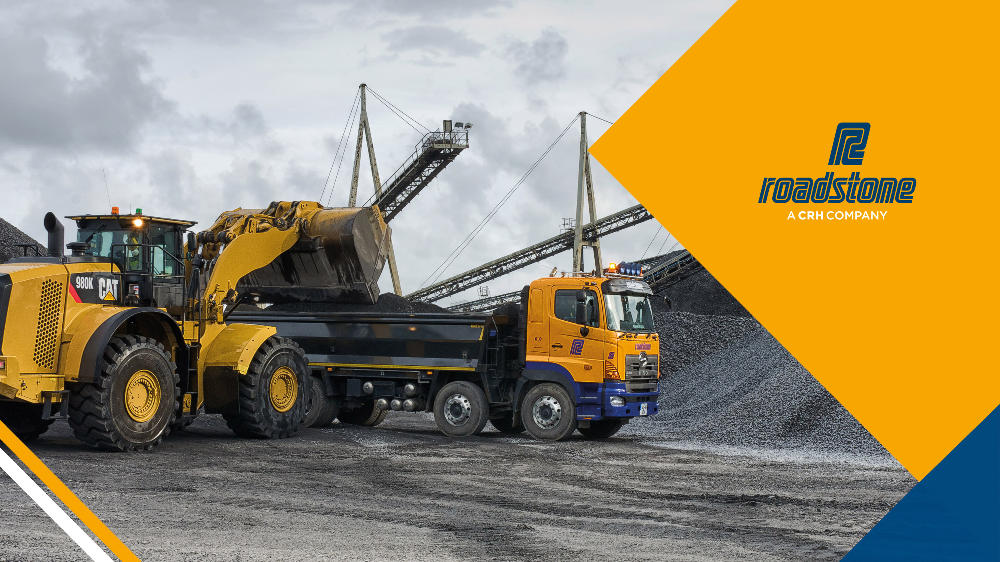

Slide 2

Extractive Industries Ireland
Mobile Plant & Fixed Plant Safety - Quarries
Date: 26/09/2018
Cormac McCarthy – Roadstone Ltd

Slide 3

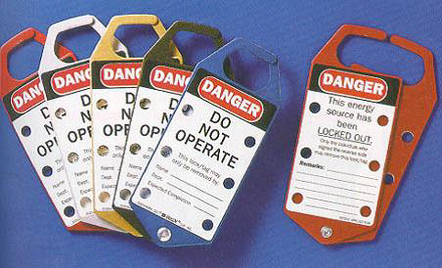

Isolation of Plant and Equipment

Slide 4
Isolation of Plant and Equipment
Plant must be isolated and locked out before guards or safety devices are removed
Each person must attach their own lock(s)
LOTOC – Lockout, tag out and confirm by attempting to start the equipment once it is isolated

Slide 5
Isolation of Plant and Equipment
Padlocks and tags can only be removed when;
All safety guards are back in place
All workers are positioned safely for start up
The machine is ready and safe for operation

Slide 6
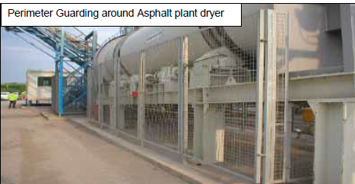
Guarding & Isolation
Fixed panel type guards
Access gates should be electrically interlocked.
Remote greasing to enable lubrication to be carried out without entering the guarded area.

Slide 7
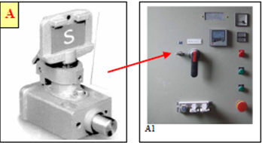
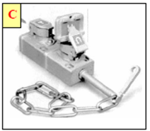
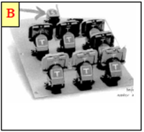
Isolation & Interlock
Isolator & Captive Key
Access Interlock
Key Exchange Unit

Slide 8
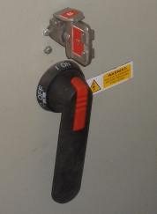
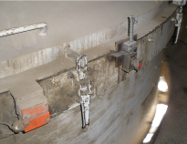
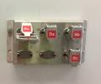
Isolation & Interlock
Access Interlock
Isolator & Captive Key
Key Exchange Unit

Slide 9
Isolation & Interlock

Slide 10
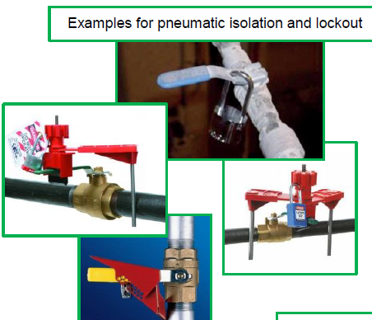
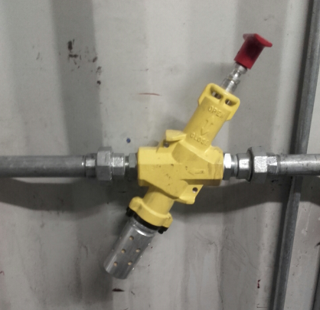
Isolation of Plant and Equipment
Energy Isolation (sources of energy)
Electrical
Pneumatic
Hydraulic
Mechanical / Gravitational
Thermal
Residual energy in machine component parts
Material flow

Slide 11
Vehicle Safety
Mirrors
Reverse Beeper / Motion Beeper
Beacons
Reversing Camera / Radar
High-vis Clothing
Under-run Barriers
Handbrake Alarm

Slide 12
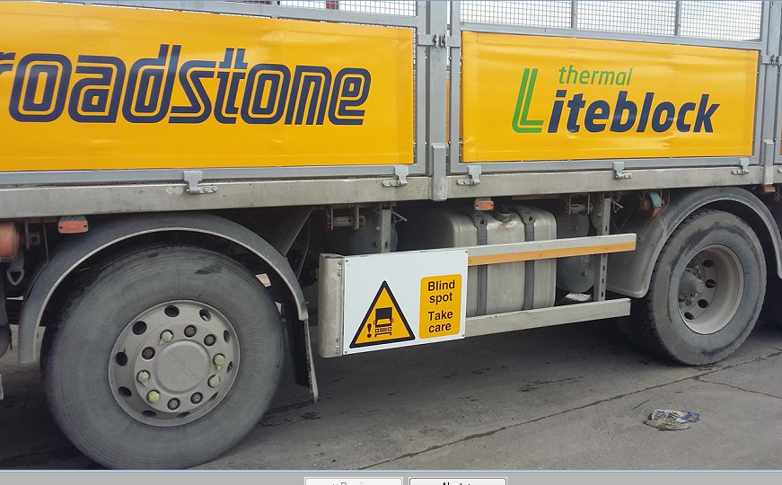
Vehicle Safety – Under-run Barrier

Slide 13
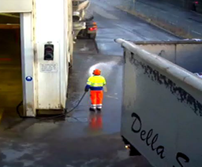
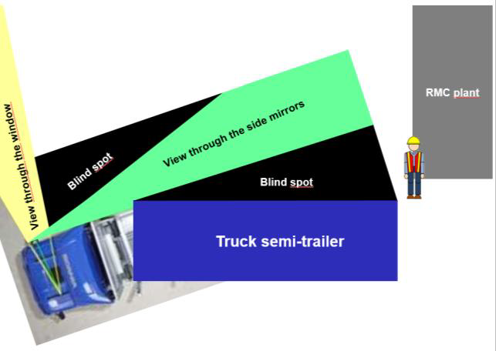
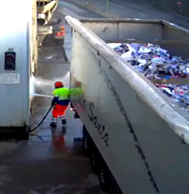
Vehicle Safety

Slide 14
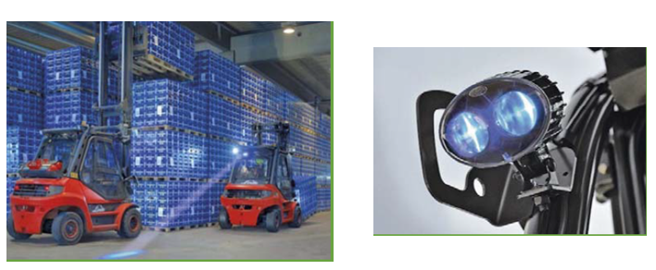
Forklift Safety
Forward and reverse blue light system

Slide 15
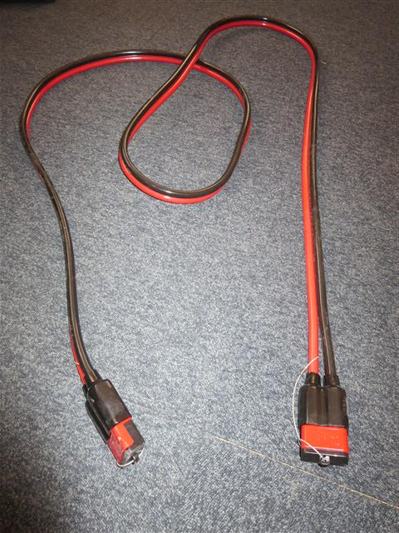
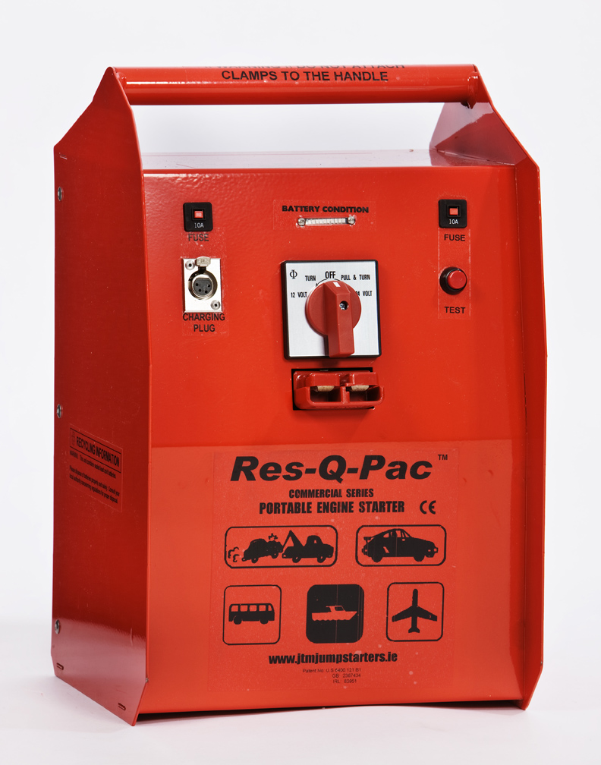
Vehicle Safety - Battery Safety
Use from
Battery Booster to machine
Machine to machine
(surge protection)
Battery Booster

Slide 16
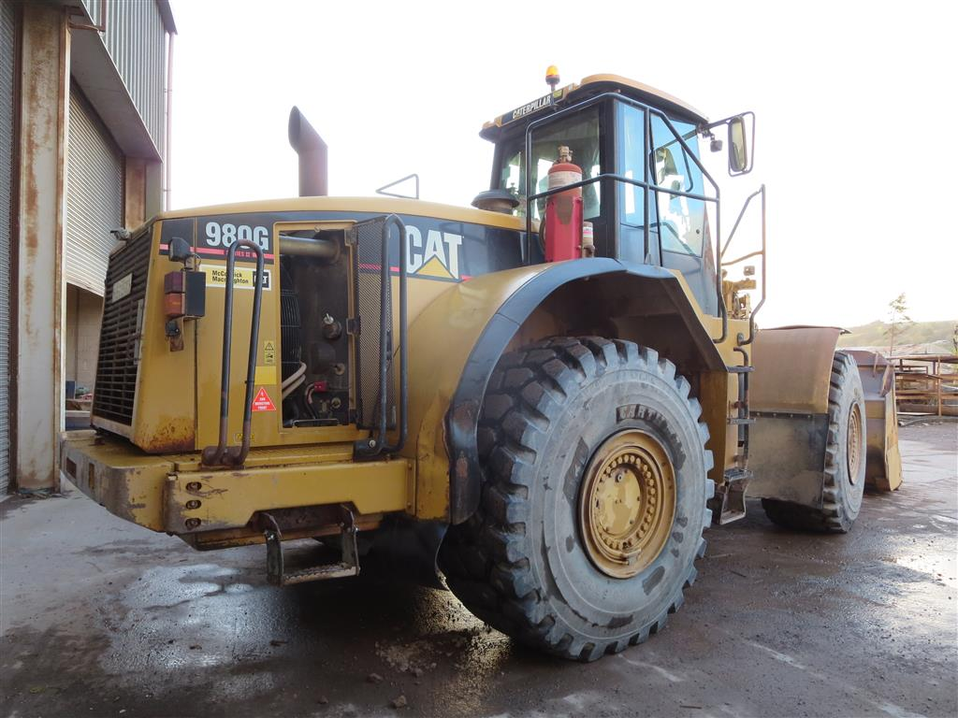
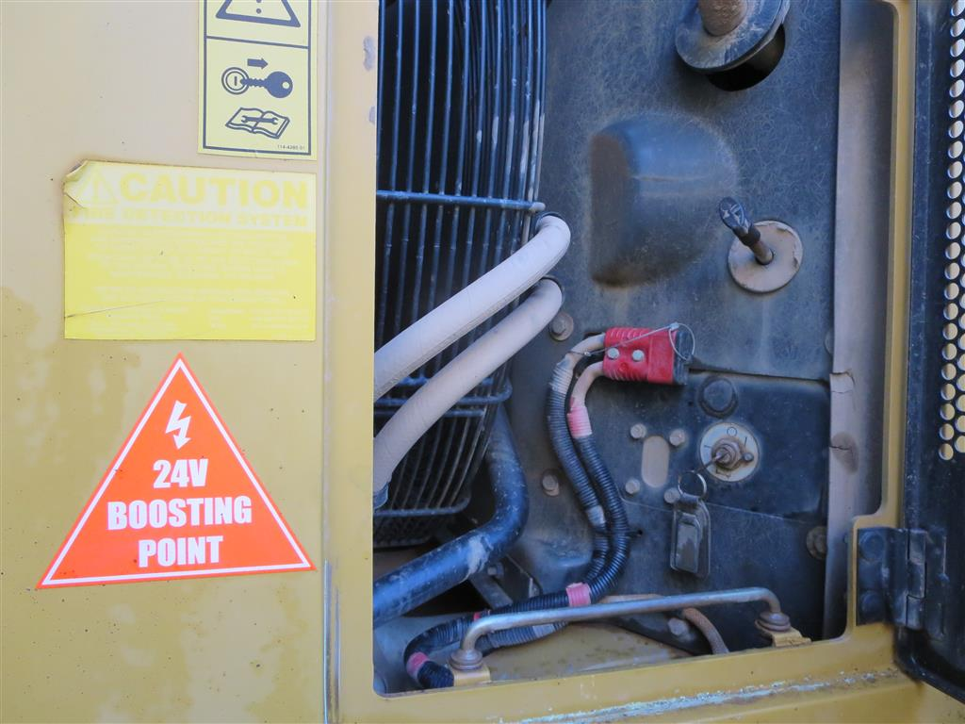
Vehicle Safety - Battery Safety

Slide 17
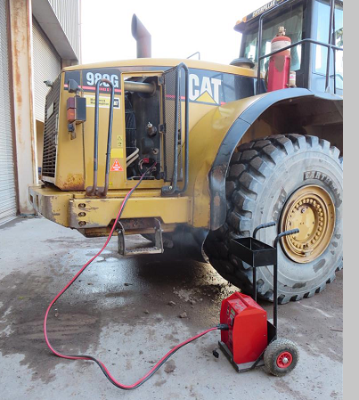
Vehicle Safety - Battery Safety

Slide 18
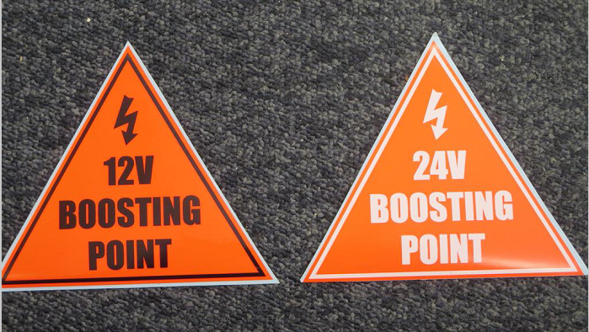
Vehicle Safety - Battery Safety
Boosting Point Label for 12 Volt or 24 Volt must be fitted on the machine.

Slide 19
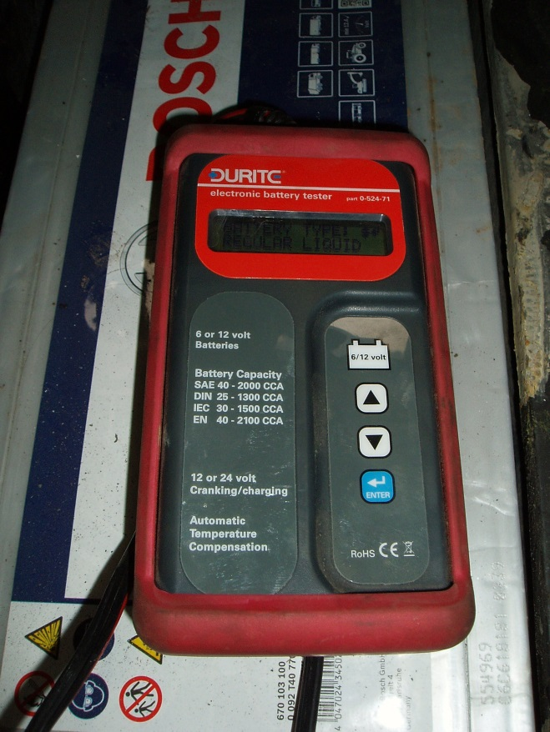
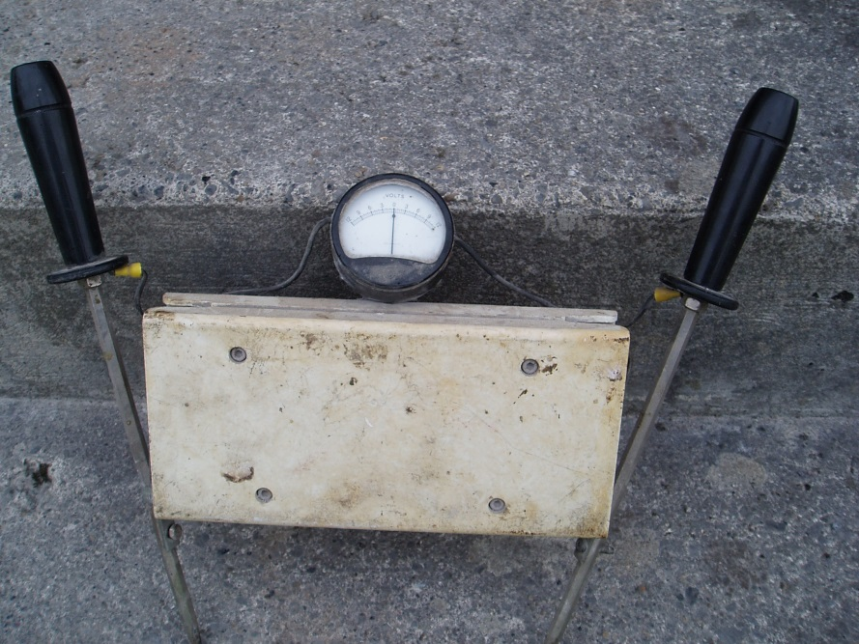
Vehicle Safety - Battery Safety
Electronic Battery Tester
Old type tester.
Applies Load - DANGEROUS

Slide 20
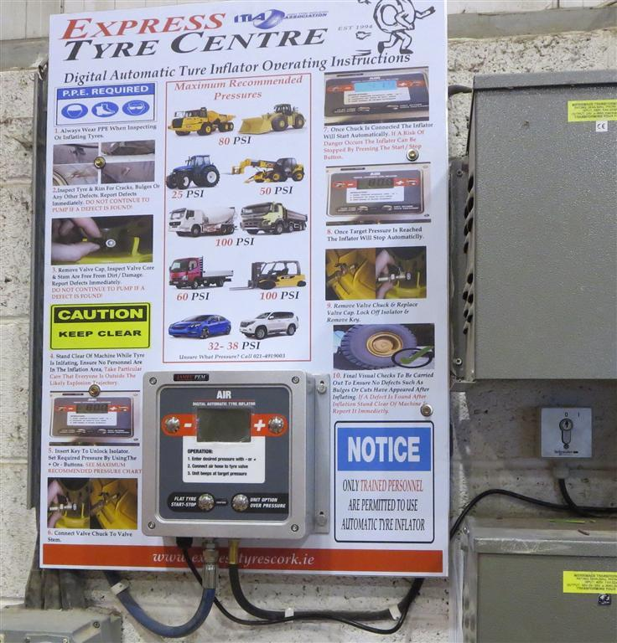
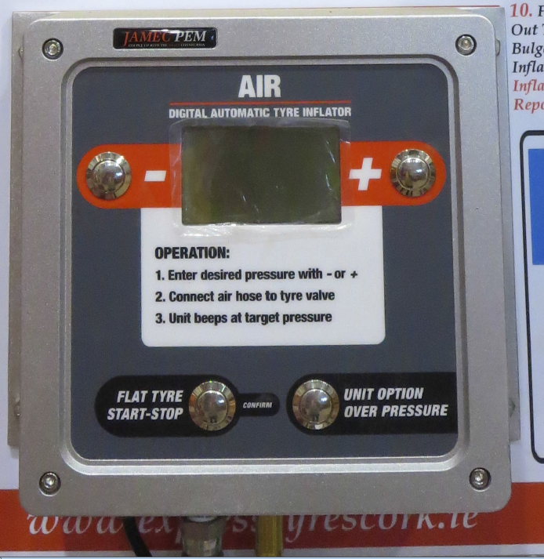
Vehicle Safety – Tyre Inflation
Automatic Tyre Inflator

Slide 21
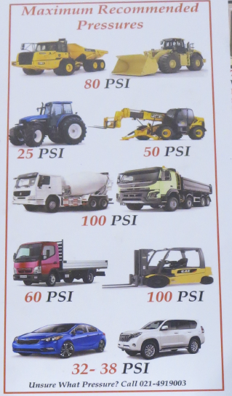
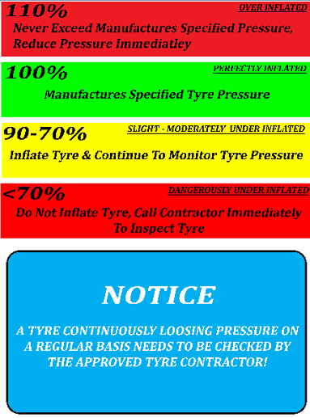
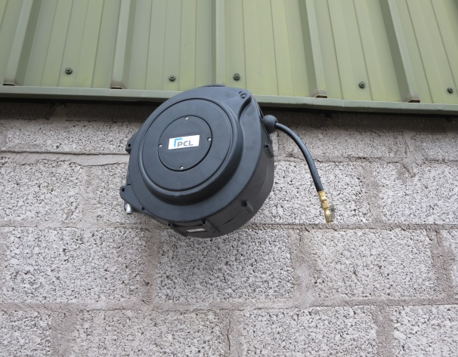
Vehicle Safety – Tyre Inflation
Tyre Pressure Charts

Slide 22
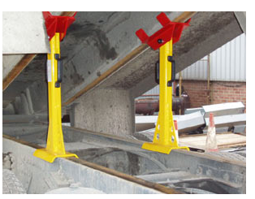
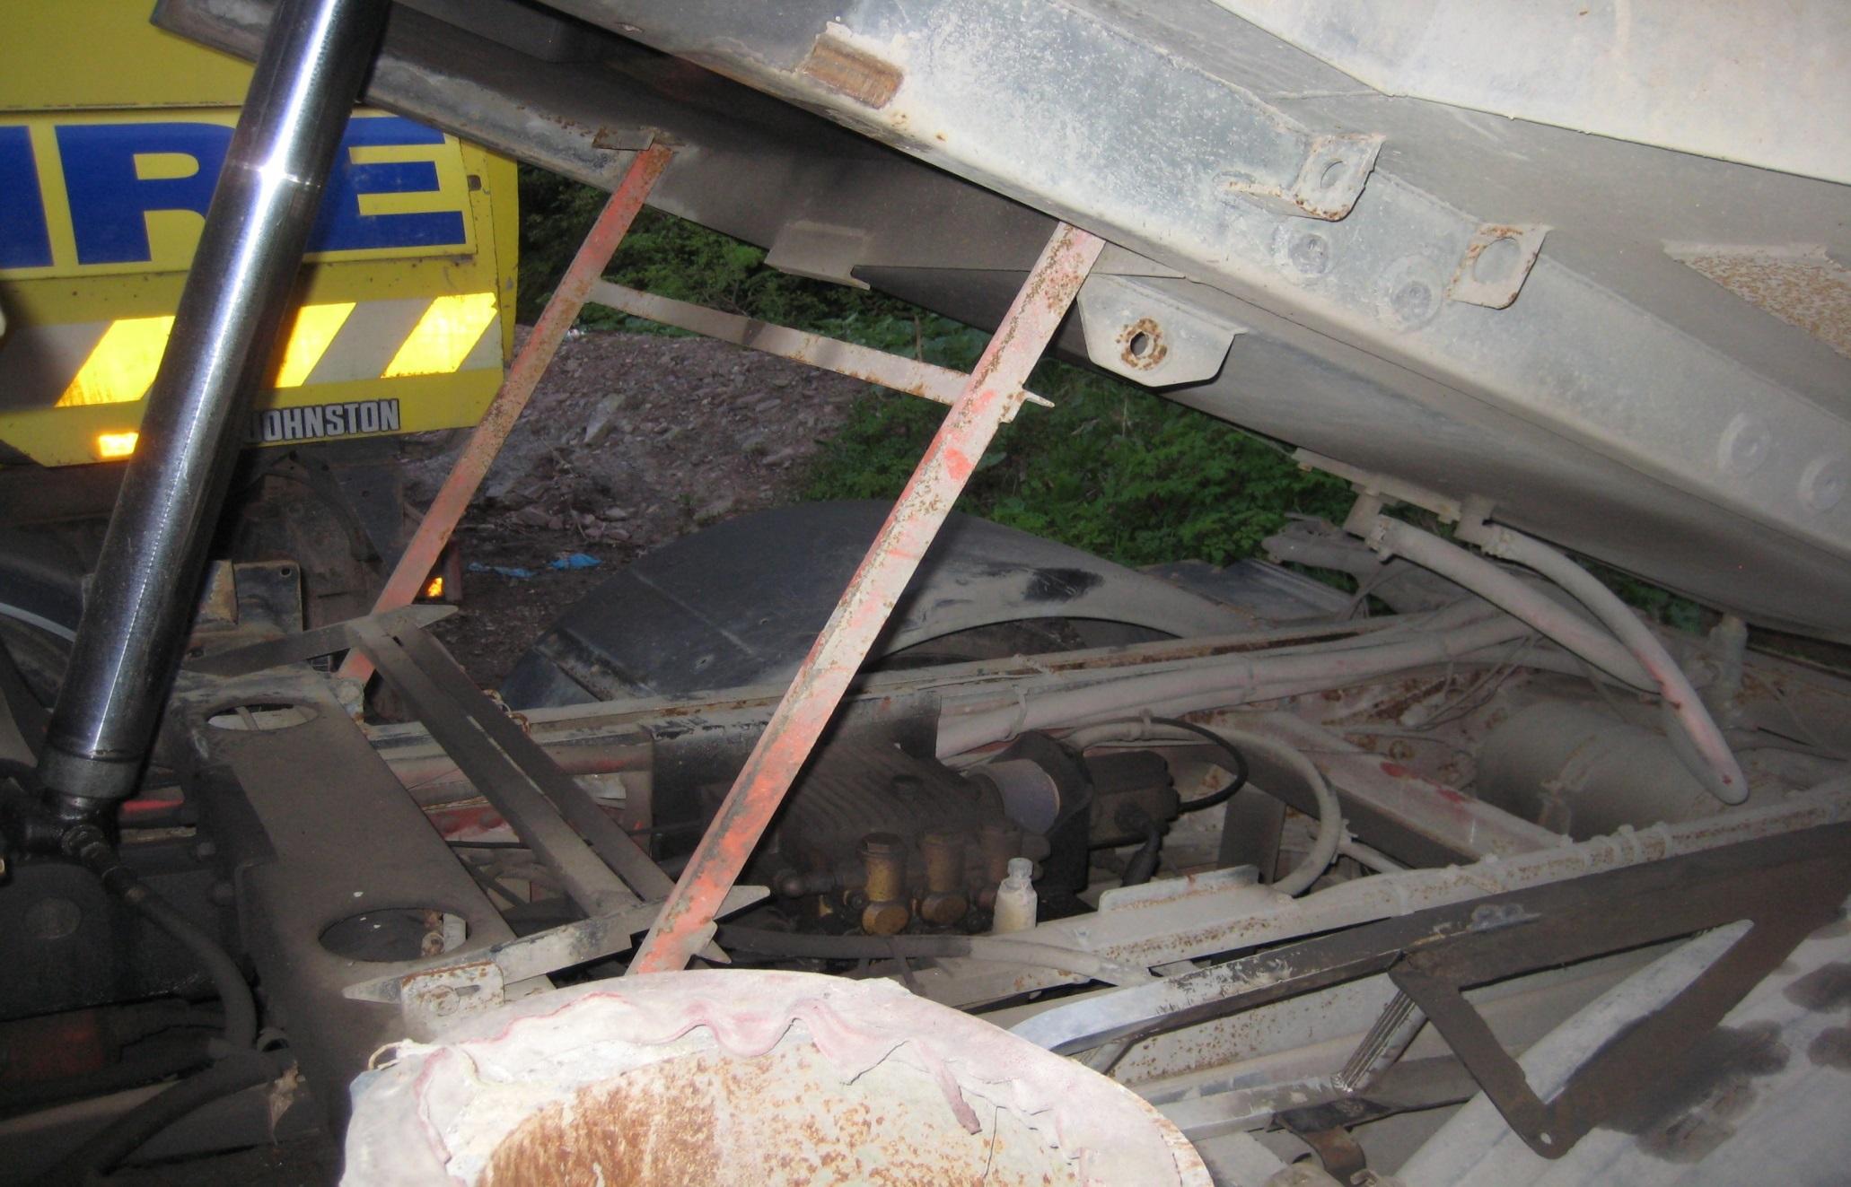
Vehicle Safety – Body Props

Slide 23
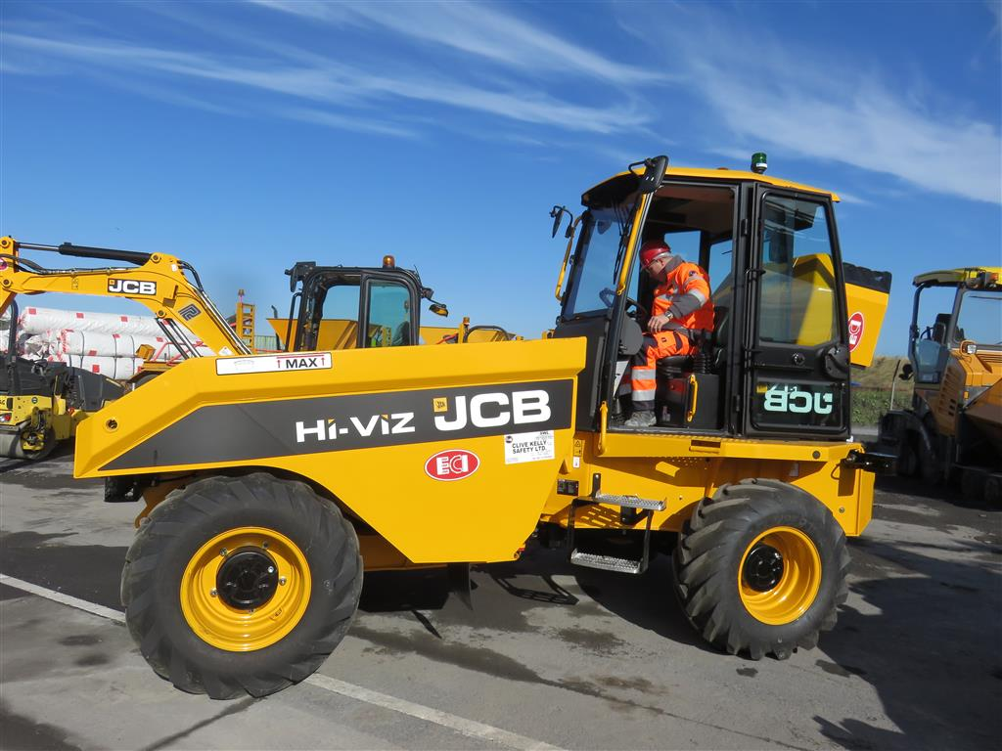
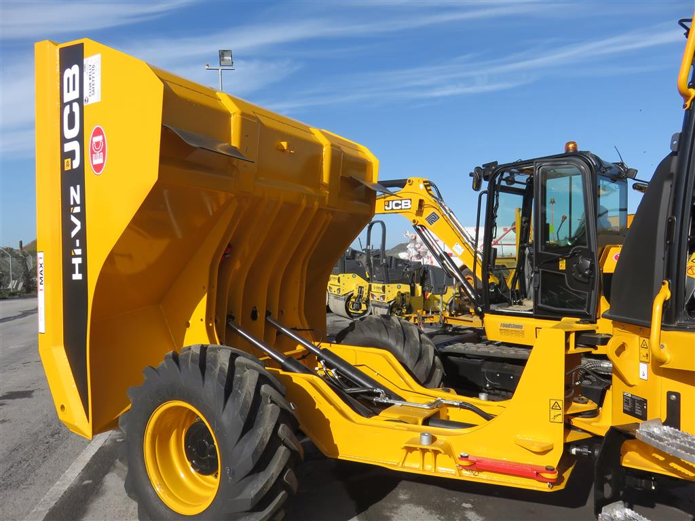
Vehicle Safety – Body Props

Slide 24
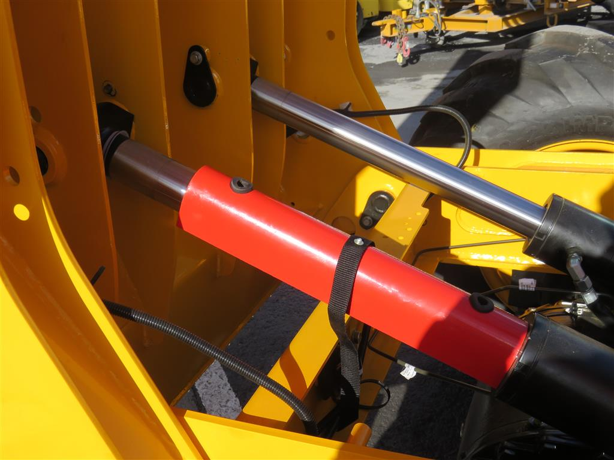
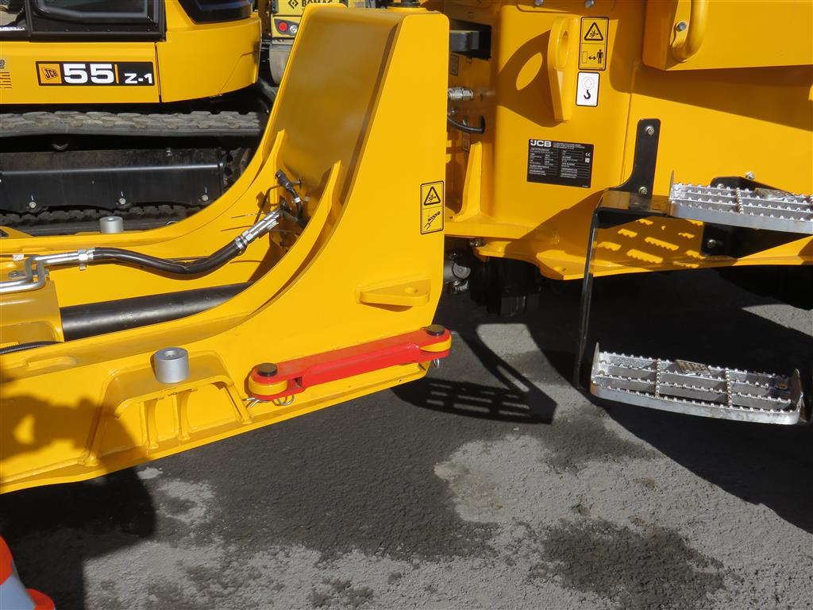
Vehicle Safety – Body Props

Slide 25
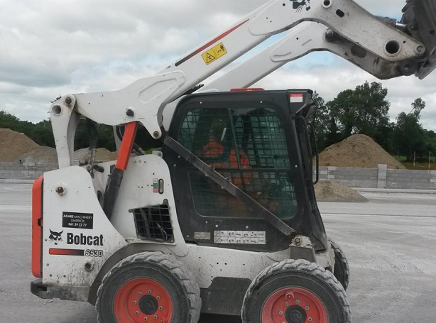
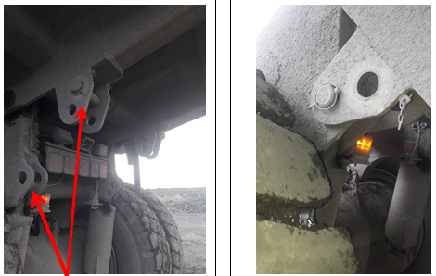
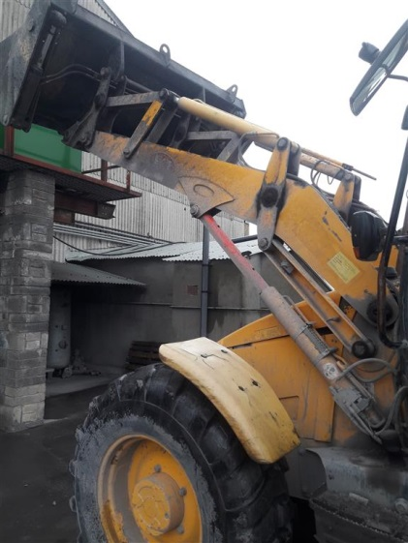
Vehicle Safety – Body Props
Skid Steer
Dumper Truck Body
180° Excavator

Slide 26
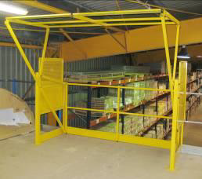
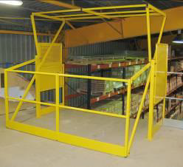
Work at Height
Fall Prevention

Slide 27
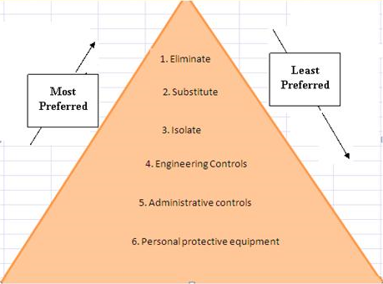
Hierarchy of Control Measures

Slide 28

Thank You

