Slide 1
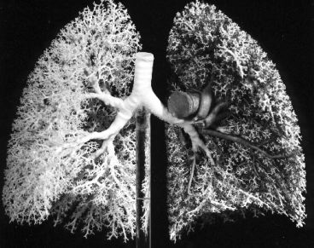
Occupational Diseases in Quarries and Mines in Ireland
Dr Tom Donnelly

Slide 2
Learning objectives
Historical Occupational Disease from Quarrying and Mines
Understand How Lungs Work.
What is crystalline Silica and its adverse effects
Control Measures
Other Issues in Quarries related to the lungs.

Slide 3
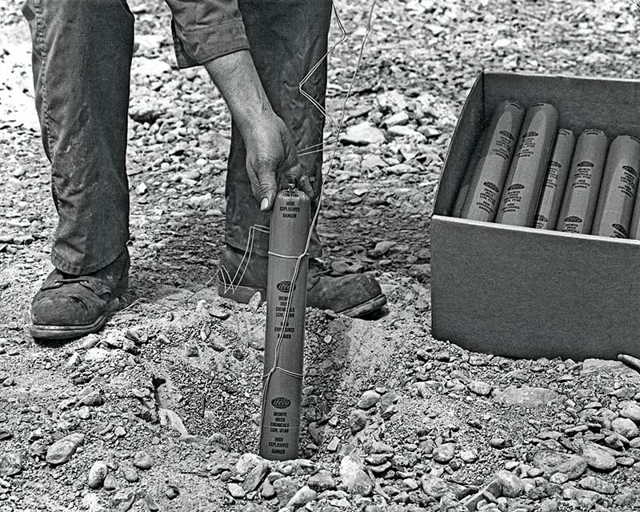
Historical Cases
Withdrawal off Nitrates and Angina: Wet dynamite (TNT) in contact with skin, angina when on holidays
Crow (Tapping) Bar Blasted out of Dynamite hole with resultant head injury and change of character (Frontal Lobe), Phineas Gage 25 yrs old in 1848, railway construction worker with resultant change of character, he eventually died from epilepsy

Slide 4
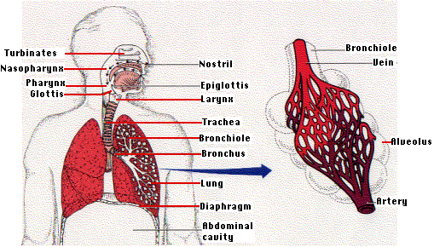
Anatomy of the Lungs
Medulla controls diaphragm- CO2 drive
Pharynx is common junction (Aspiration)
Tongue attached to Jaw Bone
Surface Area 120M2 (Tennis Court)
C02 out, O2 in
Site of disease
Route of entry
5 Lobes(3R,2L)
Notes:
5 lobes air enter mouth nostils warmed and cleared large particle dust
large surface area very suceptable to damage
Fibre size crutial respirable
Or if gaseous can reach gas exchange alveoli

Slide 5
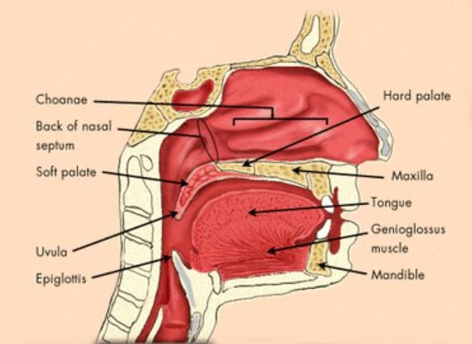
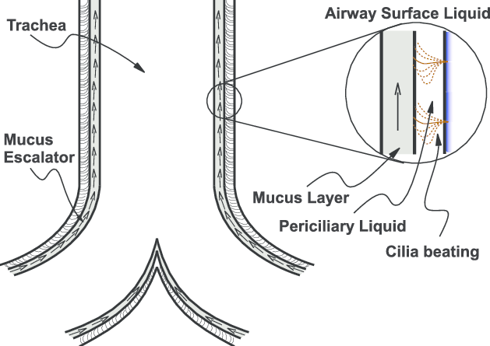
Natural Protection
Hairs, turbinates
Humidication & filtration,
Smell
Narrow nostrils, large nasal cavity
90 degree bend of nasopharynx
Wet mucous & tonsils
Reflexes – cough,sneeze,gag, swallow
Macrophages – White Blood cells and find an eat bacteria
Cilary hairs down to bronchioles(escalator)

Slide 6

Definition and types of dust
Dusts are solid particles, ranging in size from below 1 µm up to at least 100 µm, which may be or become airborne, depending on their origin, physical characteristics and ambient conditions (WHO definition),
Industrial dusts have different biological effect depending on their physico-chemical characteristics, size of particles and conditions of exposure,
Absorption and deposition of dust in the human dirways depend on the diameter of the particle, level of fragmentation of particles and minute ventilation,
According to biological effect dusts are divided into irritant, allergic, carcinogenic and fibrous.

Slide 7
Types of pneumoconioses according to pathological changes in the lungs
Collagen pneumoconioses may be caused by an exposure to
fibrinogenic dusts or by an altered tissue response to a non
fibrogenic dust (sillicosis, asbestosis)::
permanent alteration or destruction of alveolar architecture,
collagenous stromal reaction of moderate to maximal degree,
permanent scarring of lung.
Non-collagen pneumoconioses may be caused by an exposure to
non-fibrogenic dusts (stannosis):
the alveolar architecture remains intact,
the stromal reaction is minimal and consists mainly of reticulin fibres,
the dust reaction is potentially reversible.
Pneumoconioses caused by an exposure to mixed dust – coal worker’s pneumoconiosis (CWP) =anthracosis.

Slide 8

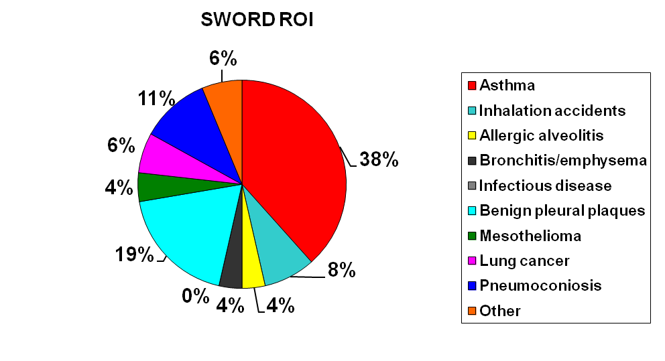
Occupational Lung Diseases In Ireland (ROI)
Occupational physicians’ reports (SWORD, 2007-2012)
N = 45

Slide 9
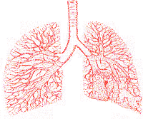
Site and Diseases
Airways – asthma and bronchitis
Lung substance (Parenchyma) – farmers lung, silicosis, asbestosis
Lining of Lung – mesothelioma (cancer)
Toxic inhalations – chlorine, carbon monoxide, hydrogen sulphide
Infections – TB, pneumonia

Slide 10
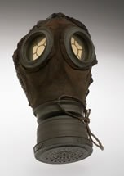
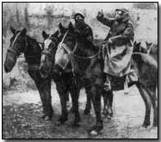

Lung Reaction
Highly water soluble substances affect upper airways
Inflammatory response eg bronchitis
Allergic – asthma and rhinitis
Fibrotic – scarring, silica or spores
Neoplastic – cancer of nasal cavity,pleura
Wilfred Owen (Dulce et Decorum est) – Chlorine attack 1917

Slide 11

Medical Classification
Obstructive disorders – Partial blockage of the air passages
Restrictive disorders – change the nature of the lung substance (fibrosis) or chest wall (pleura)
Lung function testing by measuring amount of air/given time helps differentiate the two types

Slide 12
Types of Occupational Lung Fibrosis
Sillicosis
Coal-worker pneumoconiosis (CWP)
Pneumoconiosis - tuberculosis
Welders’ pneumoconiosis
Asbestosis
Talcosis
Graphitosis
Pneumoconioses caused by a metal dusts

Slide 13
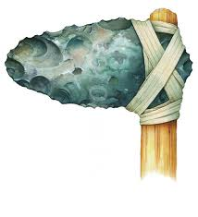
Silicosis
Silica 2nd most common element in Earths Crust (after oxygen)
If < 10 um (microns) in diameter it will reach Alveoli of lungs
It inactivates Macrophages which are lungs last line of defense
Exposure to Silica and development of Silicosis is associated with high levels of TB
Granite, Sandstone and Slate and Sand (not black lough Neagh sand) – main component of Flint and Glass
Crystalline (deadly) and Amorphous (benign)
Quartz is 2nd commonest mineral in world (1st=Feldspar)

Slide 14
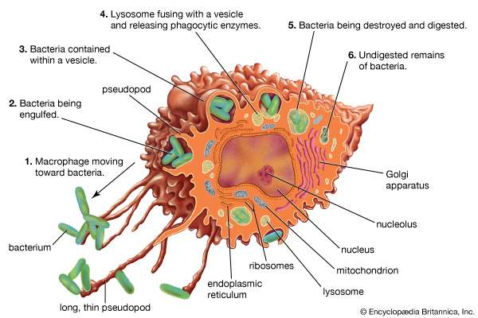
Silica
Asbestos is made from silica
It is a poor conductor of electricity but when Boron and other compounds added it is used in Computer Chips
Spines of nettles are made of silica
Macrophages try to ingest it

Slide 15
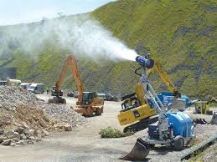
Silicosis
OELV for respirable crystalline silica is 0.1mg/m3
Chronic Silicosis > 10 yrs exposure to low levels of silica
Accelerated Silicosis – 5-10 years exposure to high levels
Acute Silicosis - Few weeks up to 5 yrs to develop
FFP3 particulate filter mask
Substituting Crystalline Silica with alternative
Dust suppression by damping
Dust extraction

Slide 16
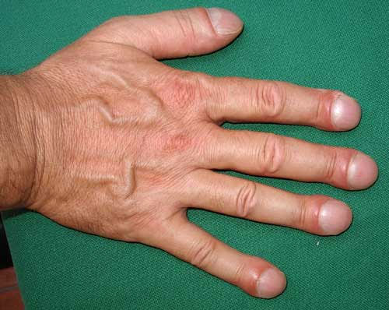
Symptoms & Signs
Symptoms = Complaints
Cough
Shortness of Breath
Wheeze
Chest Pain
Weight Loss
Fatique
Blood in Spit
Signs=physical findings
Wheeze
Rapid Breathing
Cyanosis (Blue)
Finger Clubbing
Accessory muscles

Slide 17
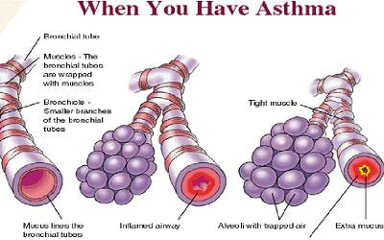
Asthma
PyeRadius 2
4cm2
1cm2
Reversible Airways Obstruction
Workplace Sensitiser < 10um diameter
Chemicals labelled R42
Biological origin (foreign proteins and enzymes)
Prevent exposure (2ary antiinflmmatory , broncho dilators)

Slide 18
Symptoms of exposure to respiratory sensitisers
Asthma
Coughing
wheezing
chest tightness
Rhinitis
conjunctivitis
Immediate or late symptoms
Continued exposure once sentised permenant lung damage
substitution……..Control
Risk assessment
Health surveillance

Slide 19
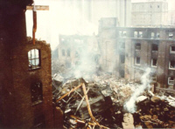
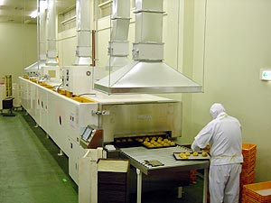
Occupational Asthma
Isocyanates
Floor/grain
Solder flux – pine rosin
Resins
Lab animals
Wood dust
Plants
Welding fumes
Glutaraldehyde
Fish Protein
Car painter
Bakers
Electronics
Boat manufacture
Research students
Joiners
Florists
Welders
Nurses
Prawns

Slide 20

Occupational Asthma
Recurrent Wheeze
Cough – esp night time
Shortness of breath
Chest tightness
Test – pulmonary function measures rate of flow (indirect measure of diameter)

Slide 21
Occupational asthma
Onset after starting job
Improvement at weekends/holidays
Exacerbations with heavy exposure
Presence of recognized asthma inducer in the workplace
Suspision that undue number of other workers affected

