Slide 1
Pre-stressed Concrete Initiative
By
Ken Logan

Slide 2
Pre-stressed Concrete Initiative
Background
Examination of standards within the industry
Production of Information Guidance sheets
Workshop
Initial Inspections – drafting individual Action Plans.
Follow-up visits.
Success of the Initiative

Slide 3
Background
Fatal accident where a worker was killed when operating from behind a guard.
HSENI decided to carry out an in-depth review of the manufacture of pre-stressed precast concrete products

Slide 4
Existing Standards
Guidance Note GS 49 from HSE – Pre-stressed Concrete (First published 1991).
The Concrete Society – Safety precautions for pre-stressing operations (post- tensioning) dated June 1980.
British Precast Prestressed Flooring Federation (under review)

Slide 5
Production of the Guidance Information Sheets
Consulted widely:
Manufacturers of the machinery / equipment in Europe and Great Britain.
Training Providers.
Industry
Regulatory Authorities – HSE & HSA

Slide 6
Drafts of the Guidance were produced and reviewed by interested parties.

Slide 7
Workshop
Held on 13th February 2013 in Cookstown.
The workshop was well attended.
Presentations were given by Industry and HSENI representatives.
Equipment was demonstrated at the workshop to assist with inspections.

Slide 8
Initial Inspections
A programme of inspections was carried out between April – June 2013.
An inspection pro-forma was used.
Action Plans were drafted and agreed with timescales set.
Follow-up visits were carried out during the Autumn.

Slide 9
PRE-STRESS HEALTH AND SAFETY INSPECTION REPORT
Name of company: _________________________________________ Limited: Yes/No
HQ address: ______________________________________________________
Site address: ______________________________________________________
Production Manager:_________________________
Tel. No. ______________Mob. No. _______________
Other Contacts: _____________________________
Tel. No. ______________Mob. No. _______________
No. of employees: ________

Slide 10
PAPERWORK
Risk Assessments: YES / NO
Safe Operating Procedures: YES / NO
Trained Operatives: YES / NO
Calibration Certificate for jacks: YES / NO

Slide 11
INSPECTION ISSUES
ACTION REQUIRED
IN / PN
Offloading, handling and storage of steel coils
Dispensing of steel wire + cutting of straps
Stressing Operation – personnel excluded from work area, warning signs, audible/visual alarm, system of work
Written instructions detailing size of strand and appropriate stressing force

Slide 12
Layout of stressing area – timber liner, guarding of wires after stressing, protection of operator
Intermediate saddles – every 10 metres, inspection
Permanent anchorage points – NDT
Hydraulic jacks – routine inspection and maintenance, current calibration certificate

Slide 13
Cleaning of barrels and wedges
Inspection of barrels and wedges – appointed individual, aid of magnification, independent inspection every 12 months, spot checks
Storage of barrels and wedges – rotation system

Slide 14
Key areas of Improvement
Effective cleaning and inspection regimes were instituted.
All operatives were given appropriate Training.
All equipment calibrated and tested.
Guarding standards were improved. Some pits were re-designed.
.

Slide 15
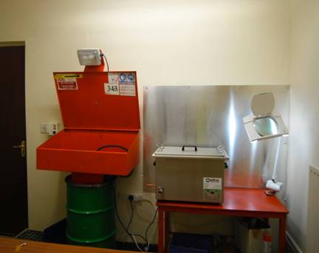
Cleaning and Inspection
Appointed individual
Individual trained
Separate room
Clean and tidy
Good lighting

Slide 16
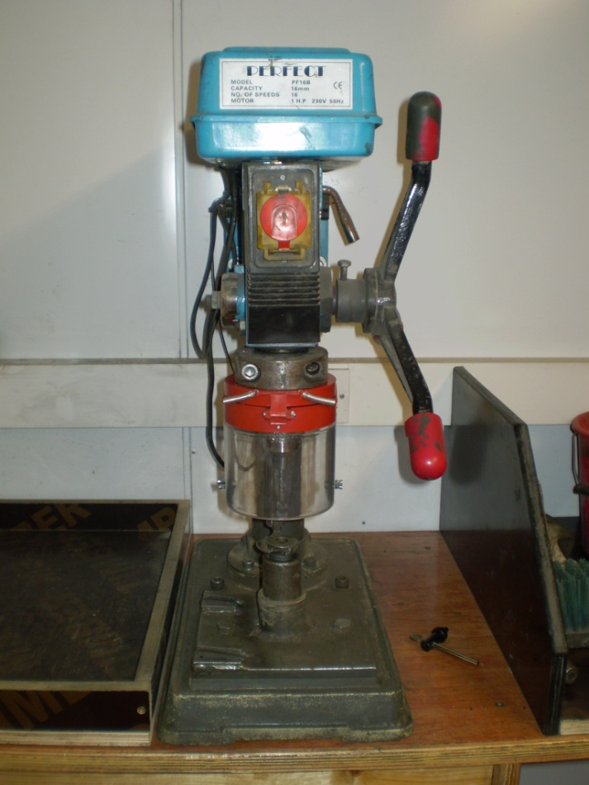
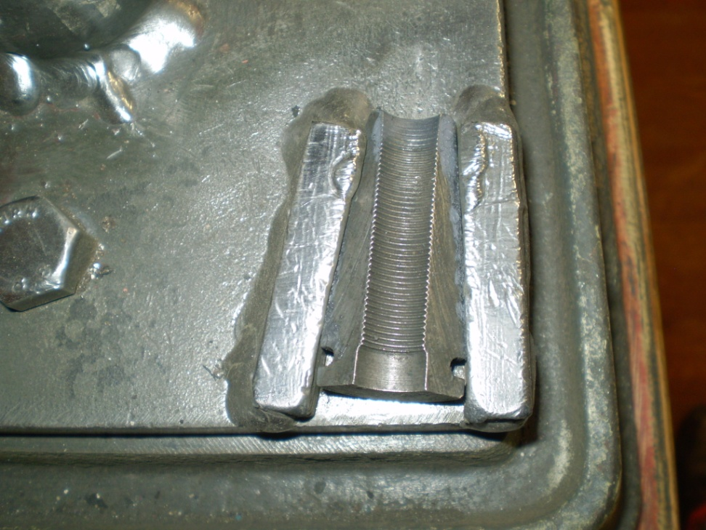
Use of Pillar drill for cleaning barrels
Holder for cleaning wedges

Slide 17
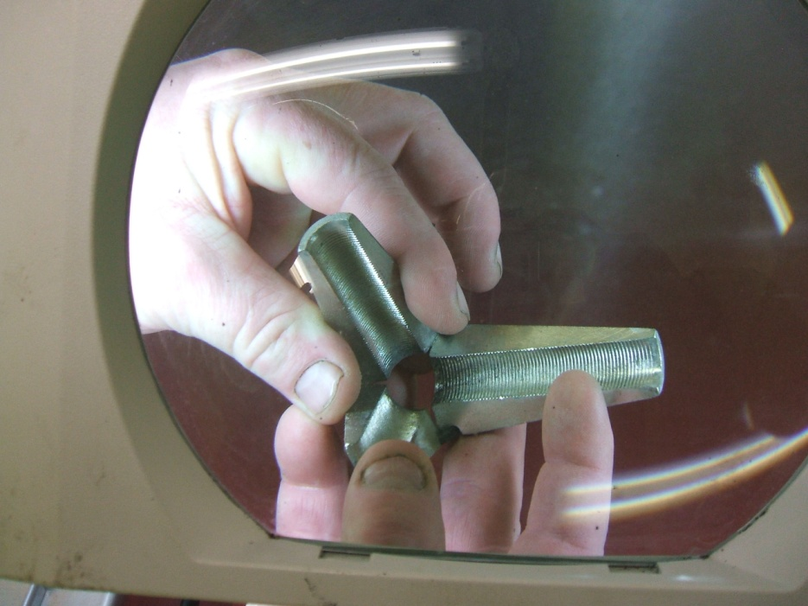
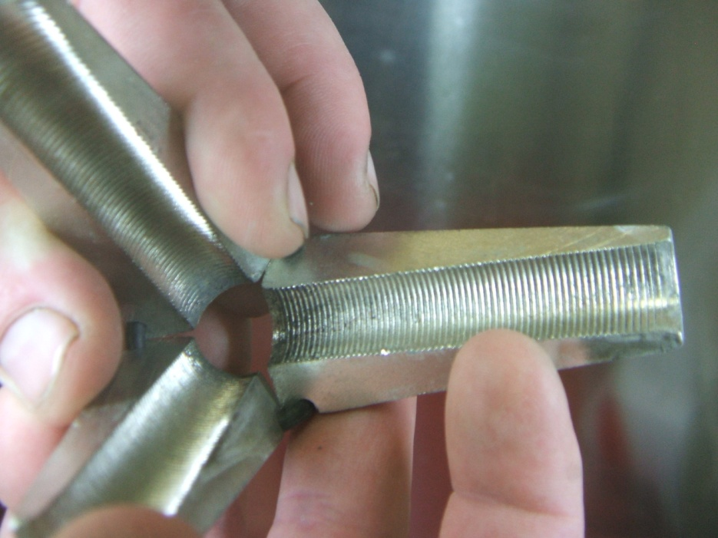
Inspection

Slide 18
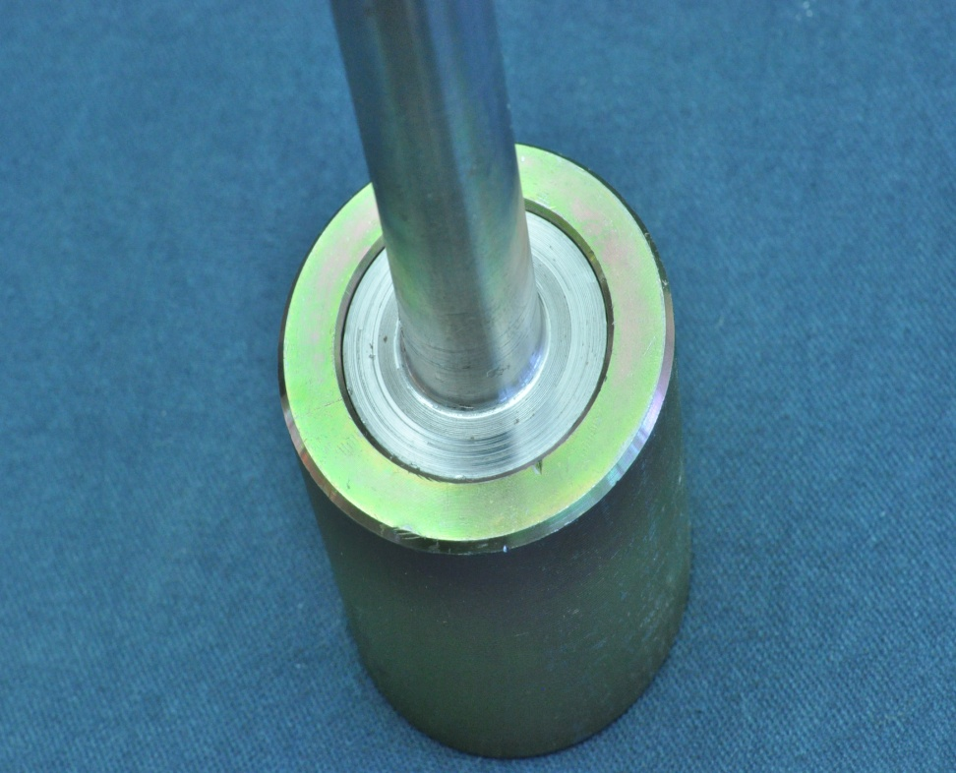
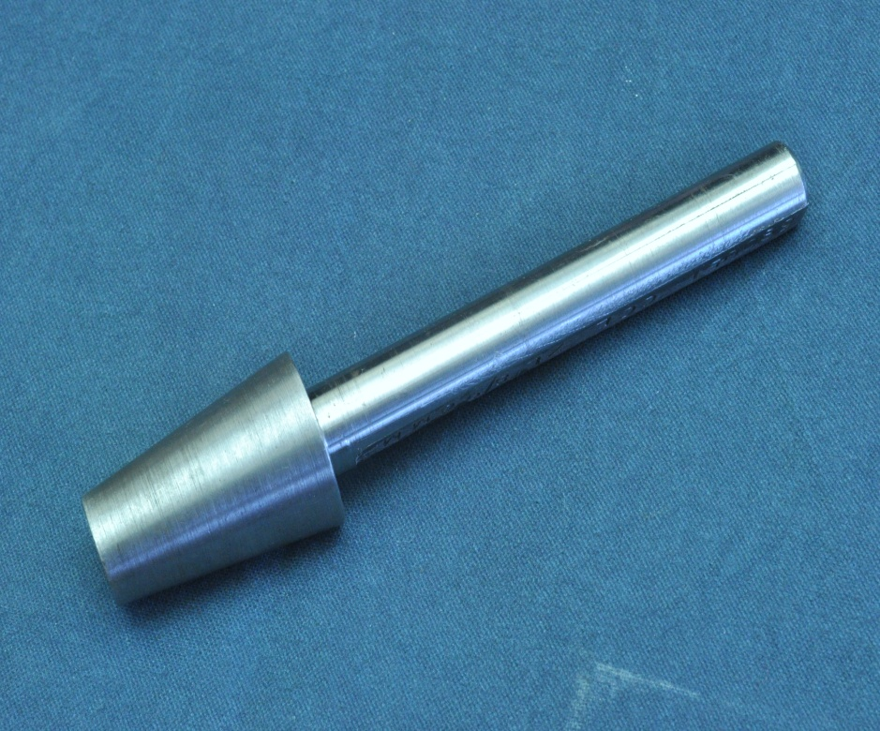
Use of a Prover to check for wear on the barrels

Slide 19
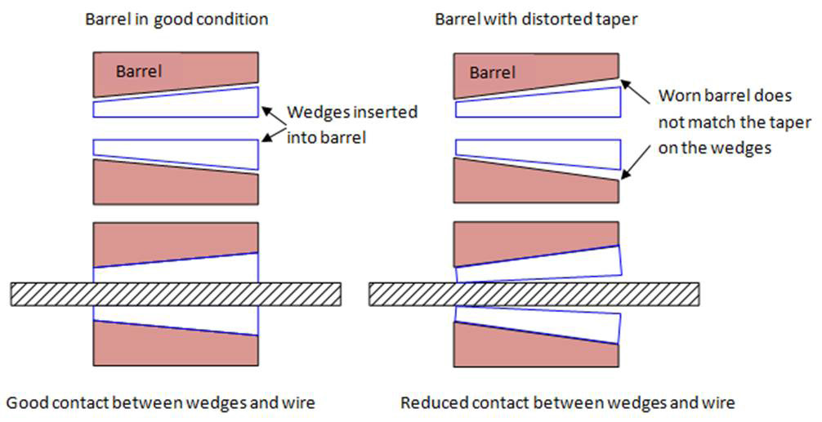

Slide 20
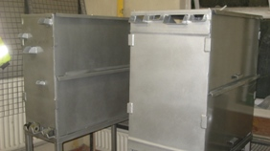
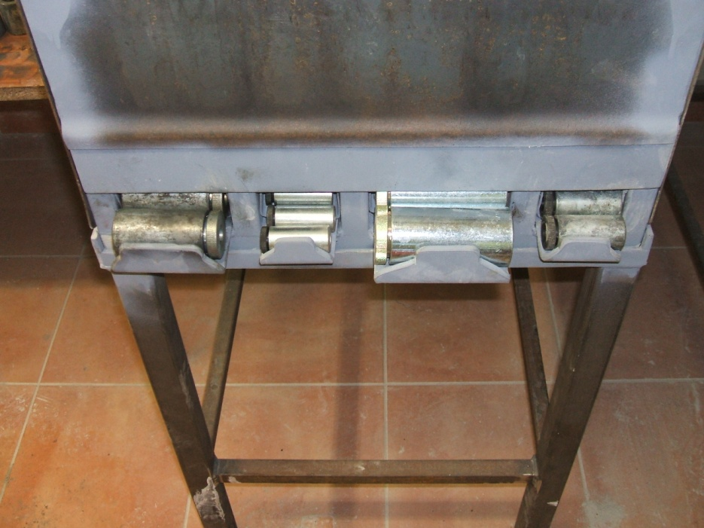
Barrel and Wedge Dispenser

Slide 21
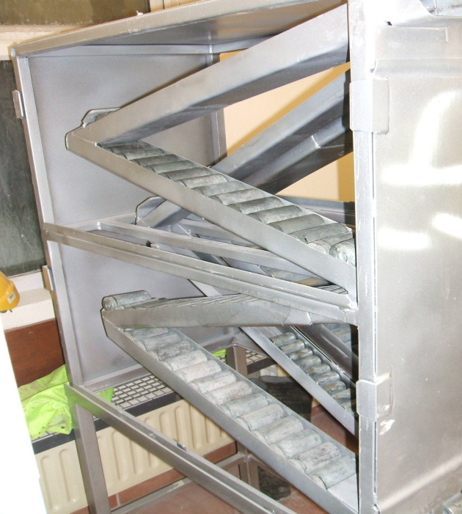
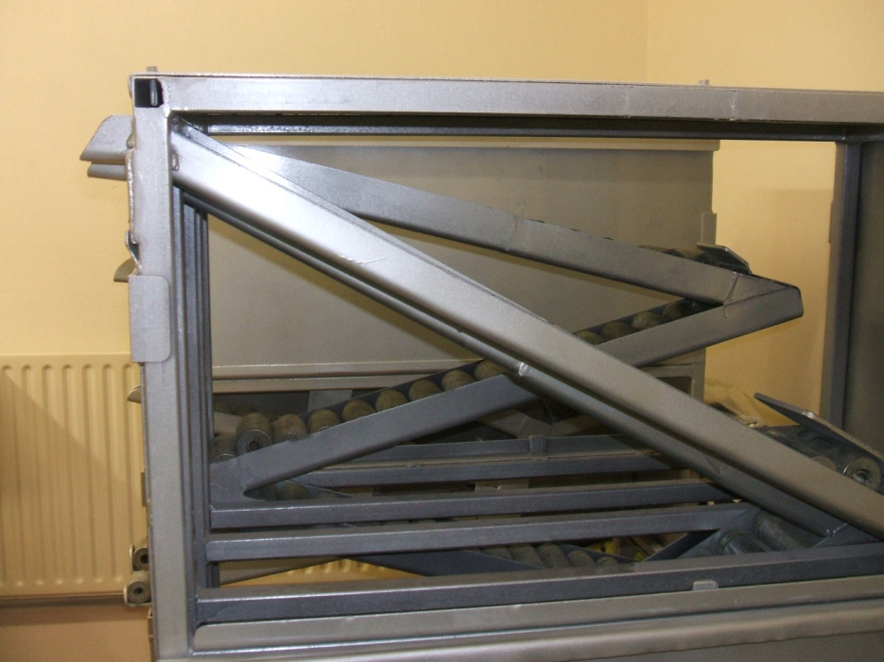
Barrel and Wedge Dispenser

Slide 22
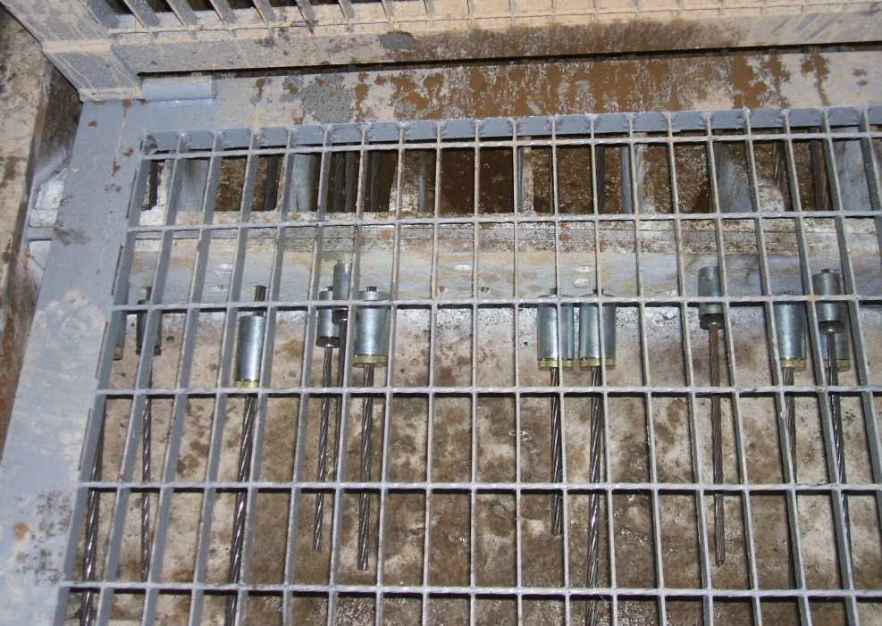
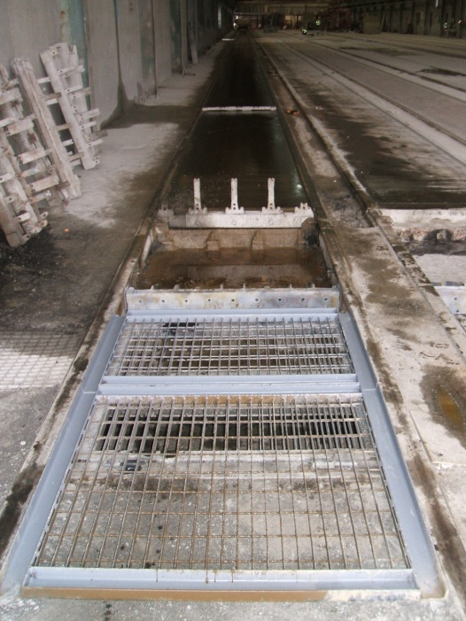
Guarding

Slide 23
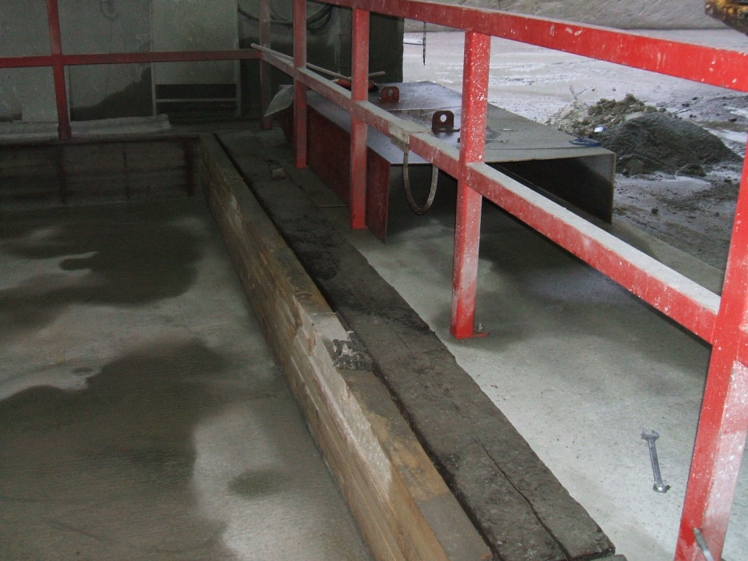
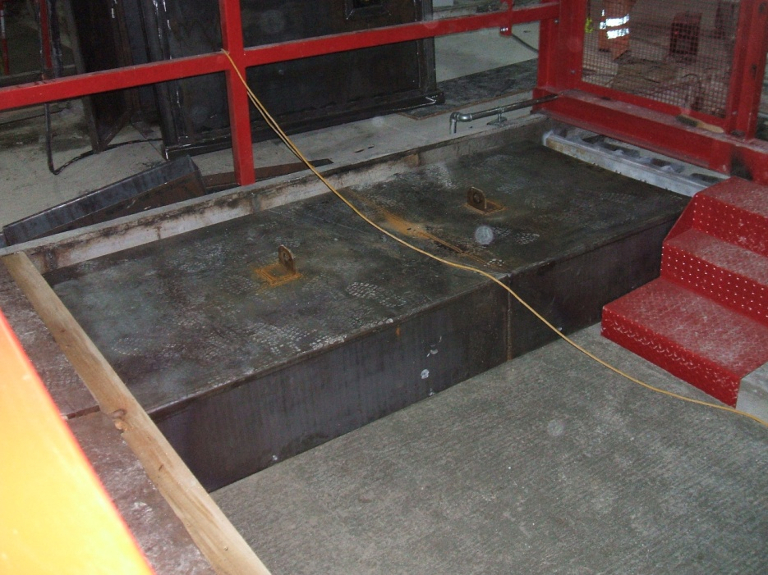
Guarding

Slide 24
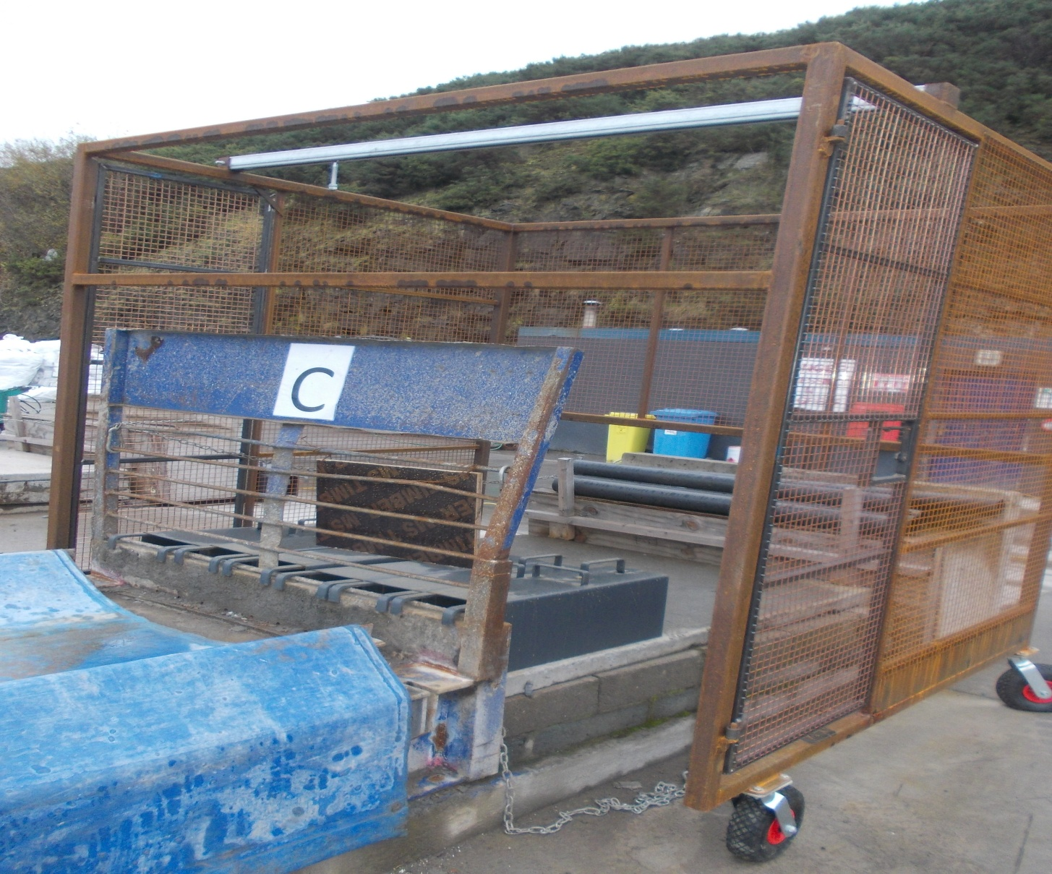

Slide 25
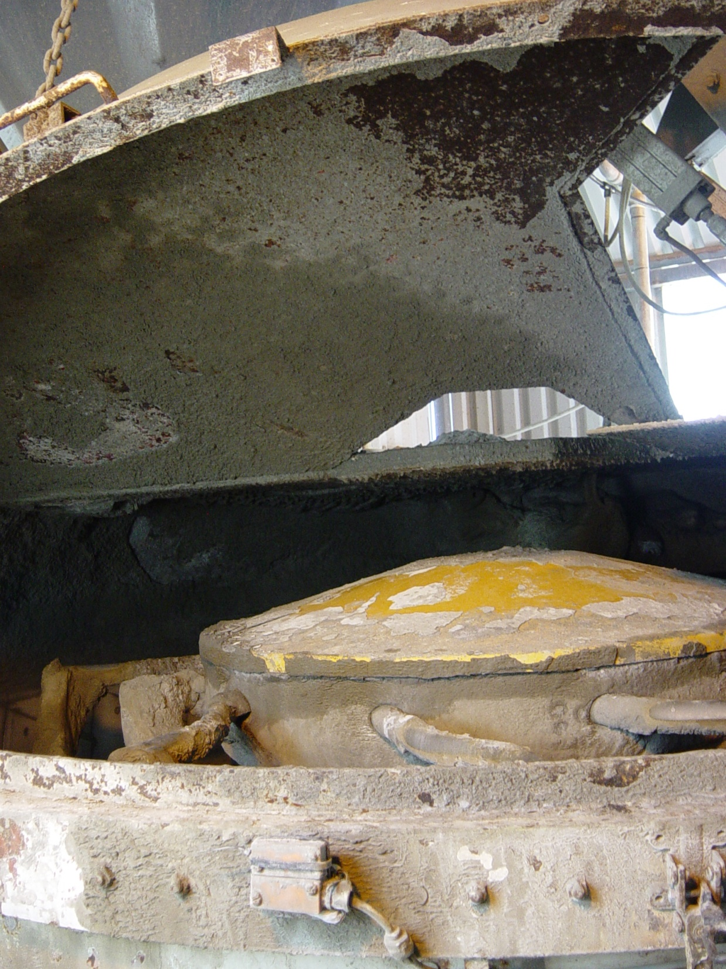

Slide 26
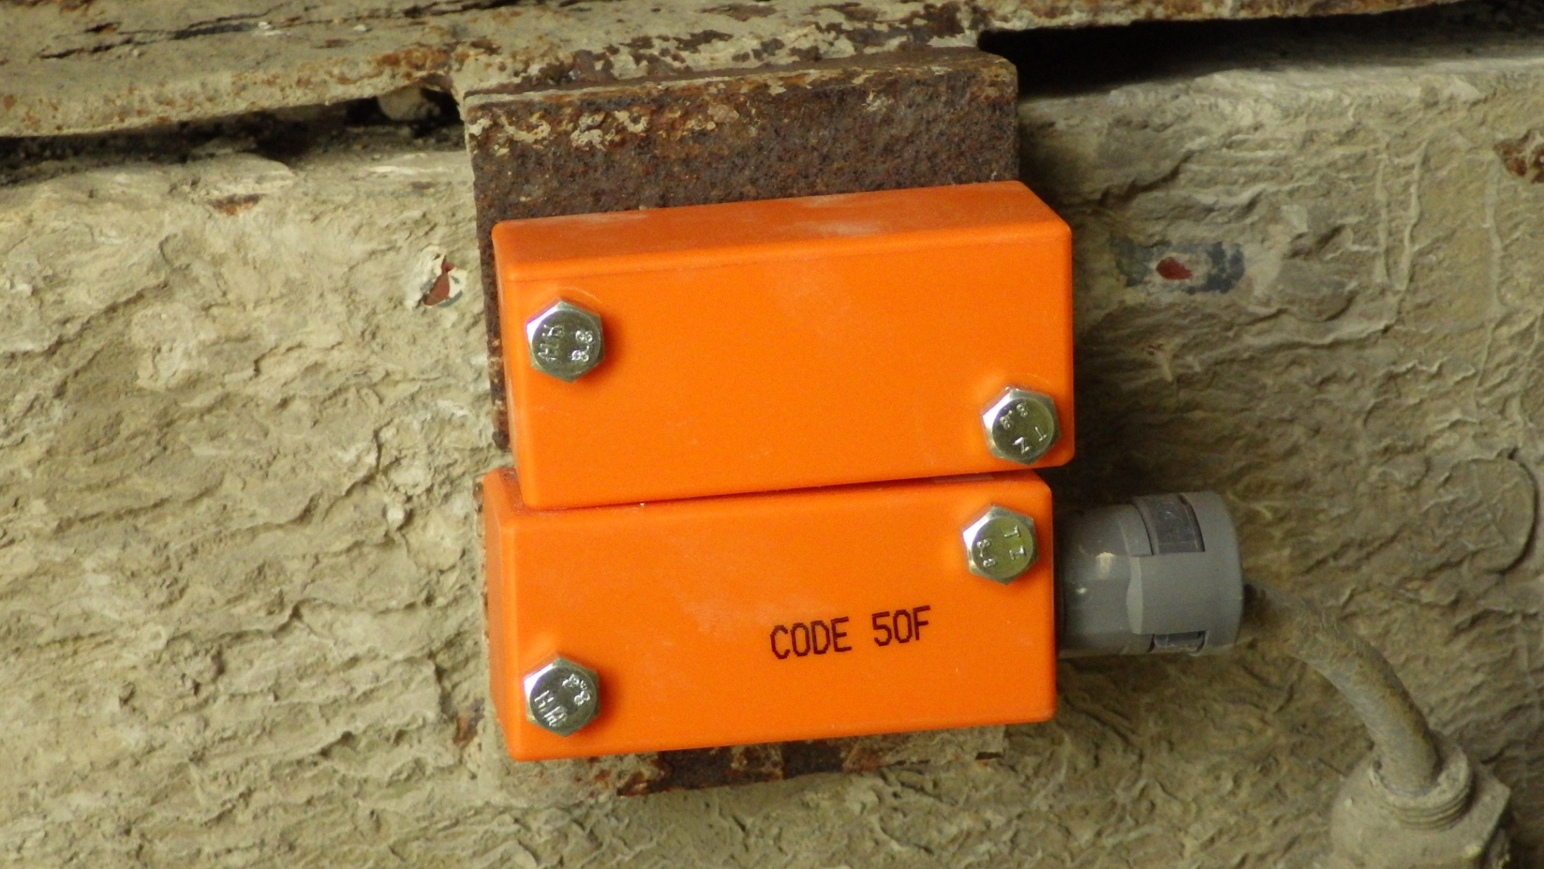

Slide 27
Key areas of Improvement
Production Beds were subjected to NDT examinations.
Wire restraint systems were improved.
Manual handing issues were addressed.
Trip hazards were removed and good housing practice implemented.
Safe Systems of work were reviewed and up-dated.

Slide 28
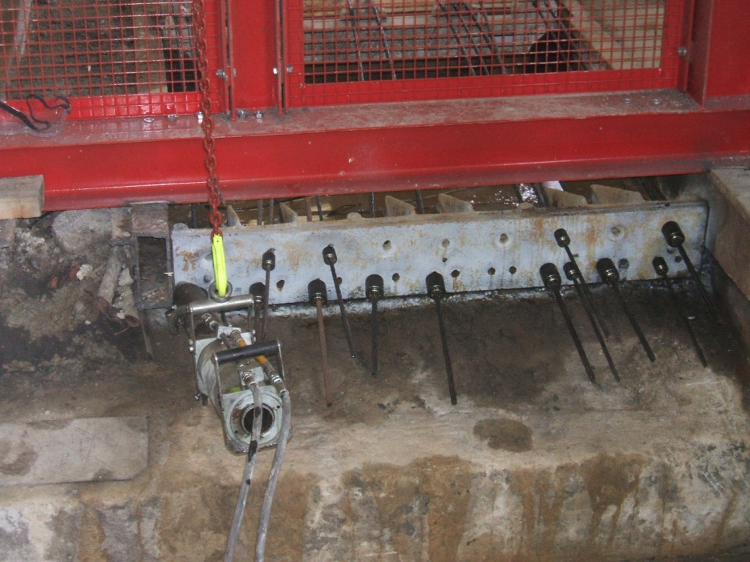
Permanent anchorage points
Daily visual inspection
Non Destructive Test every 5 years by NDT Engineer

Slide 29
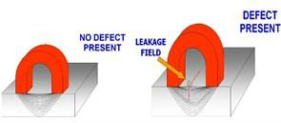
Non Destructive Testing Magnetic Particle Inspection

Slide 30
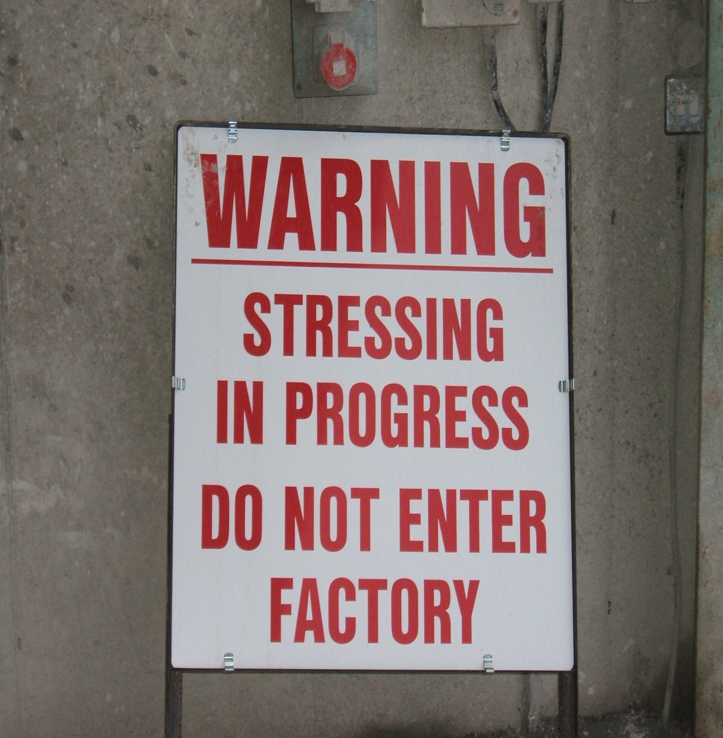

Slide 31
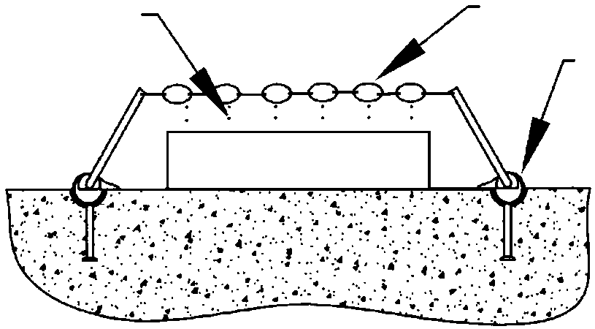
Intermediate saddles
Placed over stressing bed at regular intervals (every 10m)
Wires/Strands
Safety Chains
Spherical Head
Shackle

Slide 32
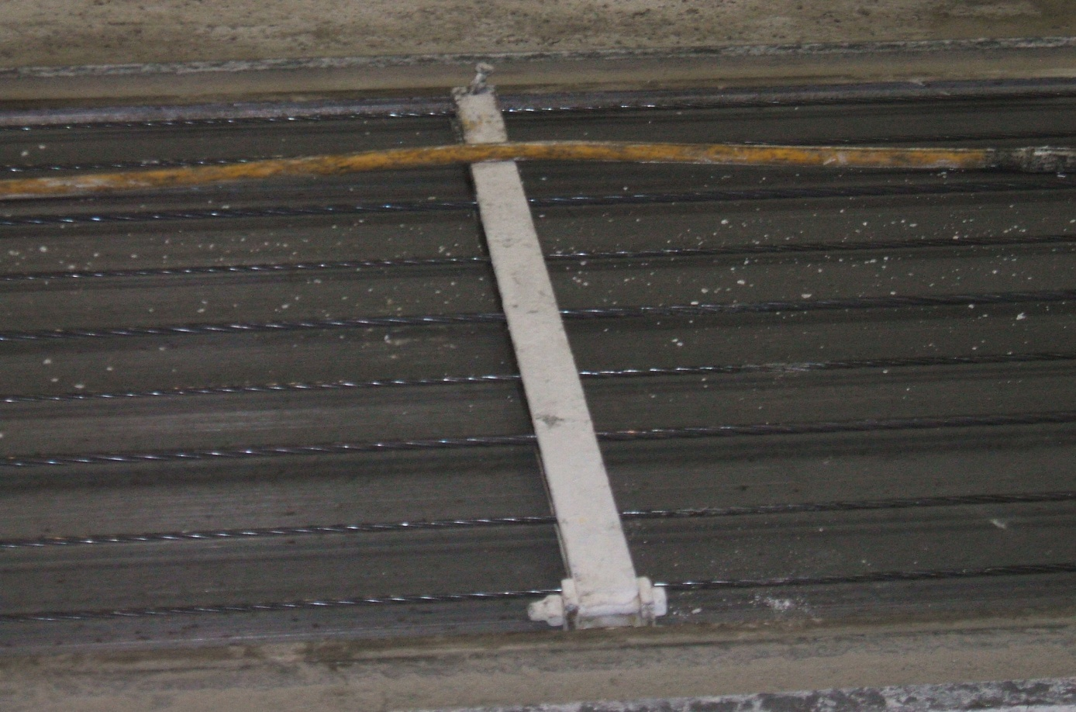
Alternative Wire Restraints

Slide 33
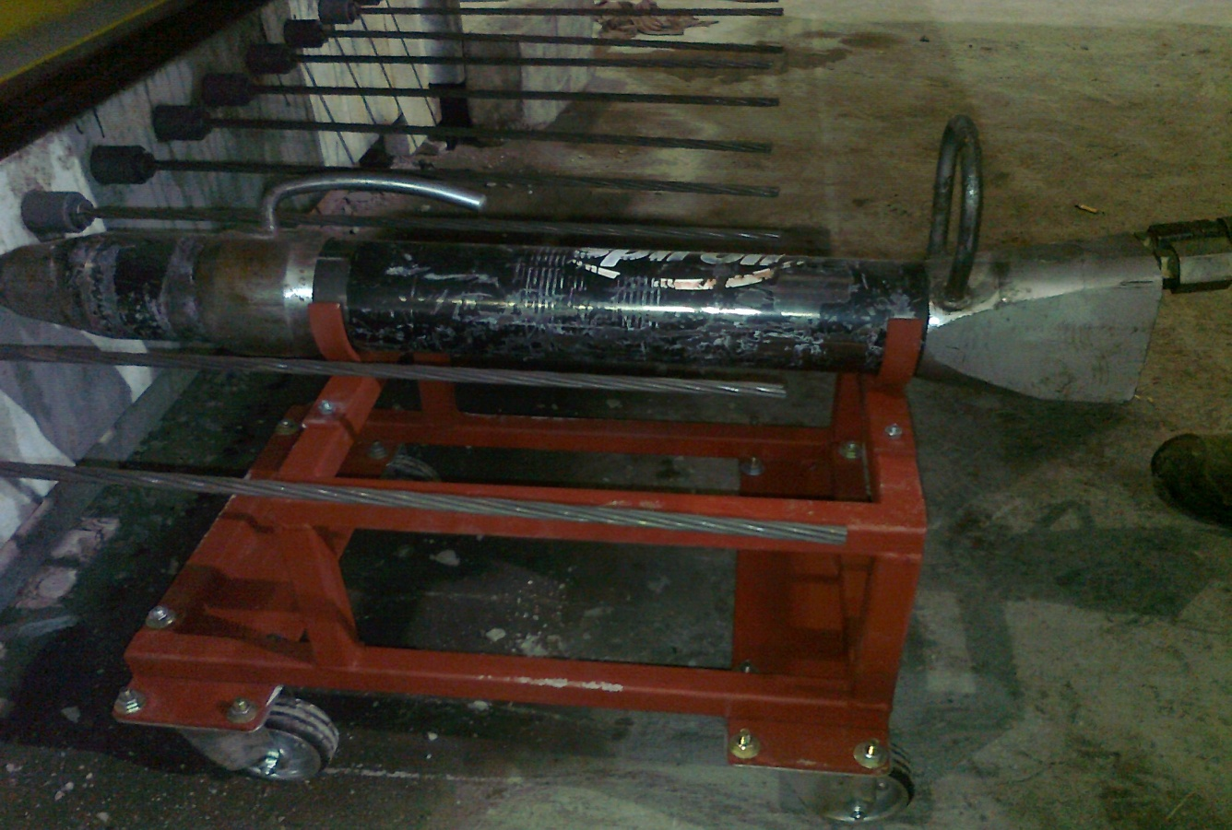
Trolley to support the hydraulic jack

Slide 34
Success of Initiative
Only one PN was served.
Management gave excellent co-operation
The initiative was fully supported by QPANI.
The workforce were fully committed to supporting the changes being implemented.

Slide 35
Success of Initiative
The Action Plans were fully implemented.
Standards within the Northern Ireland Pre-stressed Industry are second to none.

Slide 36
Success of Initiative
Information Sheets were reviewed in April 2014 and up-dated to include a section on the use of barrel gauges.
The Information sheets were shared with HSA; HSE and British Precast Pre-stressed Flooring Federation

